Slide 1
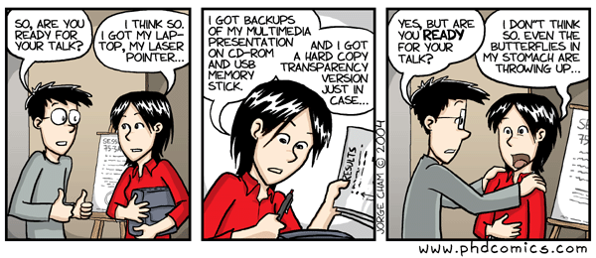
http://www.phdcomics.com/comics/archive.php?comicid=493

Slide 2
Typical HW 7 grade + comments:
Current project grade: 125
HW 7 grade: 12.5 * 2 = 25
For the math TDA background, make an appointment with one of the mentors to go over this section with you. You can e-mail all the mentors with the times you are available and exactly what you would like to discuss (simplicial complex, homology, persistence, etc.).
Obtain feedback for some sections from the writing center. You don't need to implement any feedback if you disagree with it, but suggestions could help you improve your grade.
From project page: "Describe how the data is created, what is its format, what are issues that one should consider (for example are their different types of noise), etc."
  At minimum state how many data points and how many coordinates.
  E.g., k points in R^{n}.

Slide 3
Include documented code (or pseudo-code). You must include all code/info needed to reproduce your results.
If a reference appears in your bibliography, you must cite the reference in your paper.
All figures and tables should have captions and should be referenced in your paper (if you have a figure/table, refer to it in your text). If the figure/table is not original to you, you must cite your source. Re-drawing someone else’s figure/table does not make it your original figure.
Break up your paper into sections and possibly subsections.

Slide 5
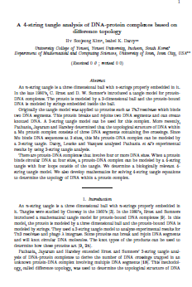
Submitting a paper for publication.
Write paper → Determine where to submit paper.
          Check where similar papers have been published.
          Observe how quickly papers published in this journal after submission.
          Check impact factor to determine if journal legitimate via https://jcr.incites.thomsonreuters.com/JCRJournalHomeAction.action
          Consider submitting preprint to
          lanl.arXiv.org

Slide 6
Submit paper
to math journal to biology journal
Wait 6 – 12 months Wait 3 – 6 weeks
Implement reviewers’ suggestions
and respond to reviewers.
Submit revised version
If accepted, paper will (eventually or almost immediately) be published.

Slide 7
Reviewer first gives brief summary of the paper (often using authors’ wording) and motivates recommendation for or against publication
This is referee's report for the paper…
Some protein complexes interact with multiple DNA segments during
biological processes.These processes can change the topology of DNA which results in knotted or linked DNA. Tangle analysis was introduced to study/model various protein actions mathematically. The protein is modeled by a 3-dimensional ball and the protein-bound DNA is modeled by strings embedded in the ball.
A protein complex bound to a circular DNA molecule at four sites can be modeled by a 4-string tangle. In this paper, the authors provide a biologically relevant 4-string tangle model of a DNA-protein complex and develop mathematics to determine the topology of DNA within the protein complex. The paper contains new and interesting results, and it is carefully written. The proofs are technical and elaborate. In referee's opinion, the paper deserves to be published in JKTR, after taking into account the corrections/suggestions given below.
List of corrections/suggestions:
page 2, line 8: delete the space after \DNA segments".
- last paragraph in the Introduction: replace \section i" with\Section i".
- Section 2: italicize the terms newly introduced:
page 2, line -4: \jumping DNA"
page 2, line -2:\ transposable element"
page 2, line -1: \transposon" and \transposition"
...
Reviewer gives specific list of corrections that must (?) be implemented

Slide 8
Response to referee's report:
We thank the reviewer for their detailed comments ….
We have implemented their suggestions as described below:
page 2, line 8: delete the space after \DNA segments".
done,
- last paragraph in the Introduction: replace \section i" with\Section i".
done
- Section 2: italicize the terms newly introduced:
done
Often additional explanation is needed
E.g.: We addressed the reviewers concern on new page ?, lines ??
often quote of the lines included in the report.
If you disagree with the reviewer and do not want to implement one of the suggestions, you must explain why.

Slide 10
yamltoR.py: extracts R code from Swirl lesson
## yamltoR.py: extracts R code from Swirl lesson
## Author: Isabel Darcy
# open file lesson.yaml for reading, call the open file f
f = open('lesson.yaml',"r”)
data_line = f.readlines() # read in each line of the file now called f
for i in data_line: # for each line
if i[:16] == " CorrectAnswer:": # for each line check if first 16
# characters are __CorrectAnswer:
print(i[17:]) # print all characters after 16 in line i
f.close() # close file f

Slide 11
yamltoRwithComments.py
f = open('lesson.yaml',"r")
data_line = f.readlines()
for i in data_line:
if i[:16] == " CorrectAnswer:":
print(i[17:])
else:
print("#"+i)
f.close()

Slide 12
PEP 8 - Style Guide for Python Code
https://www.python.org/dev/peps/pep-0008/
There are many places to learn python.
Python For Beginners includes links to a variety of resources at Python for Non-Programmers and Python for Programmers
For beginners: codecademy. Intro-active lessons that you can do in your web browser. You can also learn HTML & CSS, Javascript, jQuery, Ruby, PHP at Codecademy
Coursera course
Python via Lynda. Note Lynda is free to all UI students/staff/faculty by logging in here

Slide 14
Modified from http://www.garrreynolds.com/preso-tips/design/
1. Keep it Simple
  Lots of white space is good: The less clutter you have on your slide, the more powerful your visual message will become.
2. Limit bullet points & text
  3. Limit transitions & builds (animation)
  Only use animations that illustrate a point.
  Don’t use unnecessary animations.
4. Use high-quality graphics
5. Have a visual theme, but avoid using PowerPoint templates
6. Use appropriate charts
7. Use color well
8. Choose your fonts well
  use the same font set throughout your entire slide presentation, and use no more than two complementary sans-serif fonts (e.g., Arial and Arial Bold).
9. Use video or audio when appropriate.
10. Organize your talk: Spend time in the slide sorter (or print out your slides at least 6 to a page).

Slide 15
In an assertion-evidence slide, the headline is a sentence that succinctly states the slide’s main message
Photograph, drawing, diagram, or graph
supporting the headline message (no bulleted list)
Call-out(s), if needed:
no more than two lines
PowerPoint Template: http://writing.engr.psu.edu/AE_template_PSU.ppt
Notes:
15
This file presents a template for making Assertion–Evidence (A–E) slides in a technical presentation. The design advocated by this template arises from pages 113-152 of The Craft of Scientific Presentations (Springer, 2003) and from the first Google listing for “presentation slides”:
http://www.writing.engr.psu.edu/slides.html
To follow this template, make sure that you create the slide within this PowerPoint file. Working with a New Slide (under Insert in older versions or as a button on the Home tab in version 2007) , you should first craft a sentence headline that states an assertion about your topic. Having no assertion translates to having no slide. In the body of the slide, you should then support that headline assertion visually: photographs, drawings, diagrams, equations, or words arranged visually. Use supporting text only where necessary. Do not use bulleted lists, because bulleted lists do not reveal the connections between details.
This slide shows one orientation for the image and supporting text. Other orientations exist, as shown in the sample slides that follow.

Slide 16
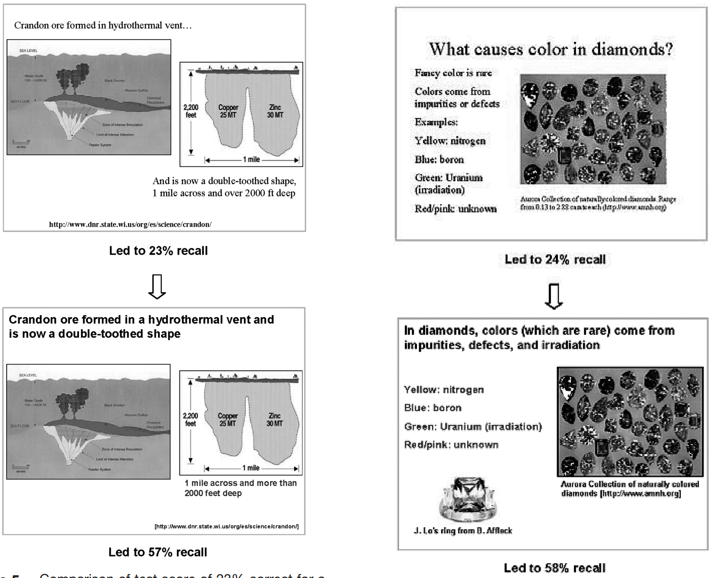
Michael Alley, Madeline Schreiber, Katrina Ramsdell, and John Muffo, Technical Communication (May 2006)
How the Design of Headlines in Presentation Slides Affects Audience Retention
http://writing.engr.psu.edu/ae_headlines.pdf

Slide 17
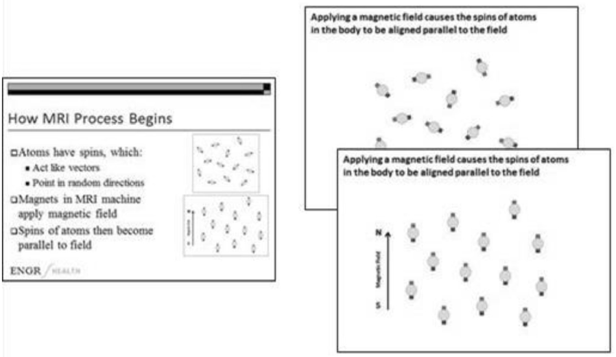
Michael Alley and Kathryn A. Neeley, Technical Communication (November 2005)
Rethinking the Design of Presentation Slides: The Assertion-Evidence Approach
http://writing.engr.psu.edu/ae_comprehension.pdf

Slide 19
TDA is a form of Exploratory Data Analysis (EDA)
https://onlinecourses.science.psu.edu/stat857/node/4
Exploratory Data Analysis (EDA) is described as data-driven hypothesis generation.
http://en.wikipedia.org/wiki/Exploratory_data_analysis
In statistics, exploratory data analysis (EDA) is an approach to analyzing data sets to summarize their main characteristics, often with visual methods. A statistical model can be used or not, but primarily EDA is for seeing what the data can tell us beyond the formal modeling or hypothesis testing task.
Exploratory data analysis was promoted by John Tukey starting in the 1960’s.

Slide 20
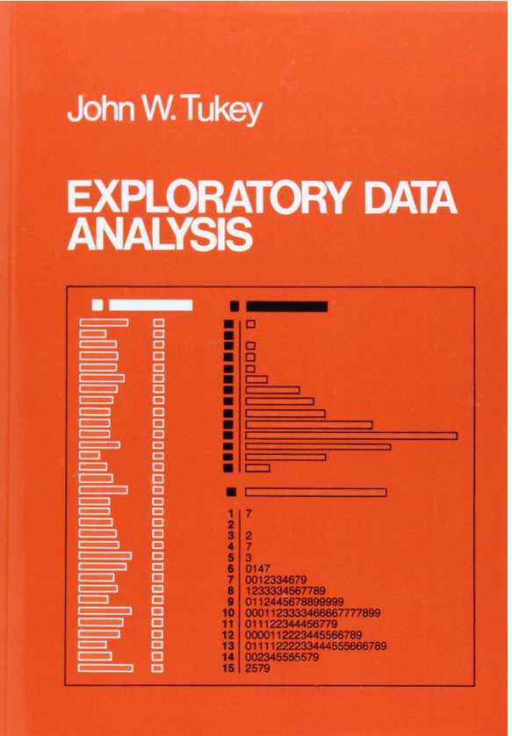
http://www.jstor.org/discover/10.2307/2392291?uid=3739256&uid=2&uid=4&sid=21106098896651
Exploratory Data Analysis
John W. Tukey, Princeton University
ISBN-10: 0201076160
ISBN-13: 9780201076165
©1977 • Pearson • Paper, 688 pp
Published 01/01/1977 • Instock

Slide 21
http://www.uta.edu/faculty/sawasthi/Statistics/stdatmin.html#eda1
EDA vs. Hypothesis Testing
As opposed to traditional hypothesis testing designed to verify a priori hypotheses about relations between variables (e.g., "There is a positive correlation between the AGE of a person and his/her RISK TAKING disposition"), exploratory data analysis (EDA) is used to identify systematic relations between variables when there are no (or not complete) a priori expectations as to the nature of those relations. In a typical exploratory data analysis process, many variables are taken into account and compared, using a variety of techniques in the search for systematic patterns.

Slide 22
http://www.uta.edu/faculty/sawasthi/Statistics/stdatmin.html#eda1
EDA vs. Hypothesis Testing
Hypothesis testing: verify a priori hypotheses
Exploratory data analysis (EDA): No (or not complete) a priori
expectations as to the nature of those relations.

Slide 23
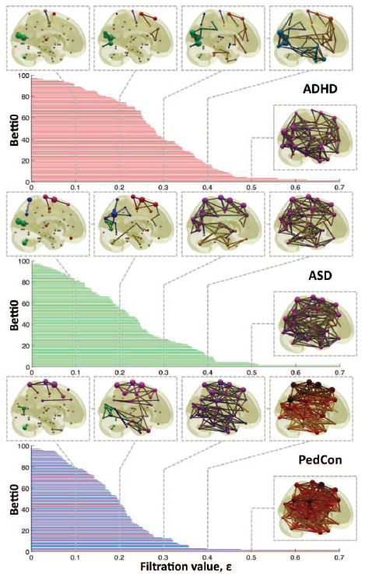

For H₀, can observe how fast connections form, possibly noting concavity
Vertices = Regions of Interest
Create Rips complex by growing epsilon balls (i.e. decreasing threshold) where distance between two vertices is given by
where f_{i} =
measurement at location i
http://ieeexplore.ieee.org/xpls/icp.jsp?arnumber=5872535

Slide 24
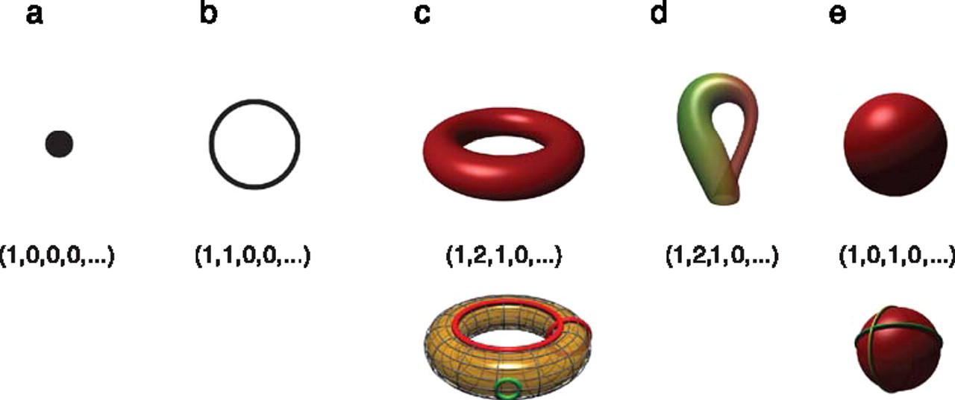

Betti numbers provide a signature of the underlying topology.
Use (β₀, β₁, β₂, …) for classification, where β_{i} = rank of H_{i}
Singh G et al. J Vis 2008;8:11
©2008 by Association for Research in Vision and Ophthalmology
Notes:
Betti numbers provide a signature of the underlying topology. Illustrated in the figure are five simple objects (topological spaces) together with their Betti number signatures: (a) a point, (b) a circle, (c) a hollow torus, (d) a Klein bottle, and (e) a hollow sphere. For the case of the torus (c), the figure shows three loops on its surface. The red loops are “essential” in that they cannot be shrunk to a point, nor can they be deformed one into the other without tearing the loop. The green loop, on the other hand, can be deformed to a point without any obstruction. For the torus, therefore, we have b 1 = 2. For the case of the sphere, the loops shown (and actually all loops on the sphere) can be contracted to points, which is reflected by the fact that b 1 = 0. Both the sphere and the torus have b 2 = 1, this is due to the fact both surfaces enclose a part of space (a void).

Slide 25
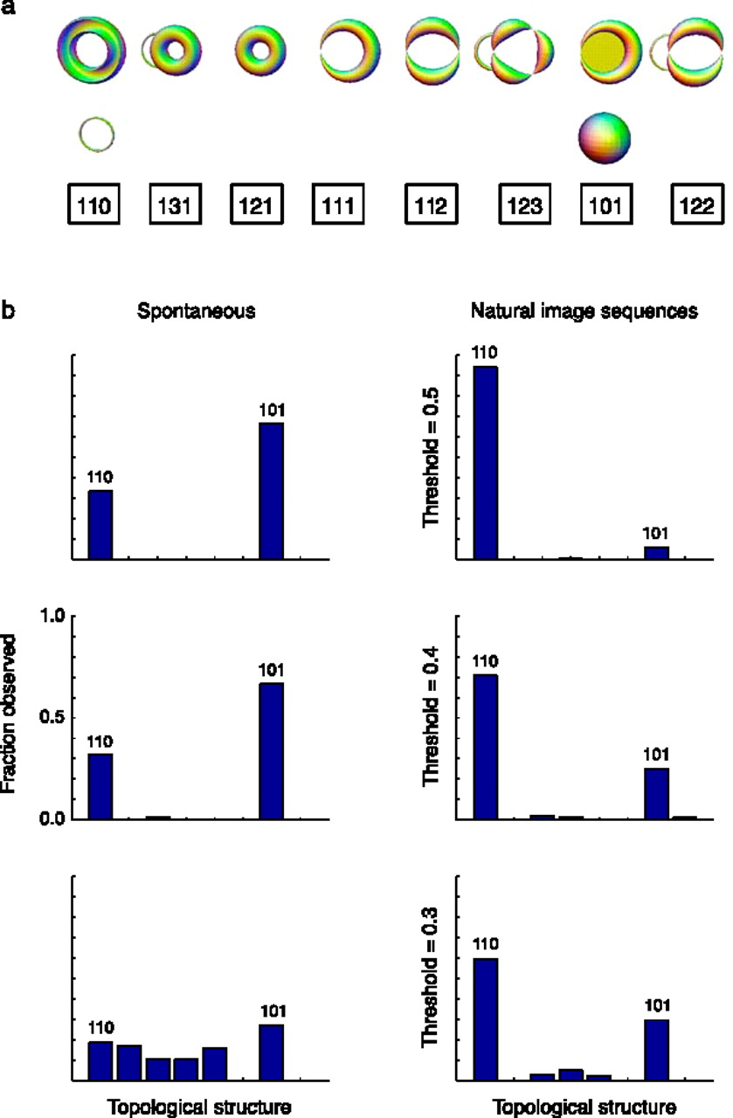
Estimation of topological structure in driven and spontaneous conditions.
Record voltages at points in time at each electrode.
Spike train: lists of firing times for a neuron
  obtained via spike sorting –i.e. signal processing.
Data = an array of N spike trains.
Compared spontaneous (eyes occluded) to evoked (via movie clips).
10 second segments broken into 50 ms bins
  Transistion between states about 80ms
The 5 neurons with the highest firing rate in each ten second window were chosen
For each bin, create a vector in R⁵ corresponding to the number of firings of each of the 5 neurons.
200 bins = 200 data points in R⁵.
  Used 35 landmark points.
20-30minutes of data = many data sets
Control: shuffled data 52700 times.
Singh G et al. J Vis 2008;8:11
©2008 by Association for Research in Vision and Ophthalmology
Notes:
Estimation of topological structure in driven and spontaneous conditions. (a) Ordering of topological signatures observed in our experiments. Each triplet ( b 0, b 1, b 2) is shown along an illustration of objects consistent with these signature. (b) Distribution of topological signatures in the spontaneous and natural image stimulation conditions pooled across the three experiments performed. Each row correspond to signatures with a minimum interval length (denoted as the threshold) expressed as a fraction of the covering radius of the data cloud (see Appendix A for the definition of the covering radius).

Slide 26
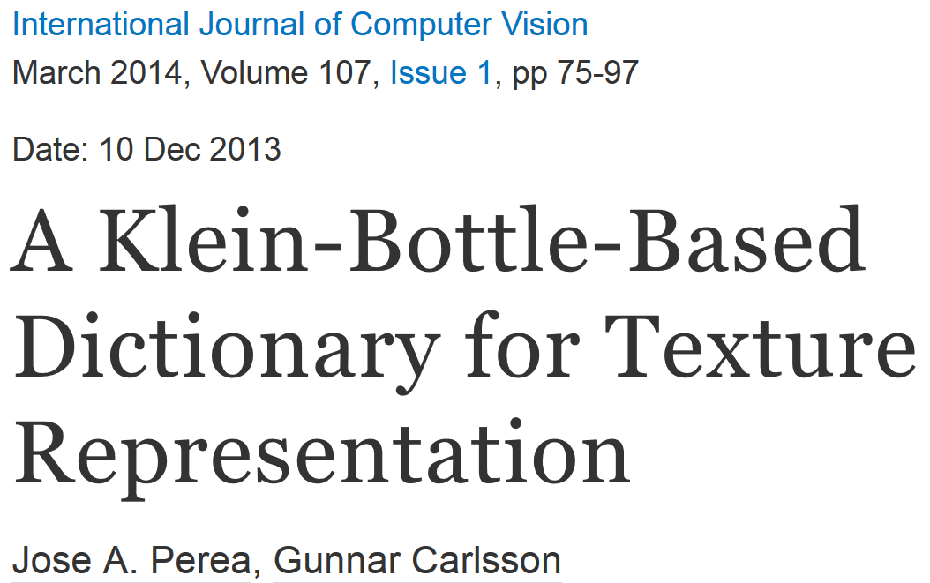
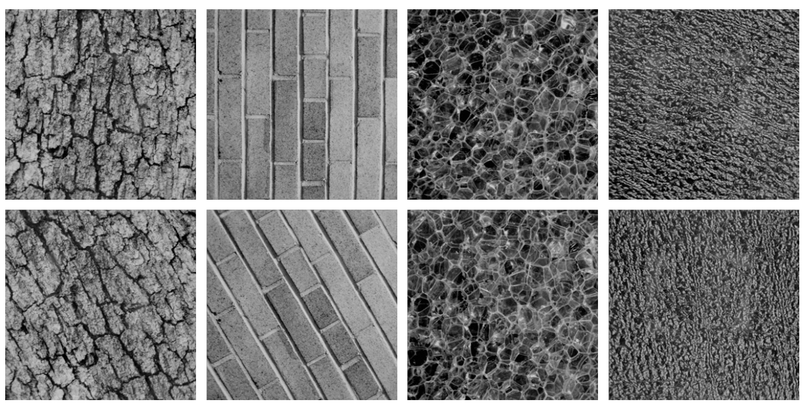
Combine your analysis with other tools

Slide 27
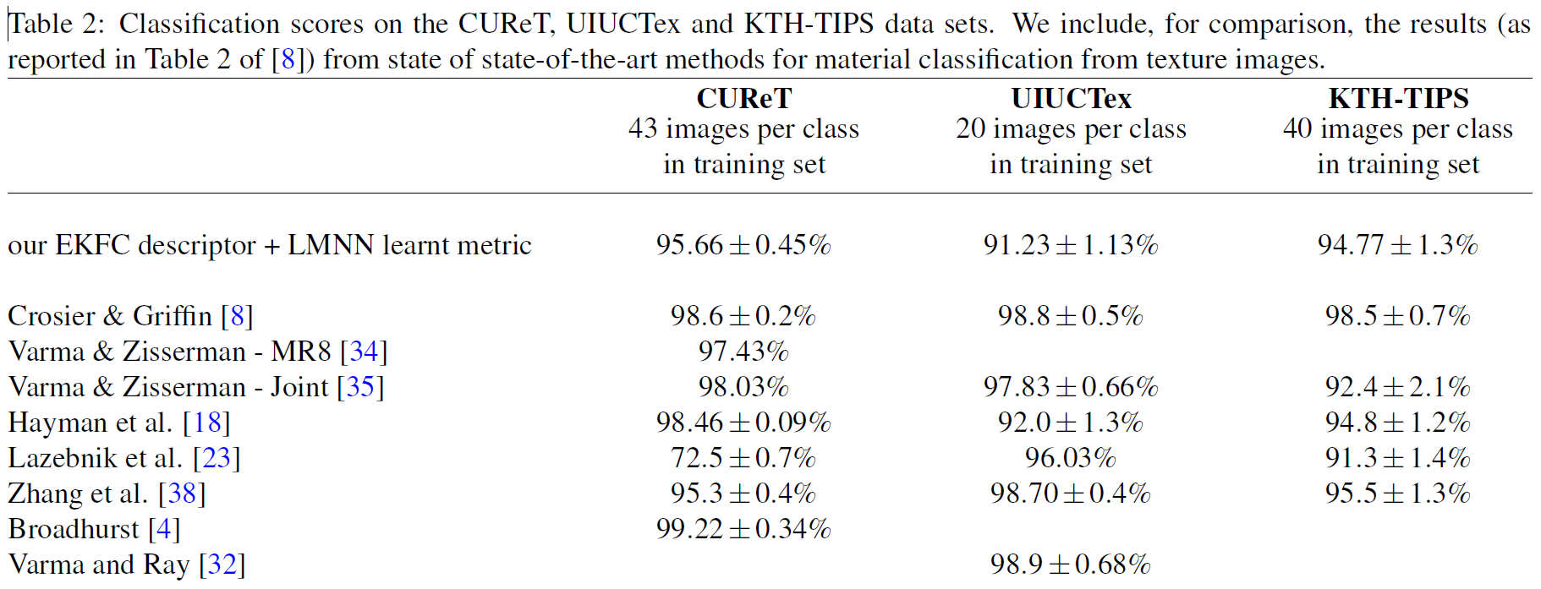
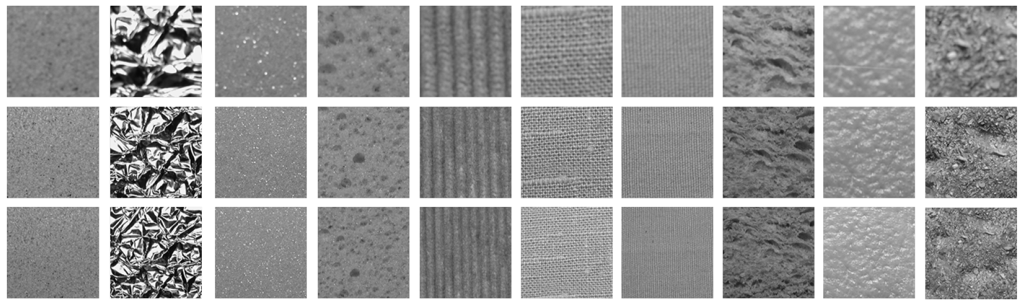

Slide 28
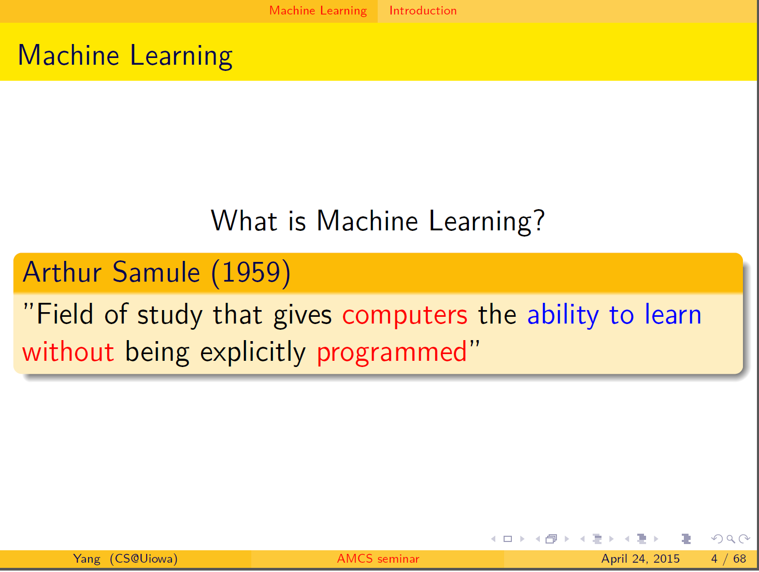

Slide 29
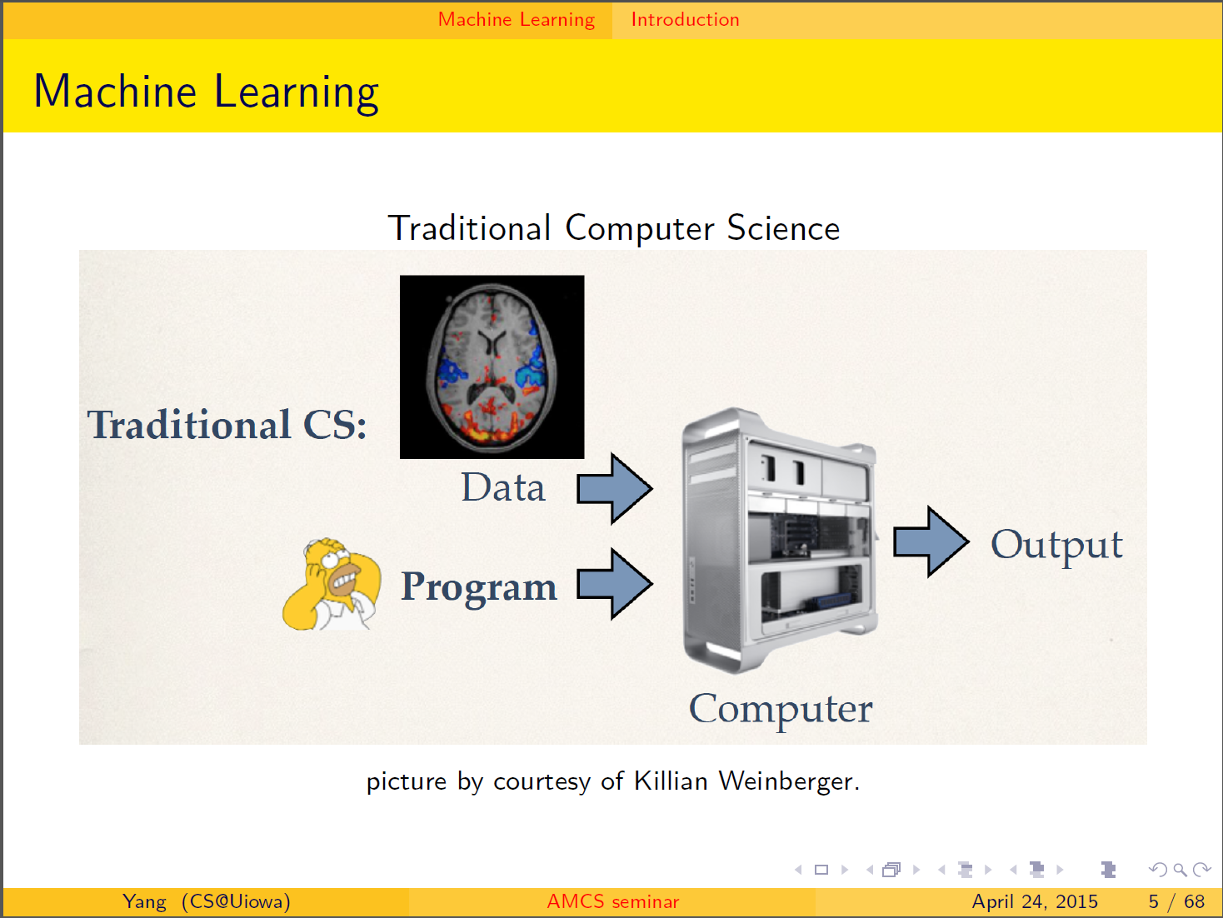

Slide 30
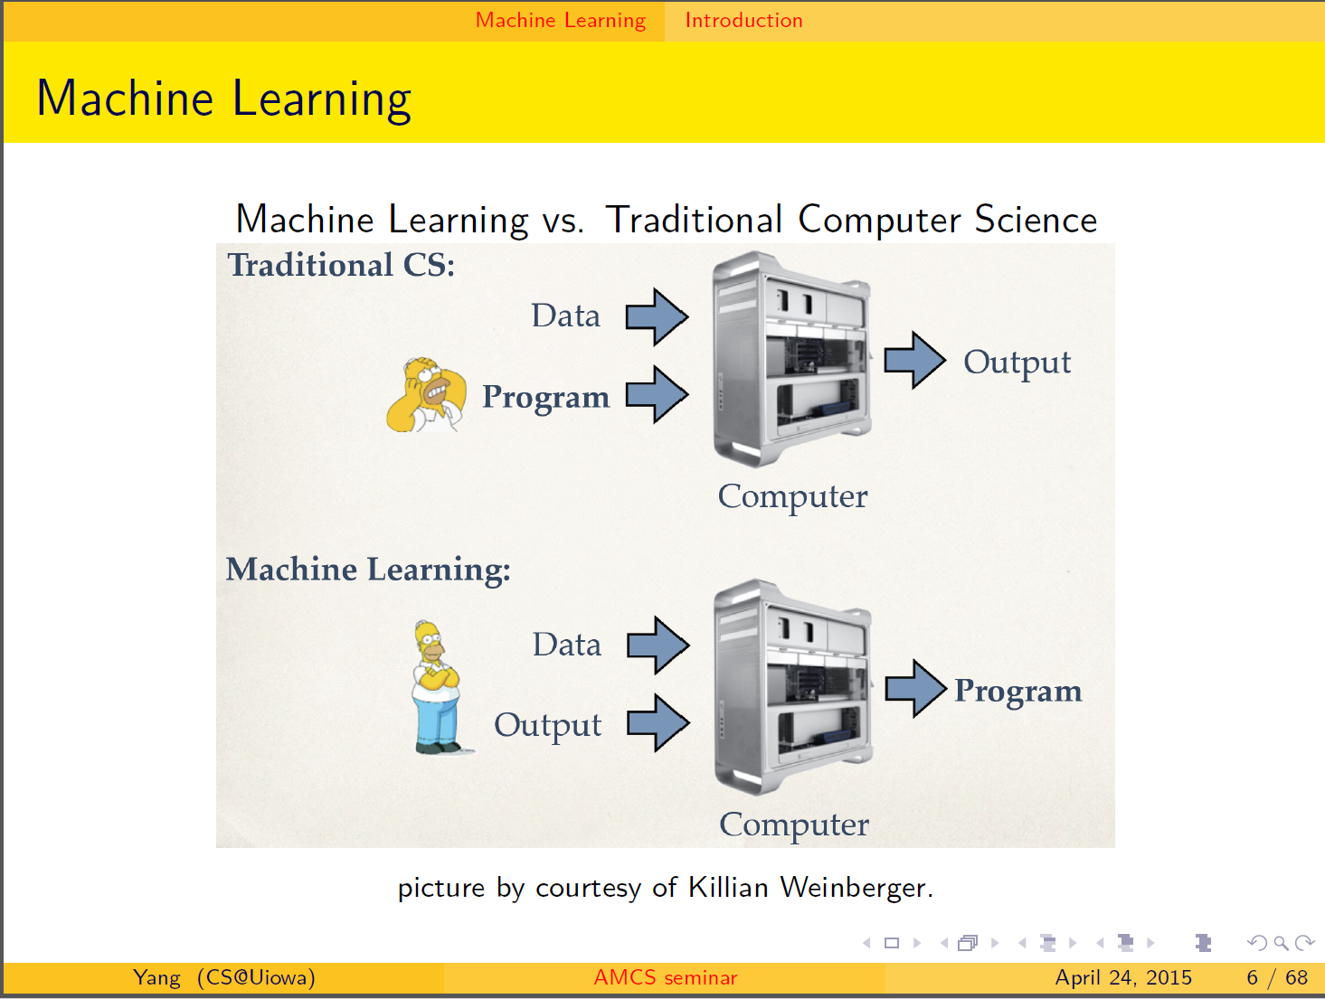

Slide 31
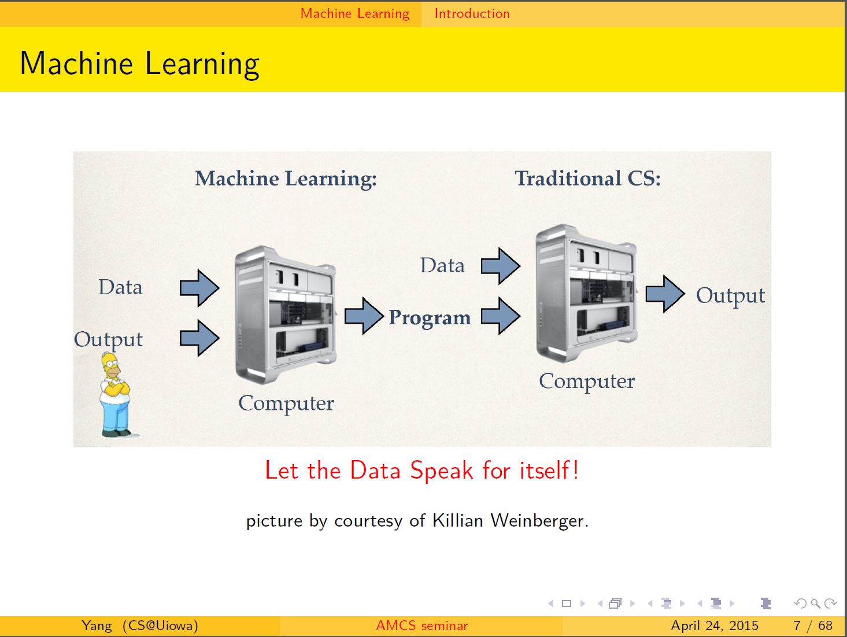

Slide 32
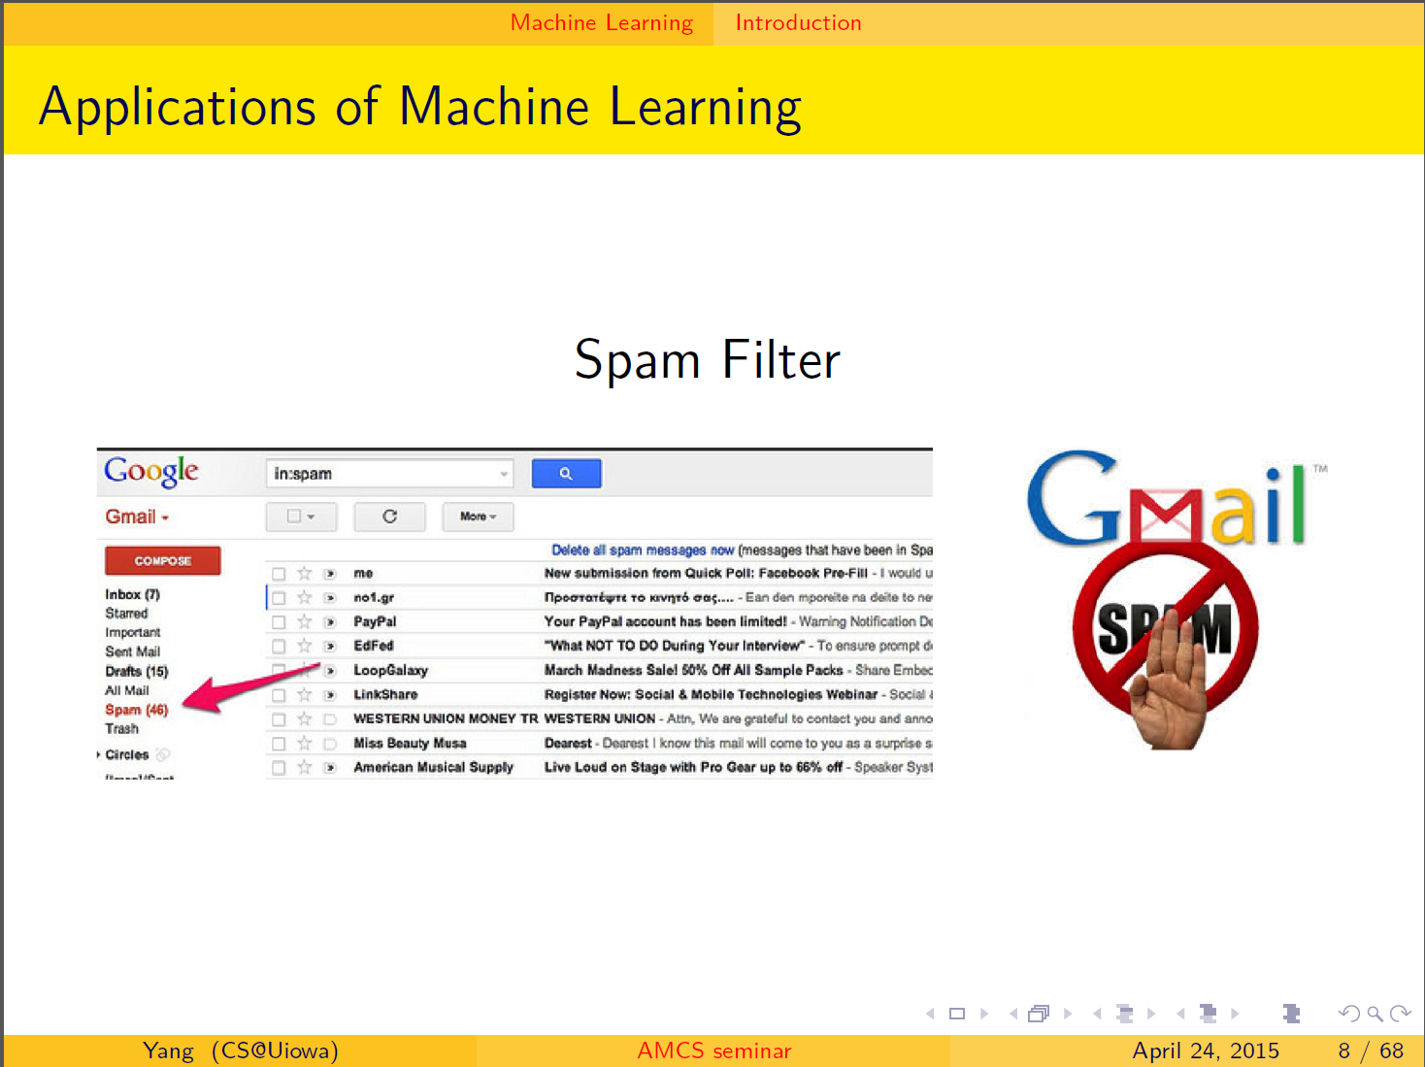

Slide 33
Estimation of topological structure in driven and spontaneous conditions.
Record voltages at points in time at each electrode.
Spike train: lists of firing times for a neuron
  obtained via spike sorting –i.e. signal processing.
Data = an array of N spike trains.
Compared spontaneous (eyes occluded) to evoked (via movie clips).
10 second segments broken into 50 ms bins
  Transistion between states about 80ms
The 5 neurons with the highest firing rate in each ten second window were chosen
For each bin, create a vector in R⁵ corresponding to the number of firings of each of the 5 neurons.
200 bins = 200 data points in R⁵.
  Used 35 landmark points.
20-30minutes of data = many data sets
Control: shuffled data 52700 times.
Singh G et al. J Vis 2008;8:11
©2008 by Association for Research in Vision and Ophthalmology
Notes:
Estimation of topological structure in driven and spontaneous conditions. (a) Ordering of topological signatures observed in our experiments. Each triplet ( b 0, b 1, b 2) is shown along an illustration of objects consistent with these signature. (b) Distribution of topological signatures in the spontaneous and natural image stimulation conditions pooled across the three experiments performed. Each row correspond to signatures with a minimum interval length (denoted as the threshold) expressed as a fraction of the covering radius of the data cloud (see Appendix A for the definition of the covering radius).

Slide 35
http://en.wikipedia.org/wiki/Machine_learning
Machine learning is a scientific discipline that explores the construction and study of algorithms that can learn from data.[1] Such algorithms operate by building a model from example inputs and using that to make predictions or decisions,[2]:2 rather than following strictly static program instructions.
https://www.cs.princeton.edu/courses/archive/spring08/cos511/scribe_notes/0204.pdf
Machine learning studies computer algorithms for learning to do stuff.
The emphasis of machine learning is on automatic methods. In other words, the goal is to devise learning algorithms that do the learning automatically without human intervention or assistance.

Slide 36

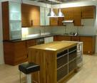



Image Categorization
Training
Training Labels
Training Images
Image Features
Classifier Training
Trained Classifier
Testing
Image Features
Trained Classifier
Prediction
Outdoor
Test Image
http://cs.brown.edu/courses/cs143/lectures/15.ppt

Slide 37
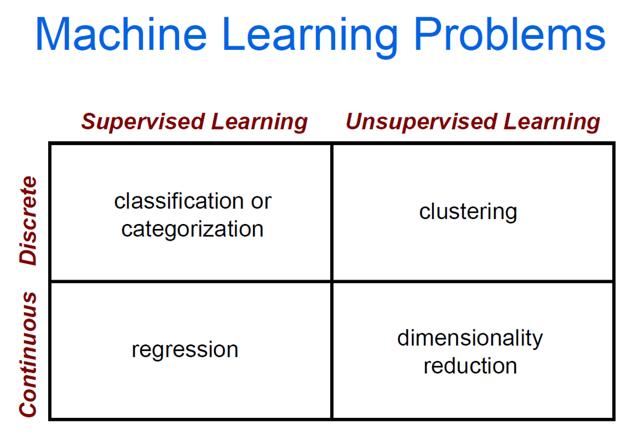
cs.brown.edu/courses/cs143/lectures/17.ppt

Slide 39
http://en.wikipedia.org/wiki/Database
A database is an organized collection of data.^{[1]} The data is typically organized to model aspects of reality in a way that supports processes requiring information. For example, modelling the availability of rooms in hotels in a way that supports finding a hotel with vacancies.
Database management systems are computer software
applications that interact with the user, other applications, and the database itself to capture and analyze data. A general-purpose DBMS is designed to allow the definition, creation, querying, update, and administration of databases. Well-known DBMSs include MySQL, PostgreSQL, Microsoft SQL Server, Oracle, Sybase
and IBM DB2

Slide 40
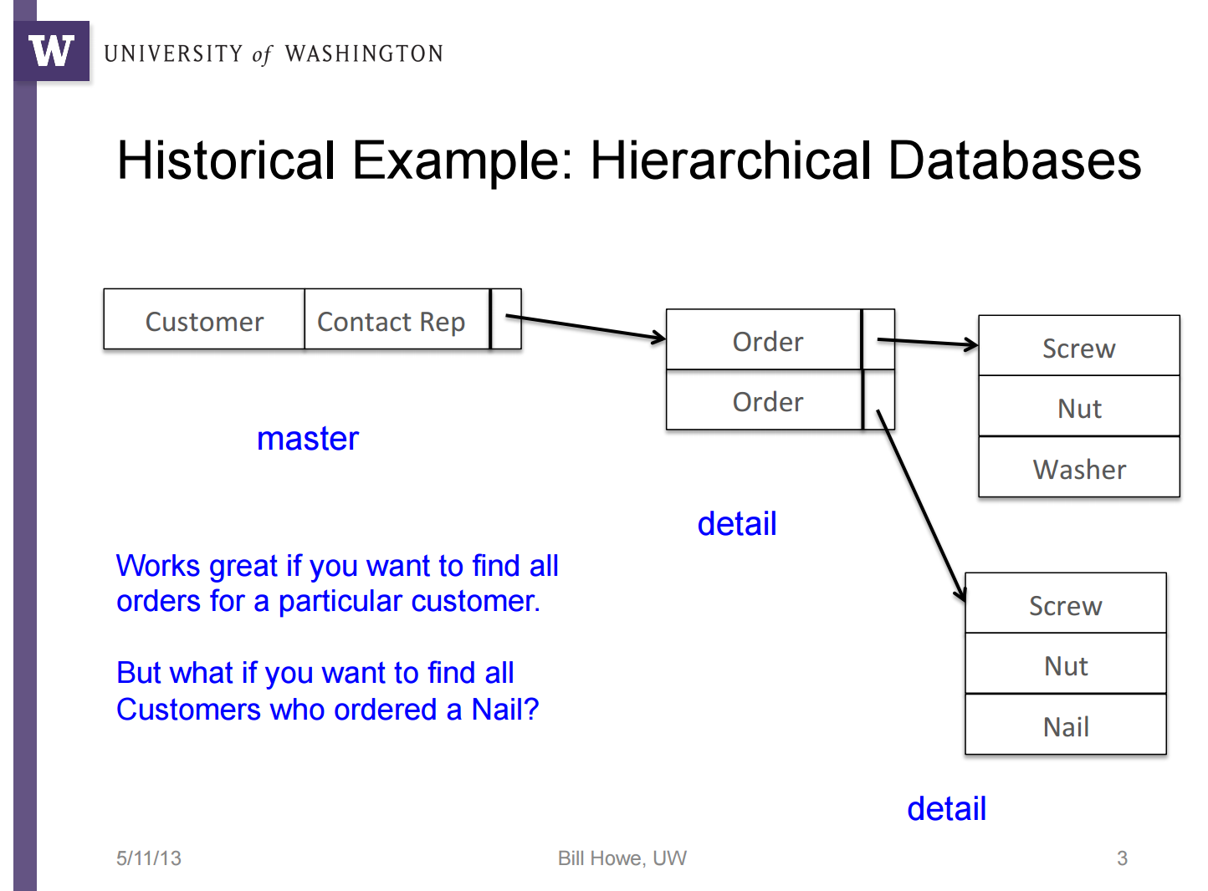

Slide 41
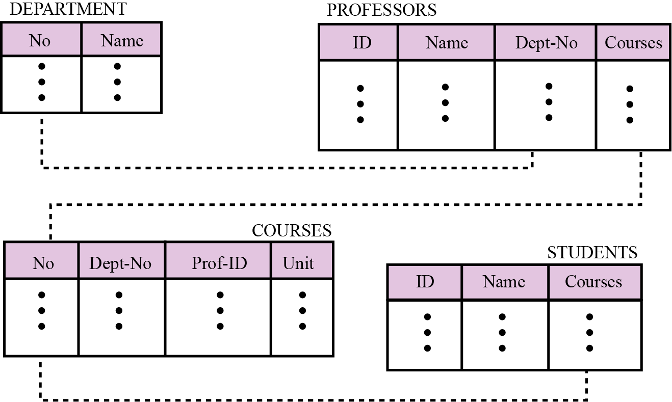
Relational database model
In the relational model, data is organized in two-dimensional tables called relations. The tables or relations are, however, related to each other, as we will see shortly.
Figure 14.5 An example of the relational model representing a university
http://www.csie.kuas.edu.tw/course/CS/old/english/ch-14.ppt

Slide 42
What is SQL?
SQL stands for Structured Query Language
SQL lets you access and manipulate databases
SQL is an ANSI (American National Standards Institute) standard
RDBMS stands for Relational Database Management System.
RDBMS is the basis for SQL, and for all modern database systems such as MS SQL Server, IBM DB2, Oracle, MySQL, and Microsoft Access.
The data in RDBMS is stored in database objects called tables.
A table is a collection of related data entries and it consists of columns and rows.
http://www.w3schools.com/sql/sql_intro.asp

Slide 43
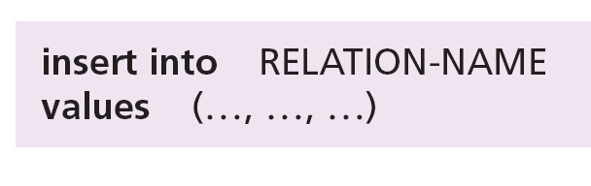
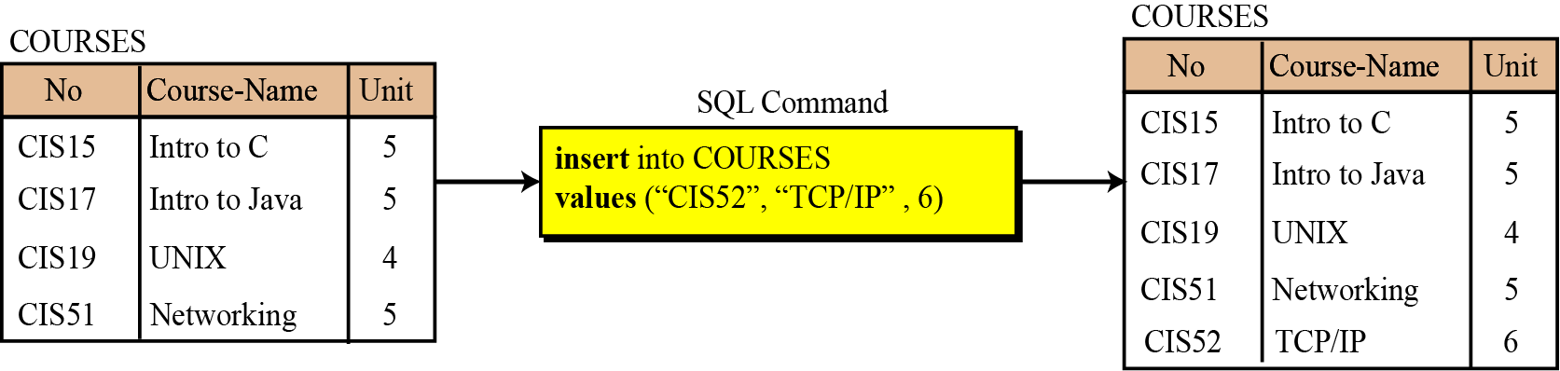
Insert
http://www.csie.kuas.edu.tw/course/CS/old/english/ch-14.ppt
The insert operation is a unary operation—that is, it is applied to a single relation. The operation inserts a new tuple into the relation. The insert operation uses the following format:
Figure 14.7 An example of an insert operation

Slide 44
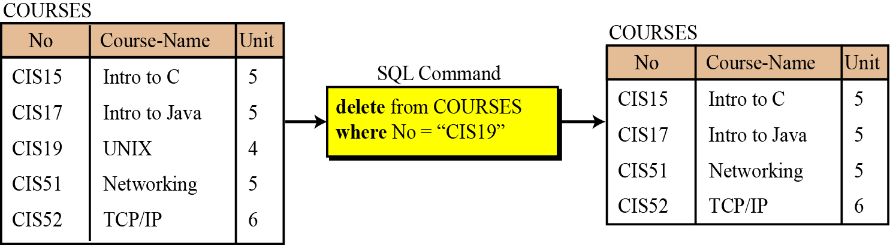
Delete
http://www.csie.kuas.edu.tw/course/CS/old/english/ch-14.ppt
The delete operation is also a unary operation. The operation deletes a tuple defined by a criterion from the relation. The delete operation uses the following format:
Figure 14.8 An example of a delete operation

Slide 45
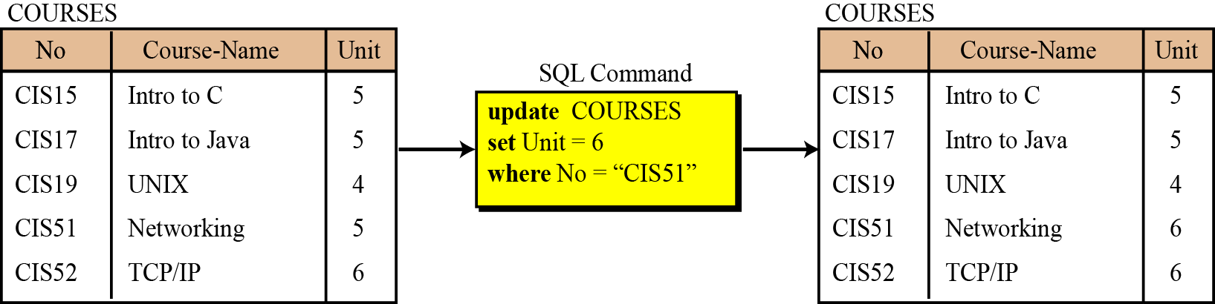
Update
http://www.csie.kuas.edu.tw/course/CS/old/english/ch-14.ppt
The update operation is also a unary operation that is applied to a single relation. The operation changes the value of some attributes of a tuple. The update operation uses the following format:
Figure 14.9 An example of an update operation

Slide 46
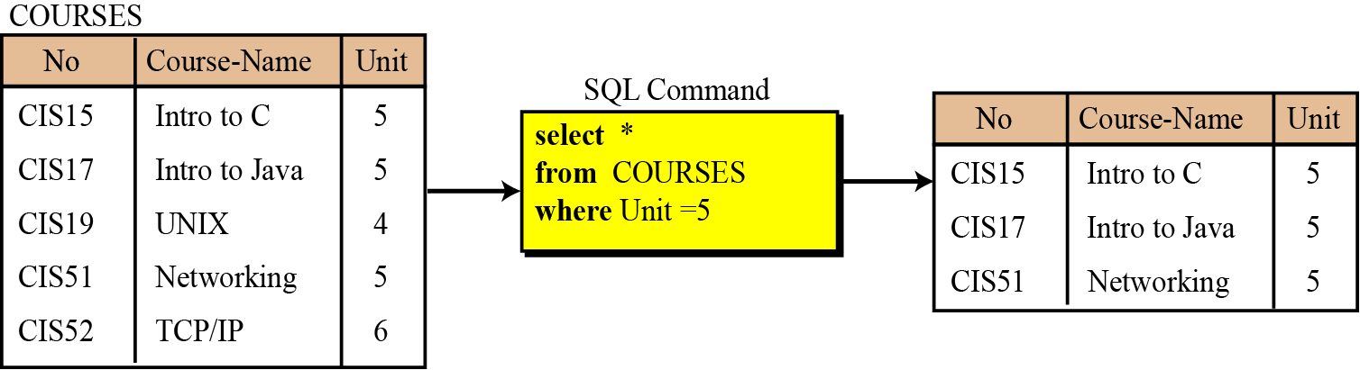
Select
http://www.csie.kuas.edu.tw/course/CS/old/english/ch-14.ppt
The select operation is a unary operation. The tuples (rows) in the resulting relation are a subset of the tuples in the original relation.
Figure 14.10 An example of an select operation

Slide 47
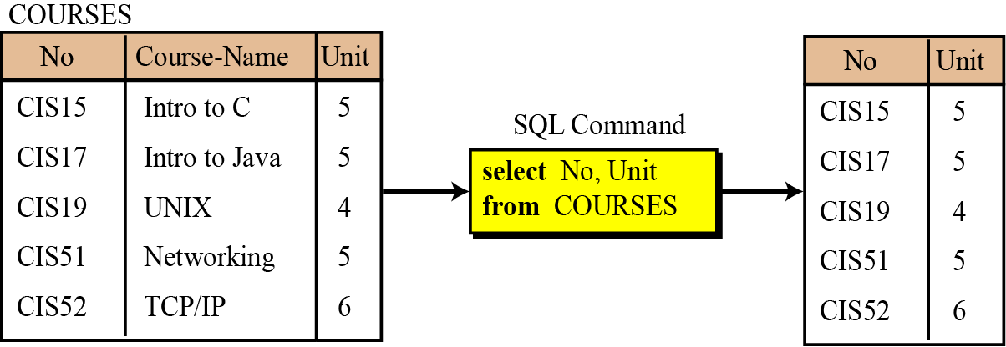
Project
http://www.csie.kuas.edu.tw/course/CS/old/english/ch-14.ppt
The project operation is also a unary operation and creates another relation. The attributes (columns) in the resulting relation are a subset of the attributes in the original relation.
Figure 14.11 An example of a project operation

Slide 48
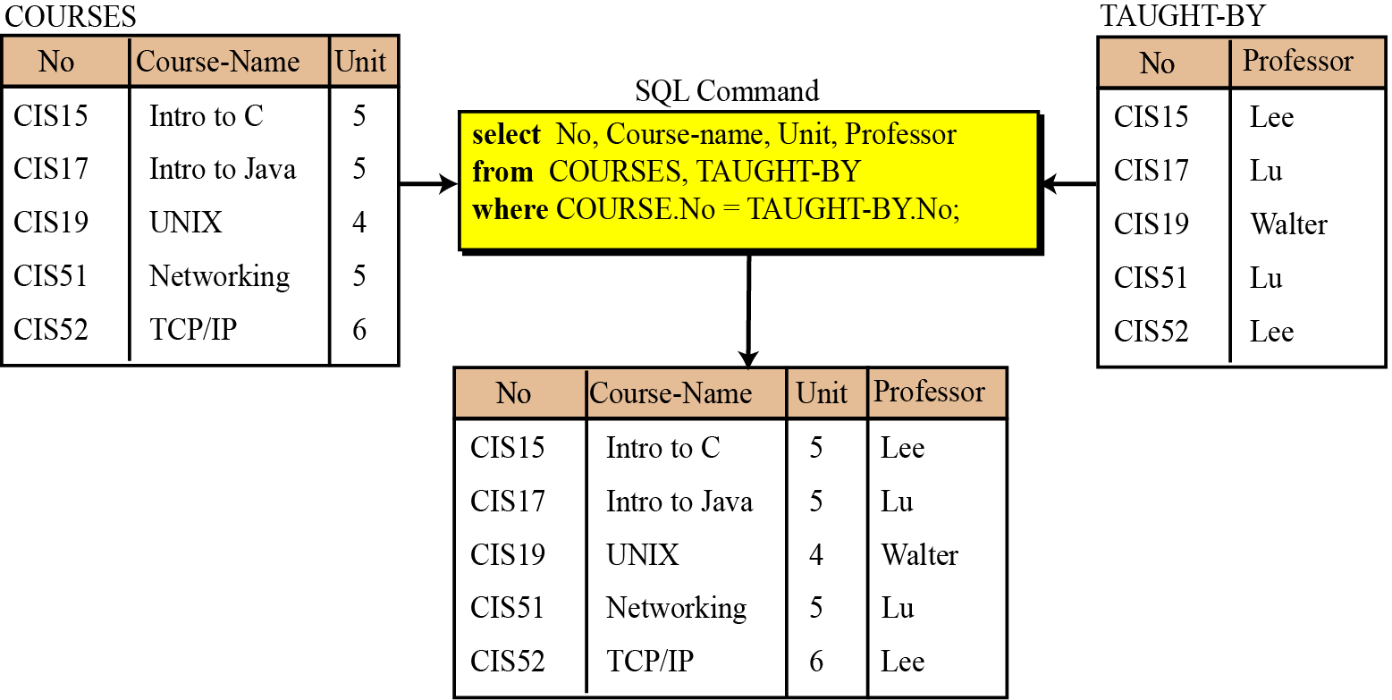
Join
http://www.csie.kuas.edu.tw/course/CS/old/english/ch-14.ppt
The join operation is a binary operation that combines two relations on common attributes.
Figure 14.12 An example of a join operation

Slide 49
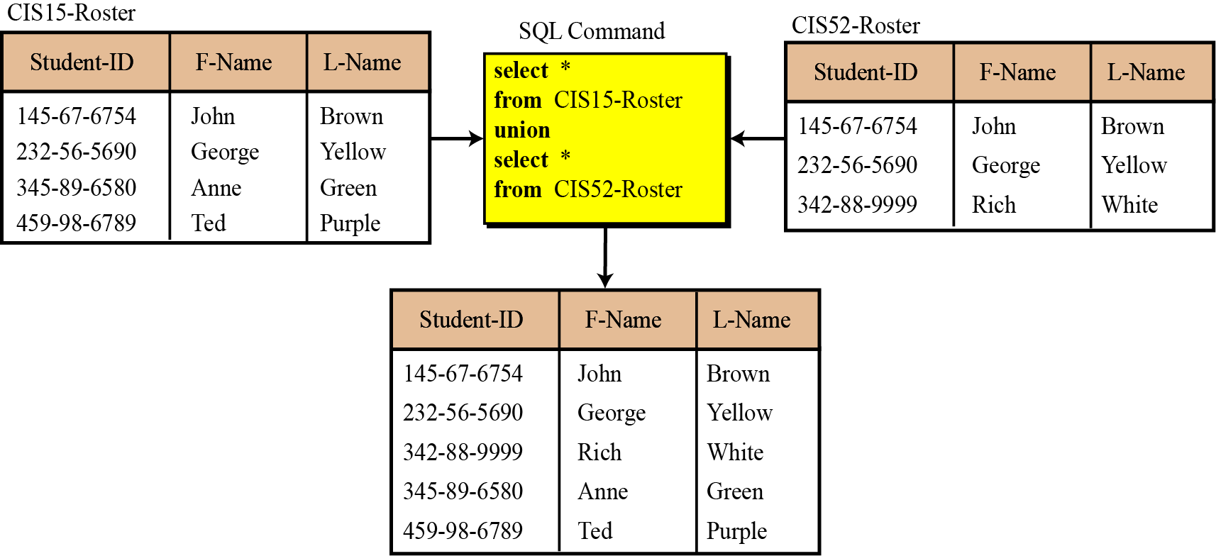
Union
http://www.csie.kuas.edu.tw/course/CS/old/english/ch-14.ppt
The union operation takes two relations with the same set of attributes.
Figure 14.13 An example of a union operation

Slide 50
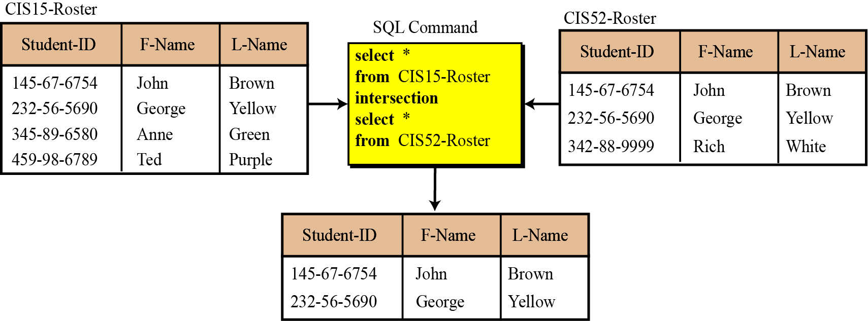
Intersection
http://www.csie.kuas.edu.tw/course/CS/old/english/ch-14.ppt
The intersection operation takes two relations and creates a new relation, which is the intersection of the two.
Figure 14.14 An example of an intersection operation

Slide 51
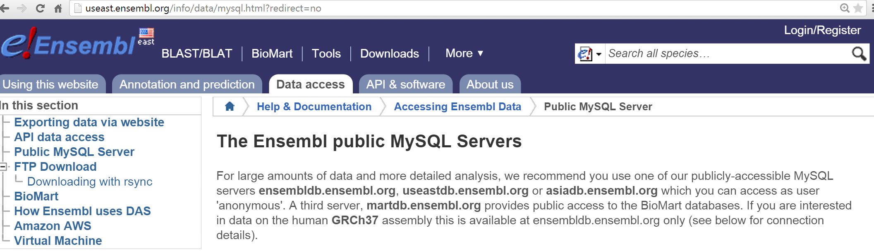
Some public databases can be accessed using MySQL

Slide 52
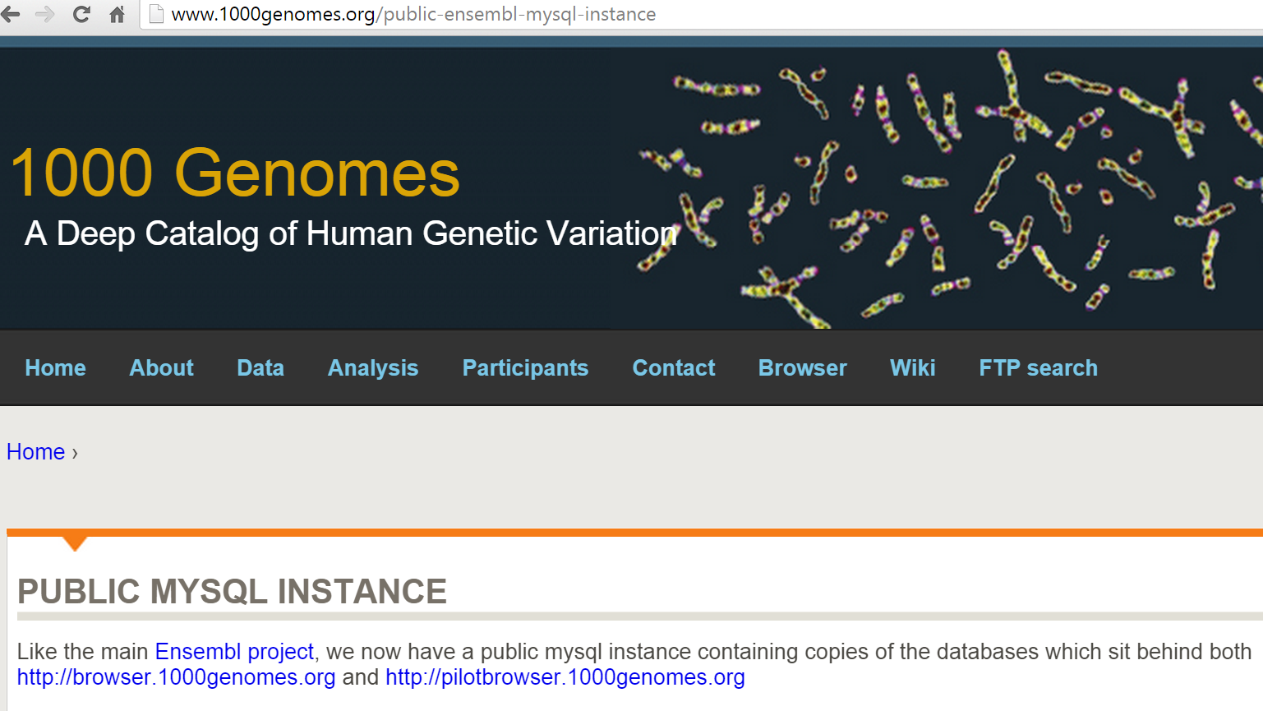

Slide 53
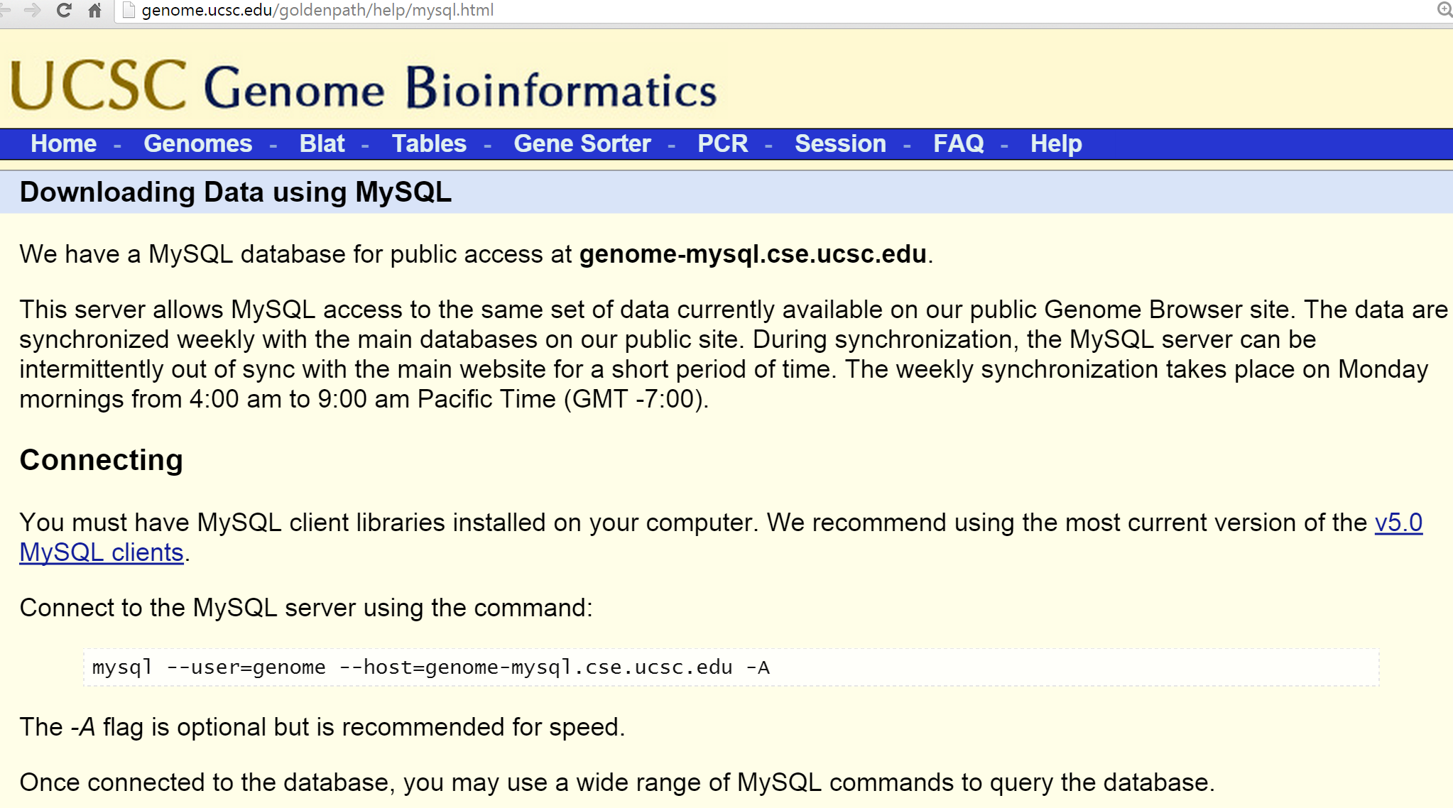

Slide 54
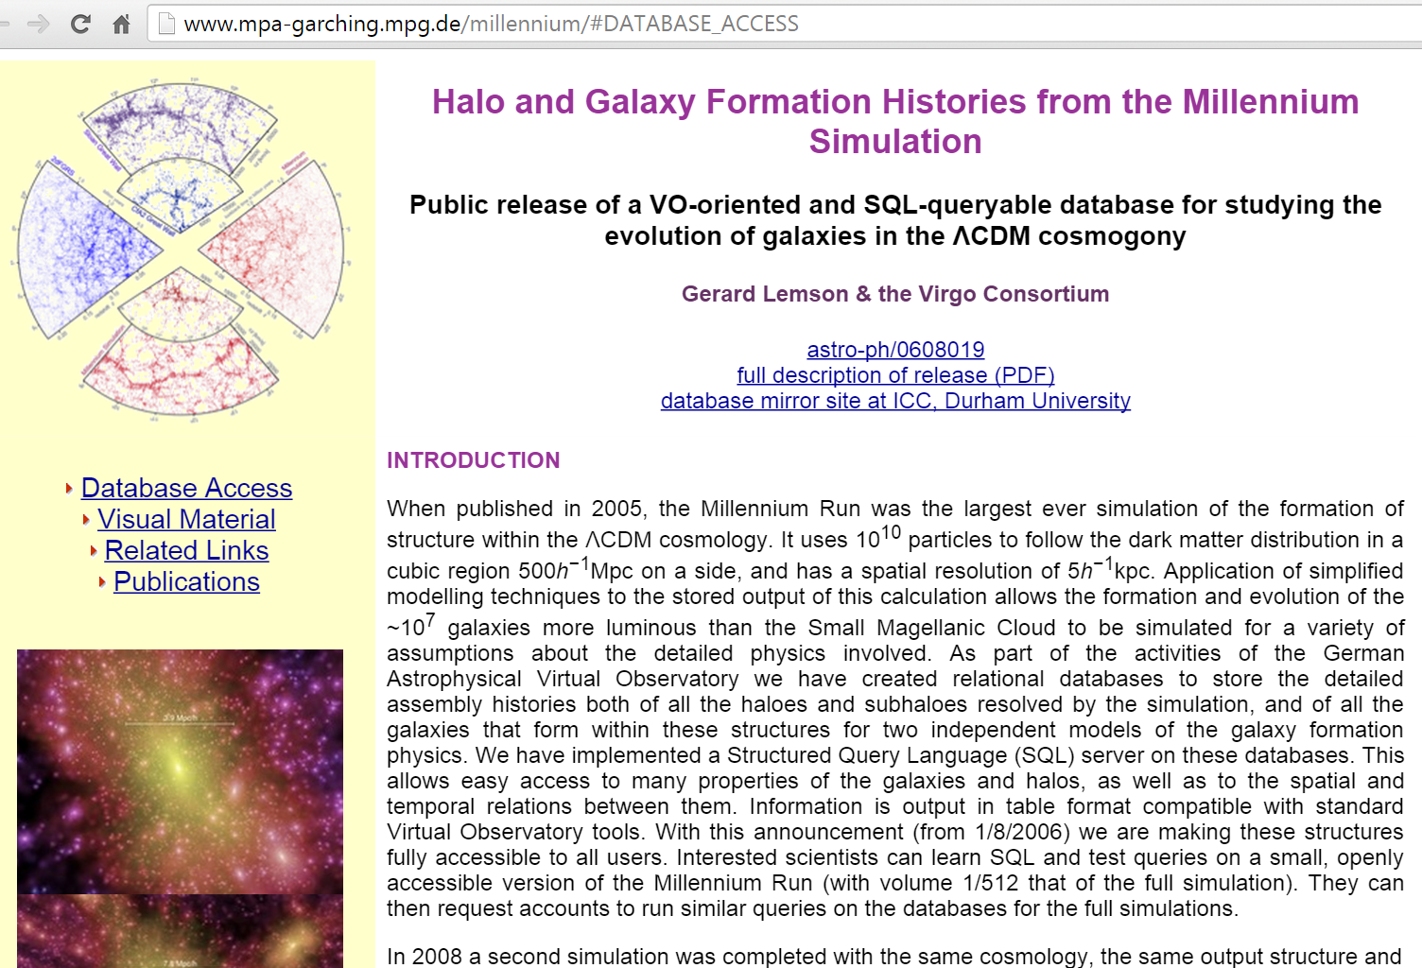

Slide 55
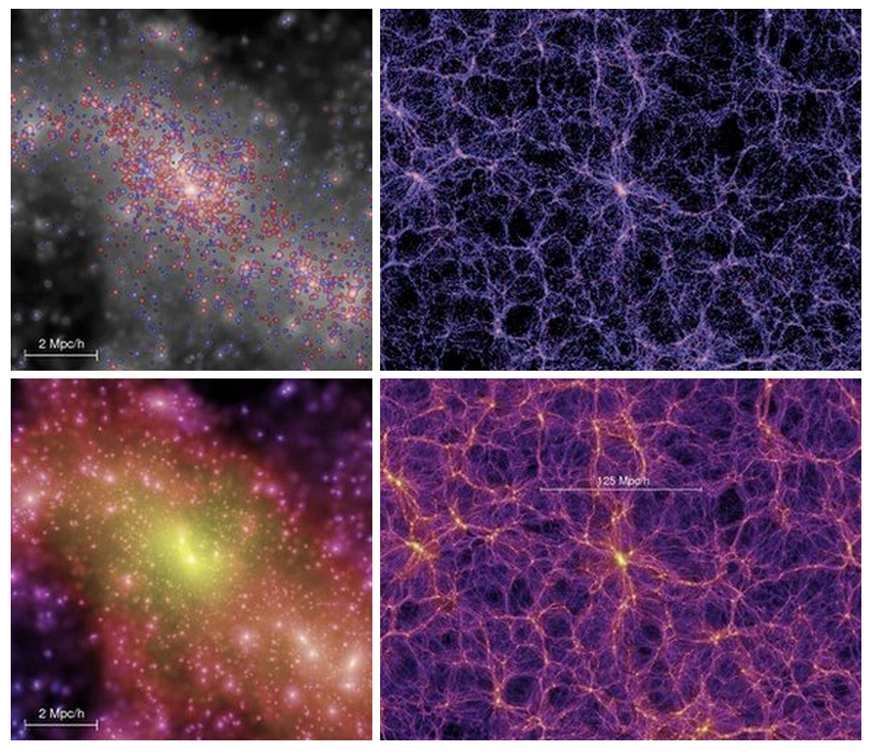
http://www.mpa-garching.mpg.de/galform/virgo/millennium/

Slide 56
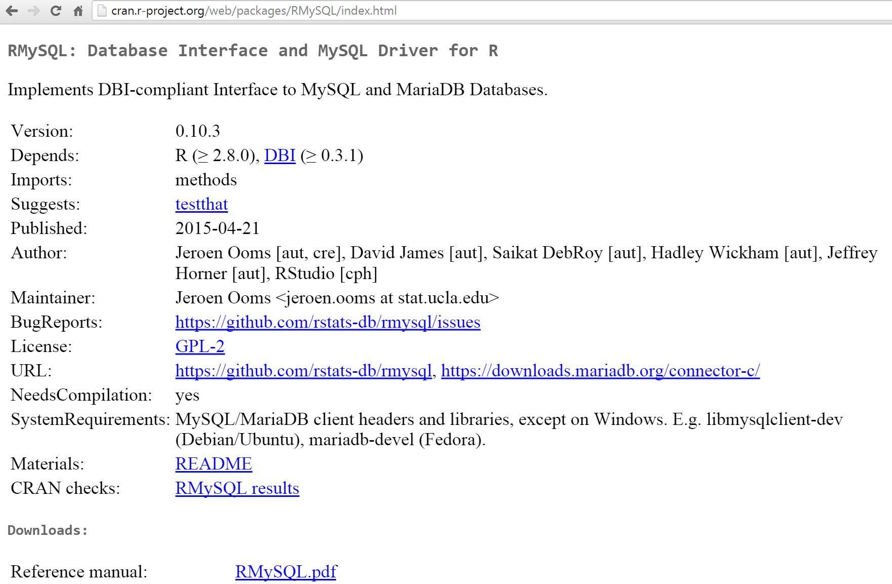

Slide 57
Should I start with a more general lecture on data analysis?
How did you like the you tube lectures?
How did you like the in-class worksheets?
Would you have liked more videos and in class worksheets?
Should I ask TA to post deadlines on ICON?
Thoughts on starting week 1: Class wiki project describing topology including deformation retract.
What do you think of my plan for assigning more HW, starting R sooner, and having parts of project turned in earlier with firm deadlines.
Other ideas/comments?

Slide 58
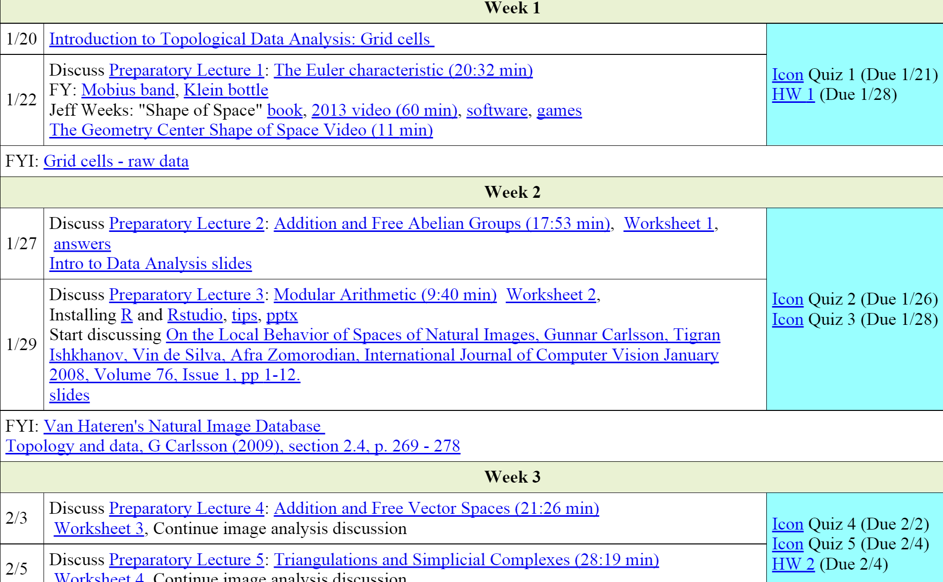
Possible modifications for next time
------------------------------------------------------ Introduction to data and shape
How did you like the you tube lectures?
How did you like the in-class worksheets?
Would you have liked more videos and in class worksheets?
---------------------------------------------------------------Computer Lab: Intro to R
HW due 2/5 (individual or group HW): Describe a data set (use feedback from writing center)

Slide 59
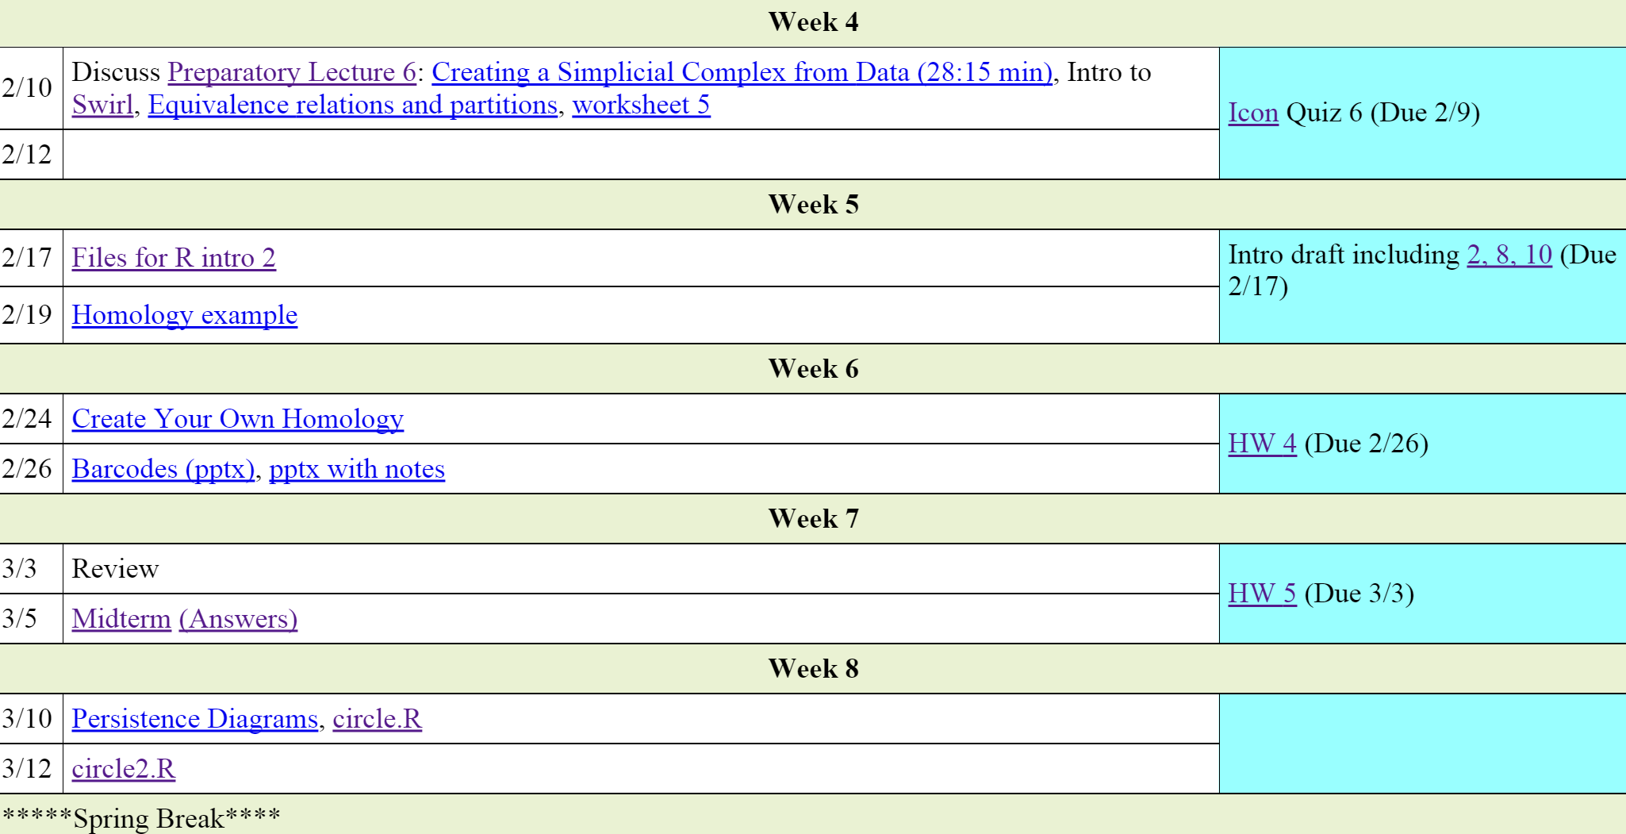
Possible modifications for next time
Starting week 1: Class wiki project describing topology including deformation retract.
Draft of commented R code, due 2/12
Outline due 2/19
Draft OR Poster due 3/12

Slide 60
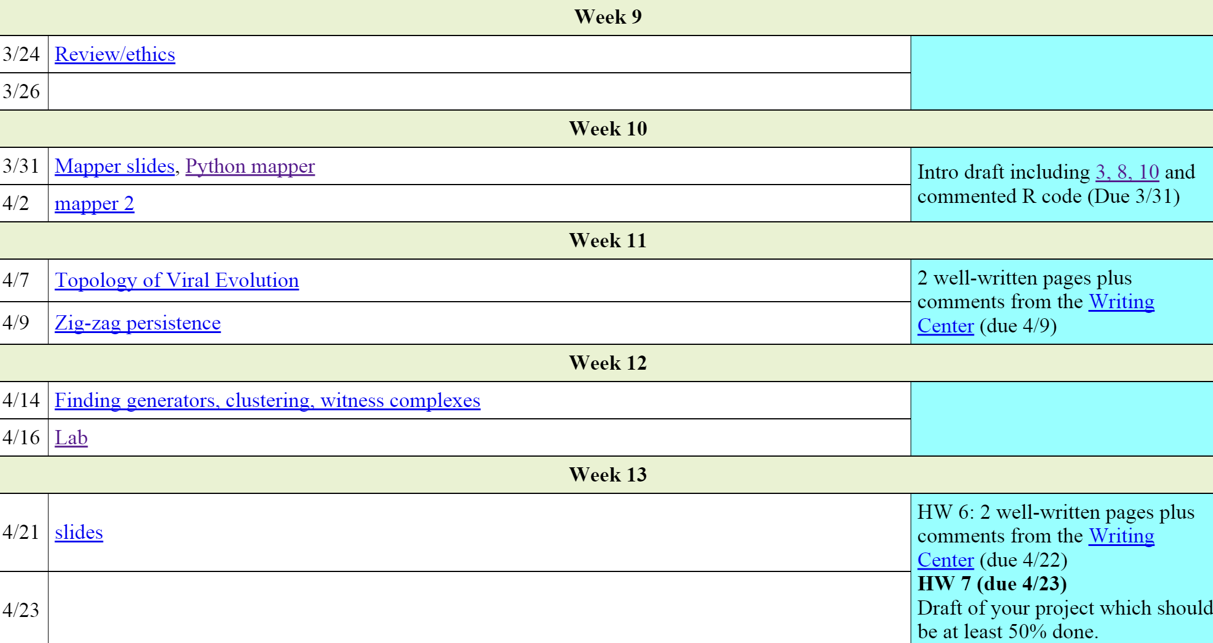
Possible modifications for next time
Should I ask TA to post deadlines on ICON?
Slides due 4/23

