Slide 1
Recombination:

Slide 2
Different recombinases have different topological mechanisms:
Ex: Cre recombinase can act on both directly and inversely repeated sites.
Xer recombinase on psi.
Unique product
Uses topological filter to only perform deletions, not inversions

Slide 3
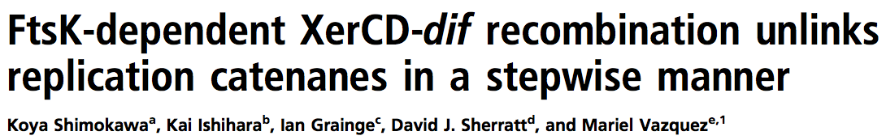
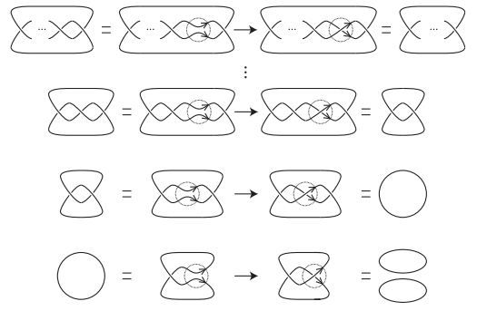
PNAS 2013

Slide 4
Tangle Analysis of Protein-DNA complexes

Slide 5
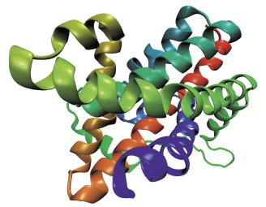
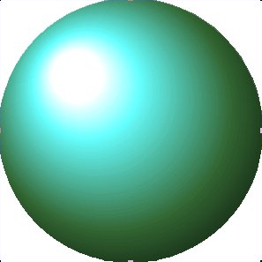
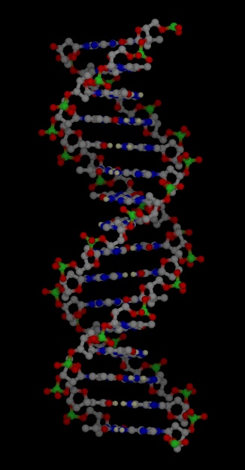
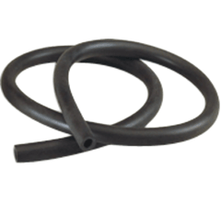
Mathematical Model
Protein =
=
=
=
DNA =

Slide 6
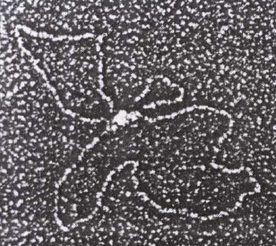
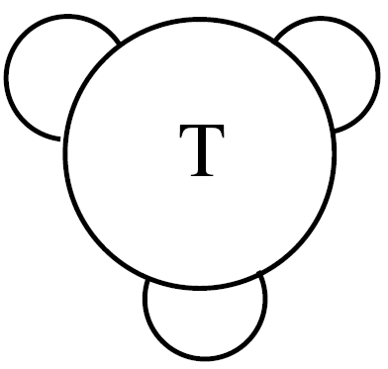
C. Ernst, D. W. Sumners, A calculus for rational tangles: applications to DNA recombination, Math. Proc. Camb. Phil. Soc. 108 (1990), 489-515.
protein = three dimensional ball
protein-bound DNA = strings.
Protein-DNA complex
Heichman and Johnson
Slide (modified) from Soojeong Kim

Slide 7
Solving tangle equations
Tangle equation from: Path of DNA within the Mu transpososome. Transposase interactions bridging two Mu ends and the enhancer trap five DNA supercoils. Pathania S, Jayaram M, Harshey RM.
Cell. 2002 May 17;109(4):425-36.

Slide 8
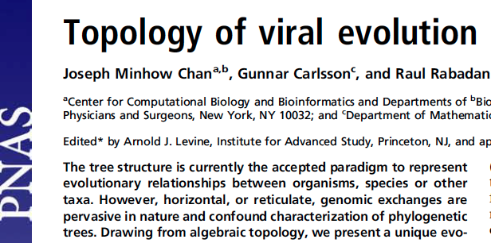
vol. 110 no. 46, 18566–18571, 2013
http://www.pnas.org/content/110/46/18566.full

Slide 9
Background

Slide 10
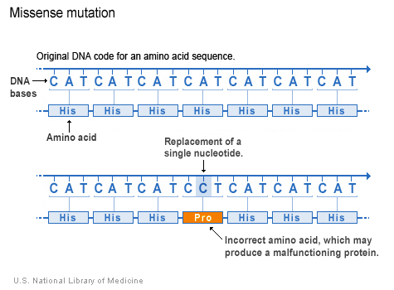
http://ghr.nlm.nih.gov/handbook/mutationsanddisorders/possiblemutations

Slide 11
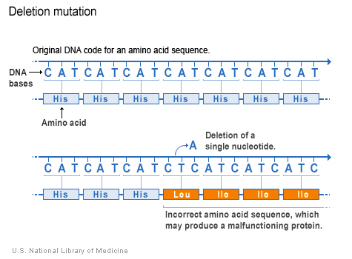
http://ghr.nlm.nih.gov/handbook/mutationsanddisorders/possiblemutations

Slide 12
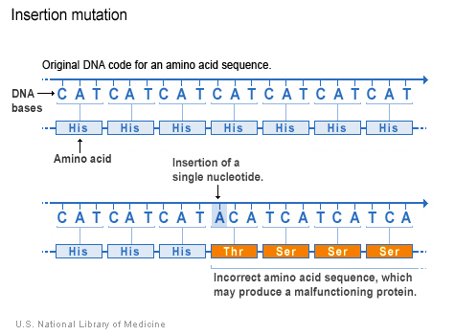
http://ghr.nlm.nih.gov/handbook/mutationsanddisorders/possiblemutations

Slide 13
Recombination:

Slide 14
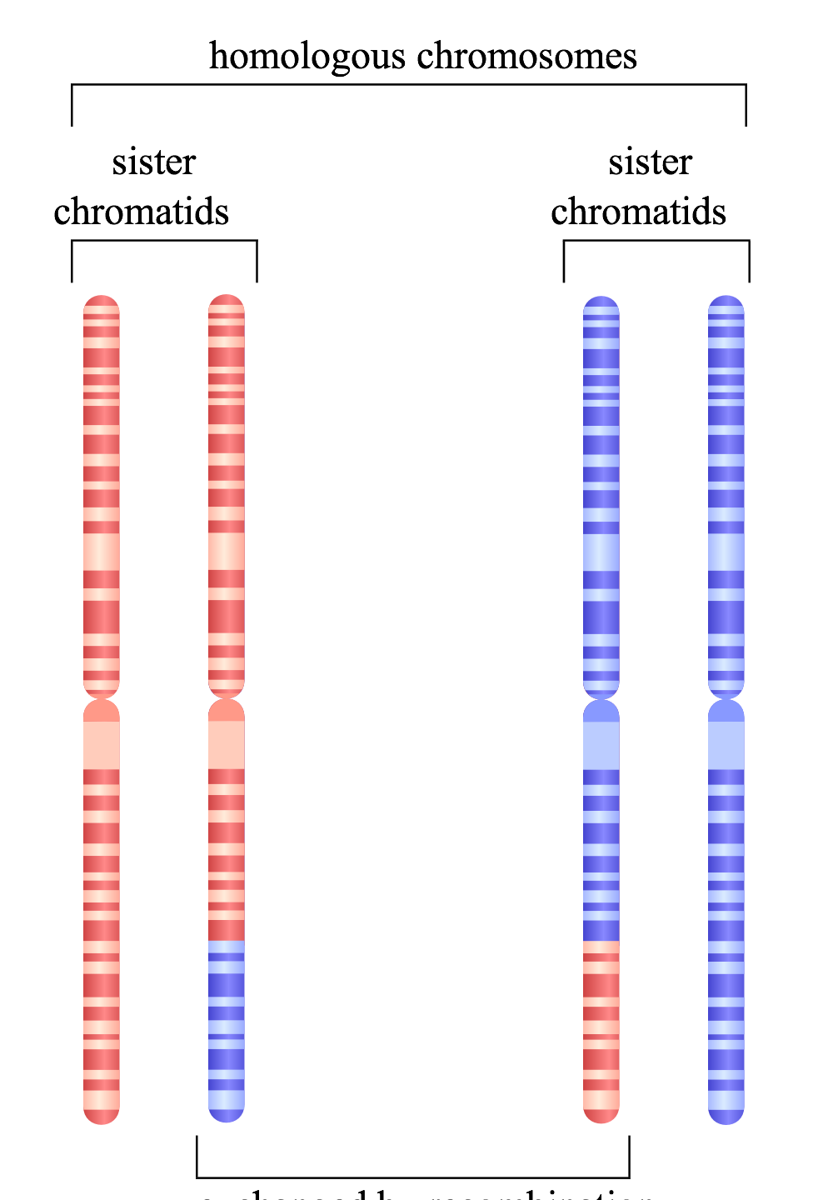
Homologous recombination
http://en.wikipedia.org/wiki/File:HR_in_meiosis.svg

Slide 15
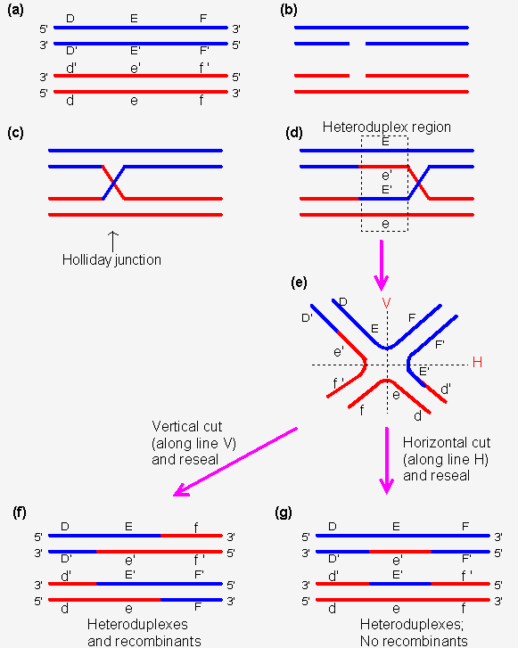
http://www.web-books.com/MoBio/Free/Ch8D2.htm

Slide 16
Homologous recombination
http://en.wikipedia.org/wiki/File:HR_in_meiosis.svg

Slide 17
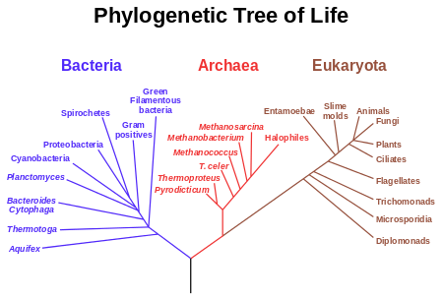

Slide 18
Where do we get distances from?
Distances can be derived from Multiple Sequence Alignments (MSAs).
The most basic distance is just a count of the number of sites which differ between two sequences divided by the sequence length. These are sometimes known as p-distances.
 | Cat | Dog | Rat | Cow
Cat | 0 | 0.2 | 0.4 | 0.7
Dog | 0.2 | 0 | 0.5 | 0.6
Rat | 0.4 | 0.5 | 0 | 0.3
Cow | 0.7 | 0.6 | 0.3 | 0
Cat | ATTTGCGGTA
Dog | ATCTGCGATA
Rat | ATTGCCGTTT
Cow | TTCGCTGTTT
http://www.allanwilsoncentre.ac.nz/massey/fms/AWC/download/SK_DistanceBasedMethods.ppt

Slide 20
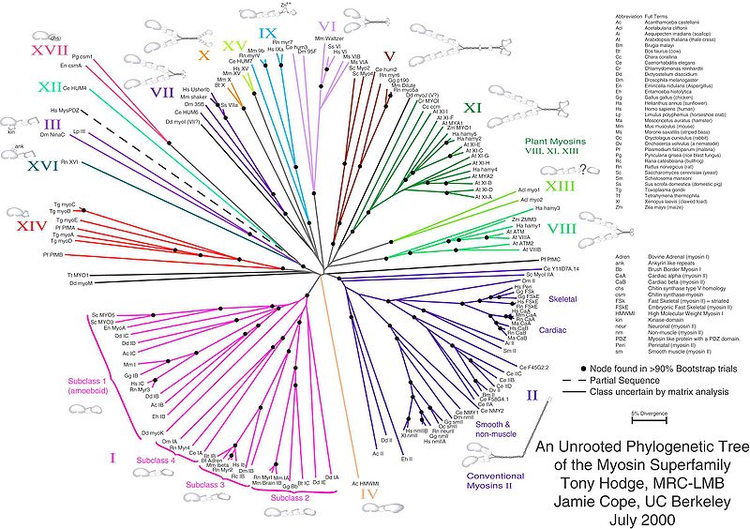

Slide 21
Perfectly “tree-like” distances
 | Cat | Dog | Rat
Dog | 3
Rat | 4 | 5
Cow | 6 | 7 | 6
Cat
Rat
1
2
1
2
4
Dog
Cow
http://www.allanwilsoncentre.ac.nz/massey/fms/AWC/download/SK_DistanceBasedMethods.ppt

Slide 22
Perfectly “tree-like” distances
 | Cat | Dog | Rat
Dog | 3
Rat | 4 | 5
Cow | 6 | 7 | 6
Cat
Rat
1
2
1
2
4
Dog
Cow
http://www.allanwilsoncentre.ac.nz/massey/fms/AWC/download/SK_DistanceBasedMethods.ppt

Slide 23
Perfectly “tree-like” distances
 | Cat | Dog | Rat
Dog | 3
Rat | 4 | 5
Cow | 6 | 7 | 6
Cat
Rat
1
2
1
2
4
Dog
Cow
http://www.allanwilsoncentre.ac.nz/massey/fms/AWC/download/SK_DistanceBasedMethods.ppt

Slide 24
Perfectly “tree-like” distances
 | Cat | Dog | Rat
Dog | 3
Rat | 4 | 5
Cow | 6 | 7 | 6
Cat
Rat
1
2
1
2
4
Dog
Cow
http://www.allanwilsoncentre.ac.nz/massey/fms/AWC/download/SK_DistanceBasedMethods.ppt

Slide 25
Perfectly “tree-like” distances
 | Cat | Dog | Rat
Dog | 3
Rat | 4 | 5
Cow | 6 | 7 | 6
Cat
Rat
1
2
1
2
4
Dog
Cow
http://www.allanwilsoncentre.ac.nz/massey/fms/AWC/download/SK_DistanceBasedMethods.ppt

Slide 26
Perfectly “tree-like” distances
 | Cat | Dog | Rat
Dog | 3
Rat | 4 | 5
Cow | 6 | 7 | 6
Cat
Rat
1
2
1
2
4
Dog
Cow
http://www.allanwilsoncentre.ac.nz/massey/fms/AWC/download/SK_DistanceBasedMethods.ppt

Slide 27
 | Cat | Dog | Rat
Dog | 3
Rat | 4 | 5
Cow | 6 | 7 | 6
Cat
Rat
1
2
1
2
4
Dog
Cow
 | Rat | Dog | Cat
Dog | 3
Cat | 4 | 5
Cow | 6 | 7 | 6
Rat
Cat
1
2
1
2
4
Dog
Cow

Slide 28
 | Cat | Dog | Rat
Dog | 3
Rat | 4 | 5
Cow | 6 | 7 | 6
Cat
Rat
1
2
1
2
4
Dog
Cow
 | Cat | Dog | Rat
Dog | 4
Rat | 4 | 4
Cow | 6 | 7 | 6
 | Rat | Dog | Cat
Dog | 3
Cat | 4 | 5
Cow | 6 | 7 | 6
Rat
Cat
1
2
1
2
4
Dog
Cow

Slide 29
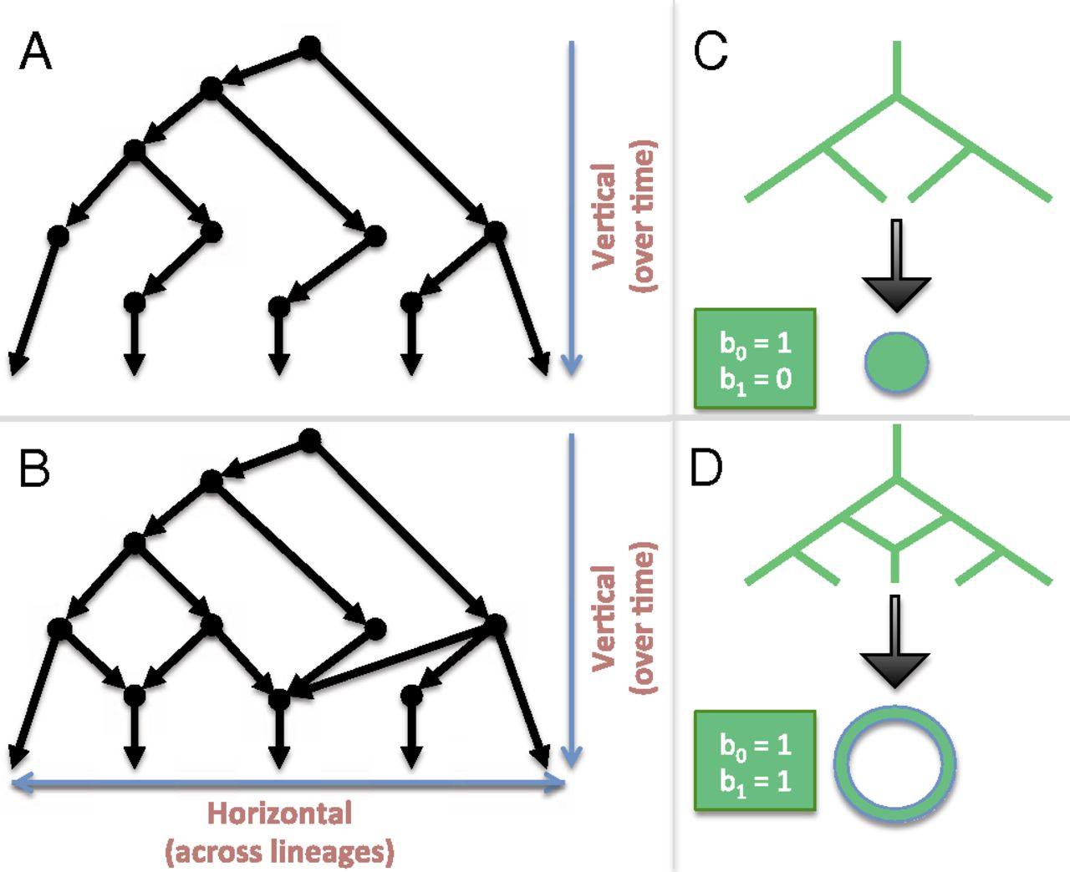
Linking algebraic topology to evolution.
Chan J M et al. PNAS 2013;110:18566-18571
©2013 by National Academy of Sciences
Notes:
Linking algebraic topology to evolution. (A) A tree depicting vertical evolution. (B) A reticulate structure capturing horizontal evolution, as well. (C) A tree can be compressed into a point. (D) The same cannot be done for a reticulate structure without destroying the hole at the center.

Slide 30
Linking algebraic topology to evolution.
Reticulation
Chan J M et al. PNAS 2013;110:18566-18571
©2013 by National Academy of Sciences
Notes:
Linking algebraic topology to evolution. (A) A tree depicting vertical evolution. (B) A reticulate structure capturing horizontal evolution, as well. (C) A tree can be compressed into a point. (D) The same cannot be done for a reticulate structure without destroying the hole at the center.

Slide 31
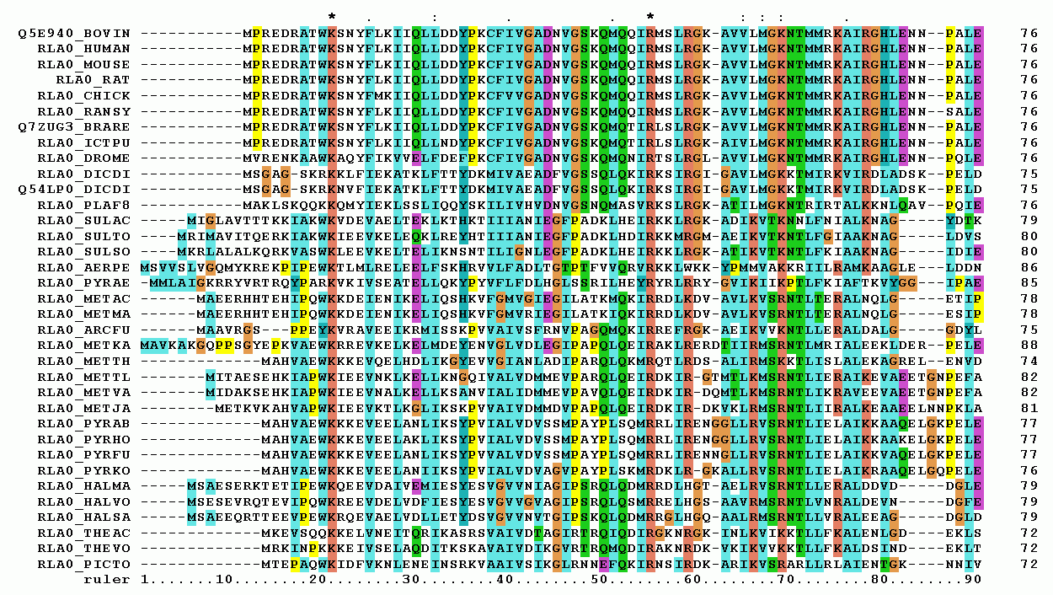
Multiple sequence alignment
http://upload.wikimedia.org/wikipedia/commons/7/79/RPLP0_90_ClustalW_aln.gif

Slide 32
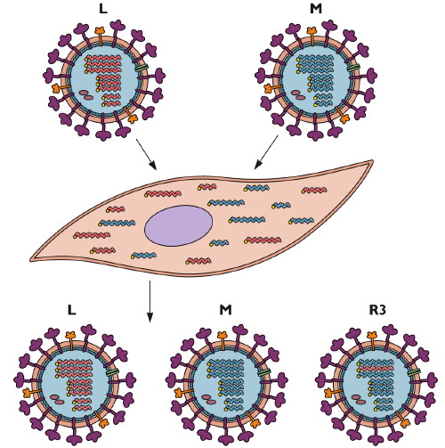
Reassortment
http://www.virology.ws/2009/06/29/reassortment-of-the-influenza-virus-genome/

Slide 33
Homologous recombination
http://en.wikipedia.org/wiki/File:HR_in_meiosis.svg

Slide 34
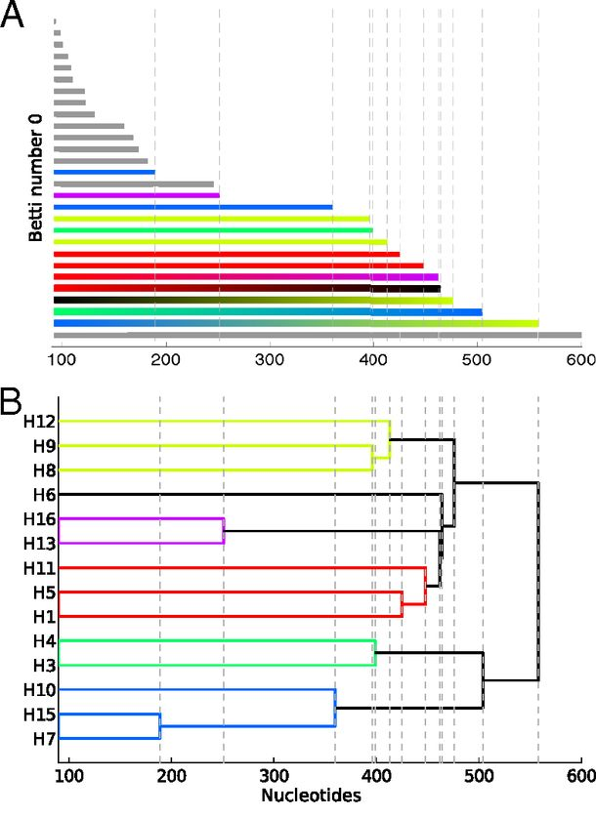
Reconstructing phylogeny from persistent homology of avian influenza HA. (A) Barcode plot in dimension 0 of all avian HA subtypes.
Influenza:
For a single segment,
no H_{k} for k > 0
no horizontal transfer
(i.e., no homologous recombination)
©2013 by National Academy of Sciences
Chan J M et al. PNAS 2013;110:18566-18571
Notes:
Reconstructing phylogeny from persistent homology of avian influenza HA. (A) Barcode plot in dimension 0 of all avian HA subtypes. Each bar represents a connected simplex of sequences given a Hamming distance of ε. When a bar ends at a given ε, it merges with another simplex. Gray bars indicate that two simplices of the same HA subtype merge together at a given ε. Solid color bars indicate that two simplices of different HA subtypes but same major clade merge together. Interpolated color bars indicate that two simplices of different major clades merge together. Colors correspond to known major clades of HA. For specific parameters, see SI Appendix, Supplementary Text. (B) Phylogeny of avian HA reconstructed from the barcode plot in A. Major clades are color-coded. (C) Neighbor-joining tree of avian HA (SI Appendix, Supplementary Text).

Slide 35
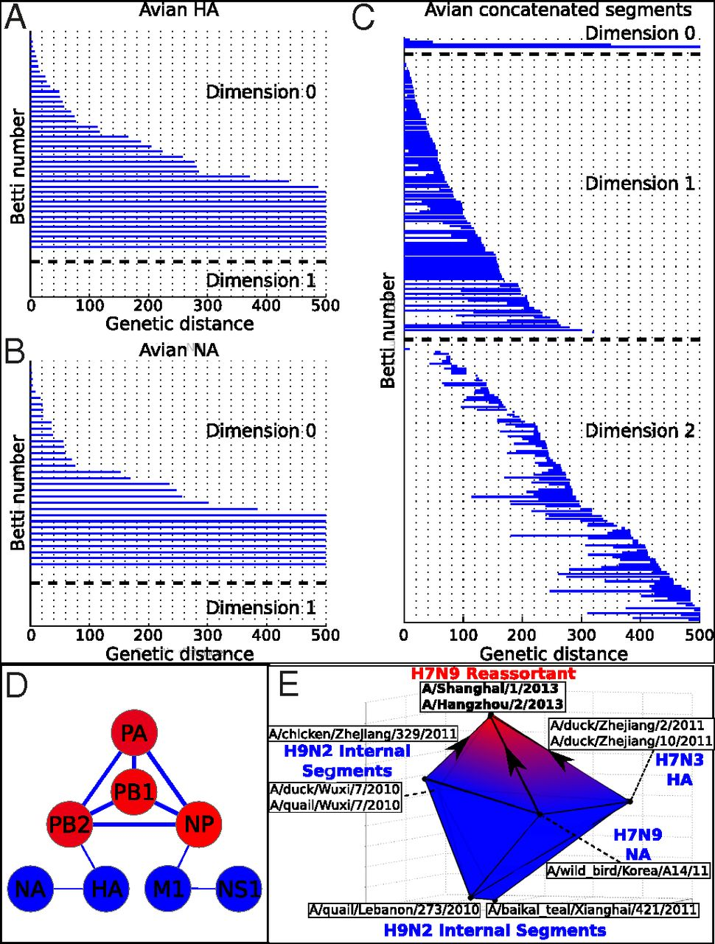
Persistent homology of reassortment in avian influenza.
For multiple segments,
non-trivial H_{k}
k = 1, 2.
Thus
horizontal transfer via reassortment
but not homologous recombination
www.virology.ws/2009/06/29/reassortment-of-the-influenza-virus-genome/
Chan J M et al. PNAS 2013;110:18566-18571
©2013 by National Academy of Sciences
Notes:
Persistent homology of reassortment in avian influenza. Analysis of (A) HA and (B) NA reveal no significant one-dimensional topological structure. (C) Concatenated segments reveal rich 1D and 2D topology, indicating reassortment. For specific parameters, see SI Appendix, Supplementary Text. (D) Network representing the reassortment pattern of avian influenza deduced from high-dimensional topology. Line width is determined by the probability that two segments reassort together. Node color ranges from blue to red, correlating with the sum of connected line weights for a given node. For specific parameters, see SI Appendix, Supplementary Text. (E) b₂ polytope representing the triple reassortment of H7N9 avian influenza. Concatenated genomic sequences forming the polytope were transformed into 3D space using PCoA (SI Appendix, Supplementary Text). Two-dimensional barcoding was performed using Vietoris–Rips complex and a maximum scale ε of 4,000 nucleotides.

Slide 36
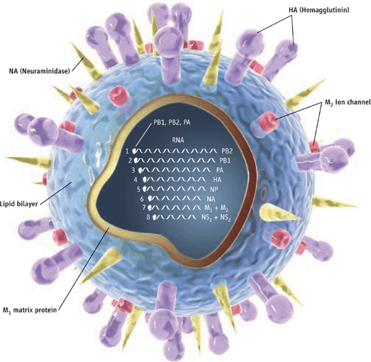
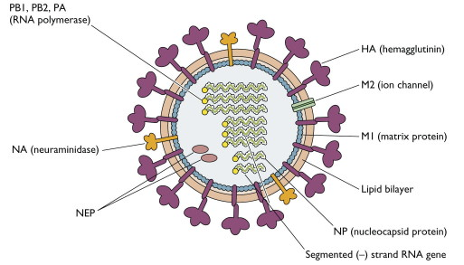
http://www.pnas.org/content/110/46/18566.full
http://www.sciencemag.org/content/312/5772/380.full
http://www.virology.ws/2009/04/30/structure-of-influenza-virus/
Notes:
Persistent homology of reassortment in avian influenza. Analysis of (A) HA and (B) NA reveal no significant one-dimensional topological structure. (C) Concatenated segments reveal rich 1D and 2D topology, indicating reassortment. For specific parameters, see SI Appendix, Supplementary Text. (D) Network representing the reassortment pattern of avian influenza deduced from high-dimensional topology. Line width is determined by the probability that two segments reassort together. Node color ranges from blue to red, correlating with the sum of connected line weights for a given node. For specific parameters, see SI Appendix, Supplementary Text. (E) b₂ polytope representing the triple reassortment of H7N9 avian influenza. Concatenated genomic sequences forming the polytope were transformed into 3D space using PCoA (SI Appendix, Supplementary Text). Two-dimensional barcoding was performed using Vietoris–Rips complex and a maximum scale ε of 4,000 nucleotides.

Slide 37
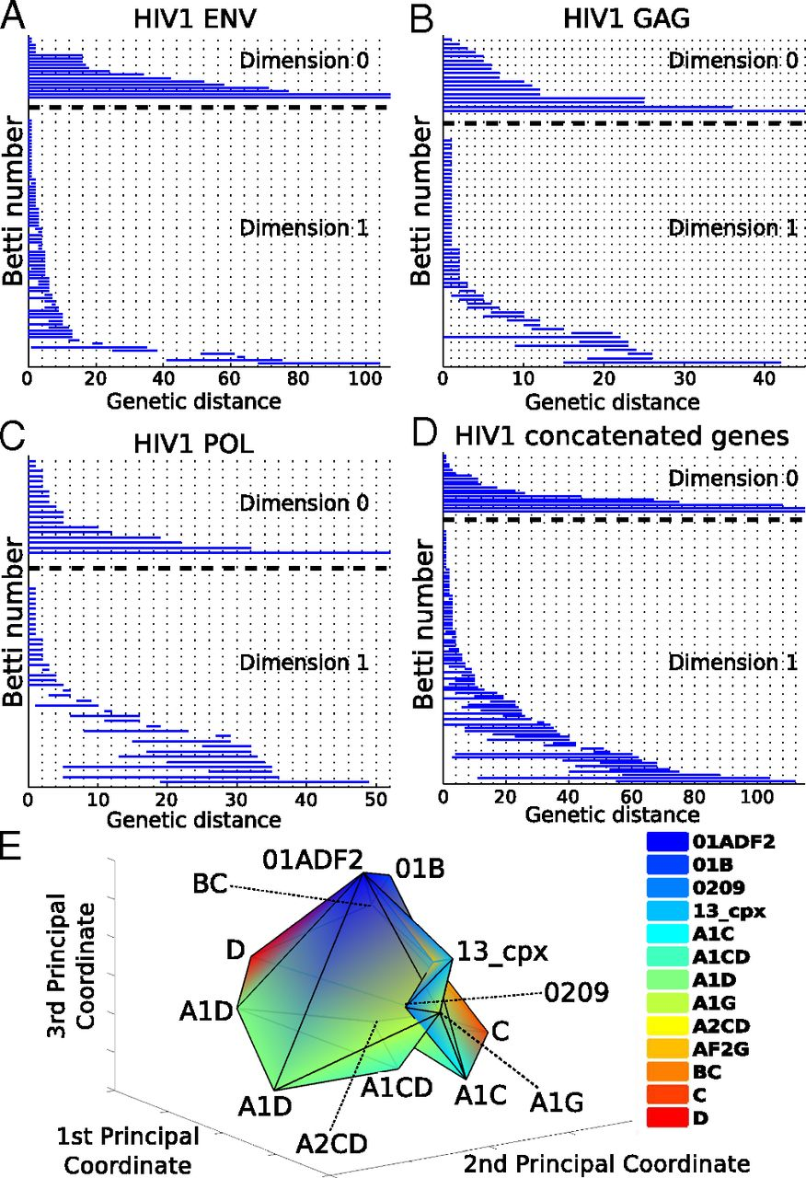
Barcoding plots of HIV-1 reveal evidence of recombination in (A) env, (B), gag, (C) pol, and (D) the concatenated sequences of all three genes.
HIV –
single segment
(so no reassortment)
Non-trivial H_{k}
k = 1, 2.
Thus horizontal transfer via homologous recombination.
©2013 by National Academy of Sciences
Chan J M et al. PNAS 2013;110:18566-18571
Notes:
Barcoding plots of HIV-1 reveal evidence of recombination in (A) env, (B), gag, (C) pol, and (D) the concatenated sequences of all three genes. One-dimensional topology present for alignments of individual genes as well as the concatenated sequences suggests recombination. (E) b₂ polytope representing a complex recombination event with multiple parental strains. Sequences of the [G4] generator of concatenated HIV-1 gag, pol, and env were transformed into 3D space using PCoA (SI Appendix, Supplementary Text) of the Nei–Tamura pairwise genetic distances. Two-simplices from the [G4] generator defined a polytope whose cavity represents a complex recombination. Each vertex of the polytope corresponds to a sequence that is color-coded by HIV-1 subtype. For specific parameters, see SI Appendix, Supplementary Text.

Slide 38
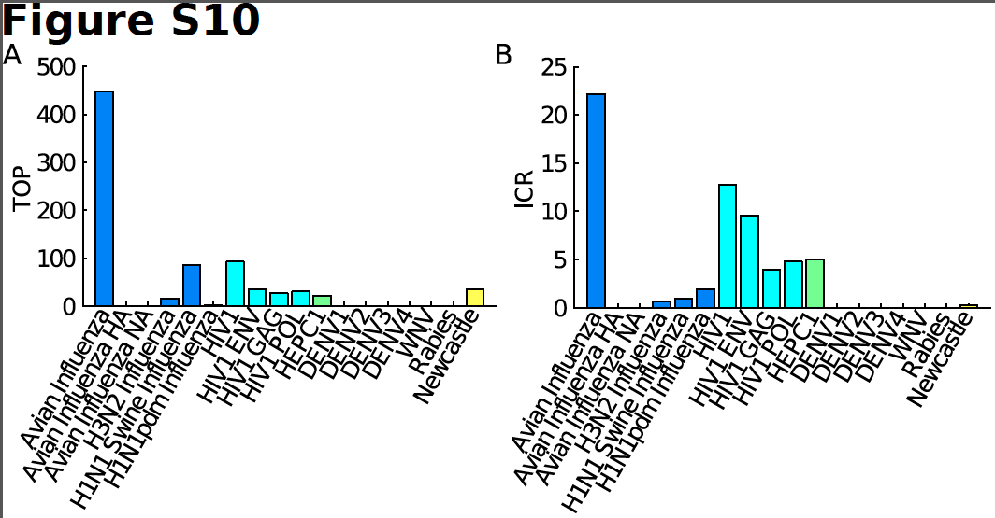
TOP = Topological obstruction
= maximum barcode length in non-zero dimensions
TOP ≠ 0 ➔ no additive distance tree
TOP is stable

Slide 39
ICR = irreducible cycle rate
= average number of the one-dimensional
irreducible cycles per unit of time
Simulations show that ICR is proportional to and provides a lower bound for recombination/reassortment rate

Slide 40
Persistent homology Viral evolution
Filtration value ε Genetic distance
(evolutionary scale)
β₀ at filtration value ε Number of clusters at scale ε
Generators of H₀ A representative element of
the cluster
Hierarchical Hierarchical clustering
relationship among
H₀ generators
β₁ Number of reticulate events
(recombination and
reassortment)

Slide 41
Persistent homology Viral evolution
Generators of H₁ Reticulate events
Generators of H₂ Complex horizontal
genomic exchange
H_{k} ≠ 0 for some k > 0 No phylogenetic tree
representation
Number of Lower bound on rate of
higher-dimensional reticulate events
generators over time
(irreducible cycle rate)

