Slide 1
http://homepage.divms.uiowa.edu/~idarcy/COURSES/100/FALL20/3600.html
Quiz 2 covers section 2.3 as well as videos from week 3.
Open tomorrow (?) and due Monday BEFORE class.
The quiz is worth 20 points.
You will need to upload the answer to one of the questions to ICON.
If you use any resources for any of the questions, you must cite that source in the file you upload to ICON.

Slide 12
Proving Convergence
https://tutorial.math.lamar.edu/Classes/CalcII/RatioTest.aspx

Slide 13
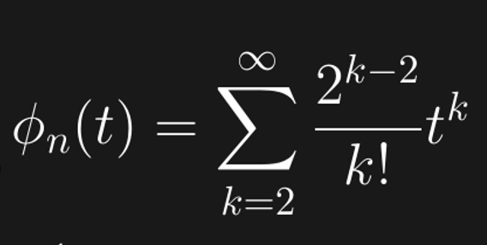
Prove converges.

