Slide 1
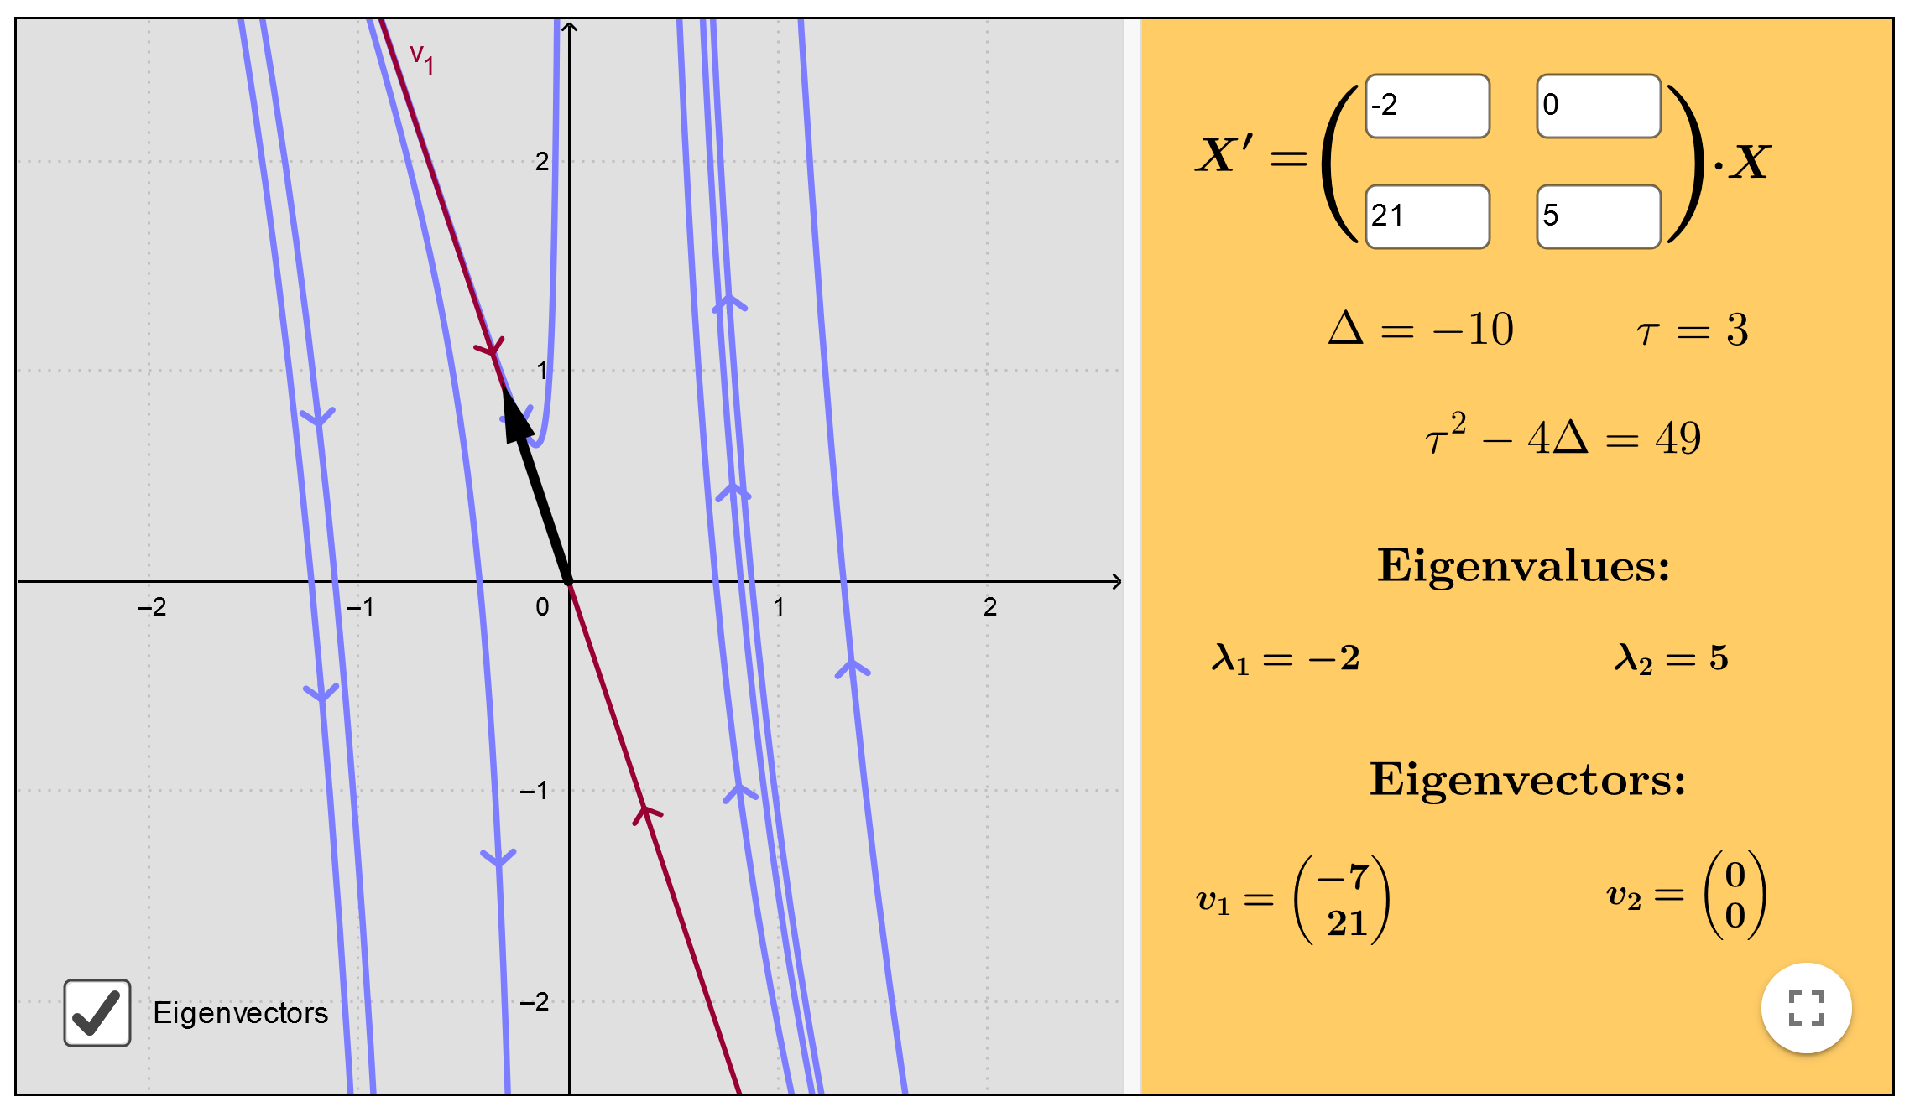
https://www.geogebra.org/m/fYxXgbsU

Slide 2
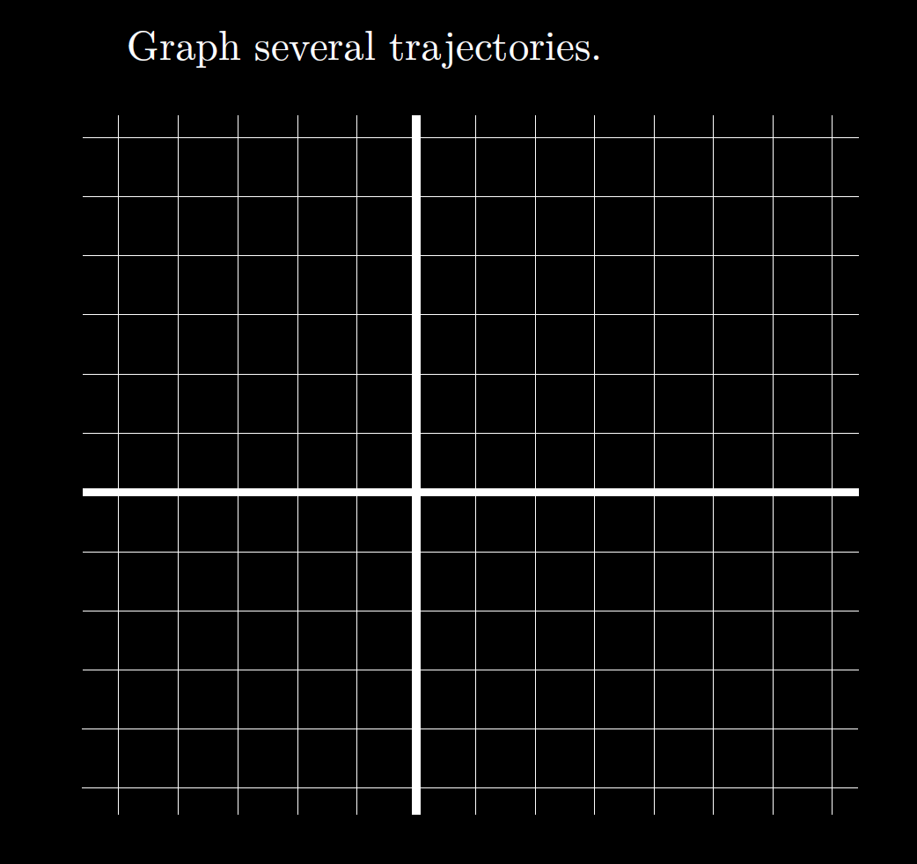

Slide 3
SetColor(text1, "#80FF0000")
https://www.geogebra.org/3d
(t, -e^(-2t), 3*e^(-2t))
(t, -10e^(-2t), 30*e^(-2t))
(t, e^(-2t), -3*e^(-2t))
(t, 0, e^(-5t)) (t, 0, -e^(-5t))
(t, -e^(-2t), 3*e^(-2t) + e^(-5t) )
(t, -e^(-2t), 3*e^(-2t) + e^(5t) )

Slide 4
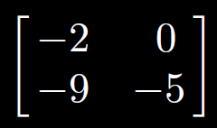

Slide 8
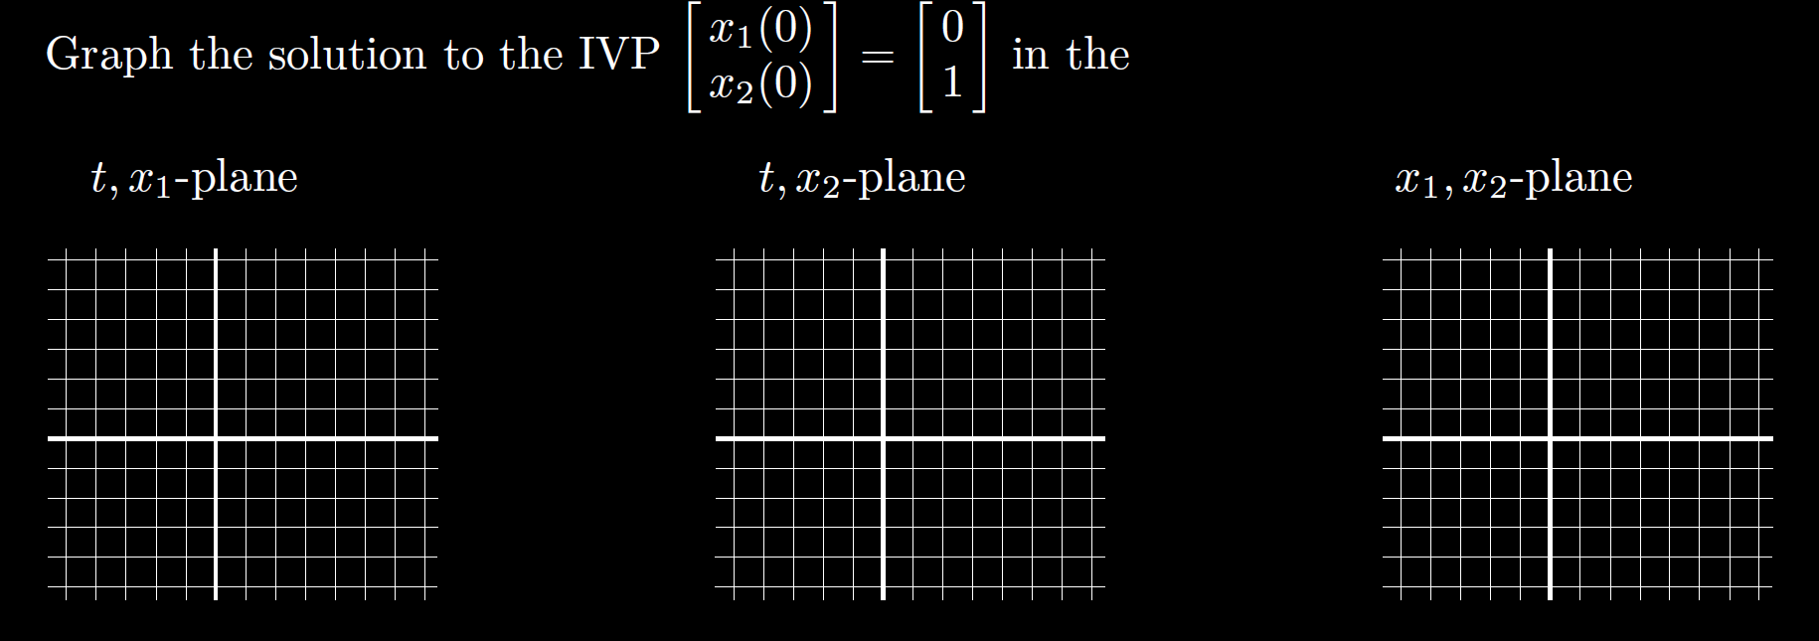

Slide 13
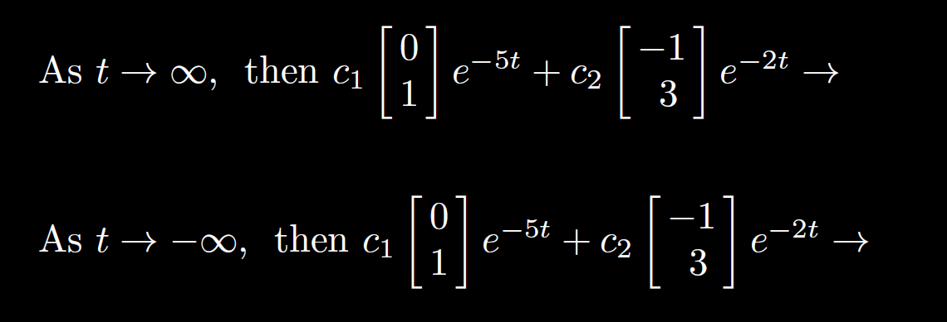

Slide 15
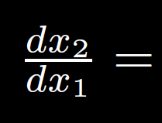

Slide 18
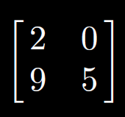

Slide 21
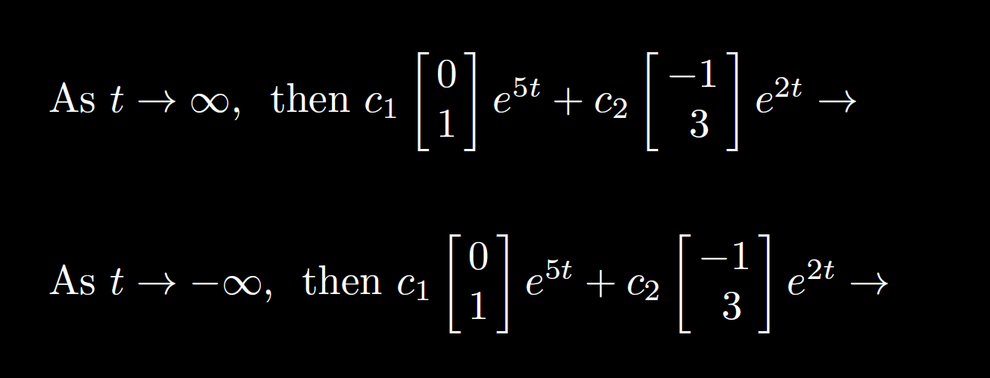

Slide 27
