Slide 5
Graph

Slide 6
Graph
Slope field:

Slide 7
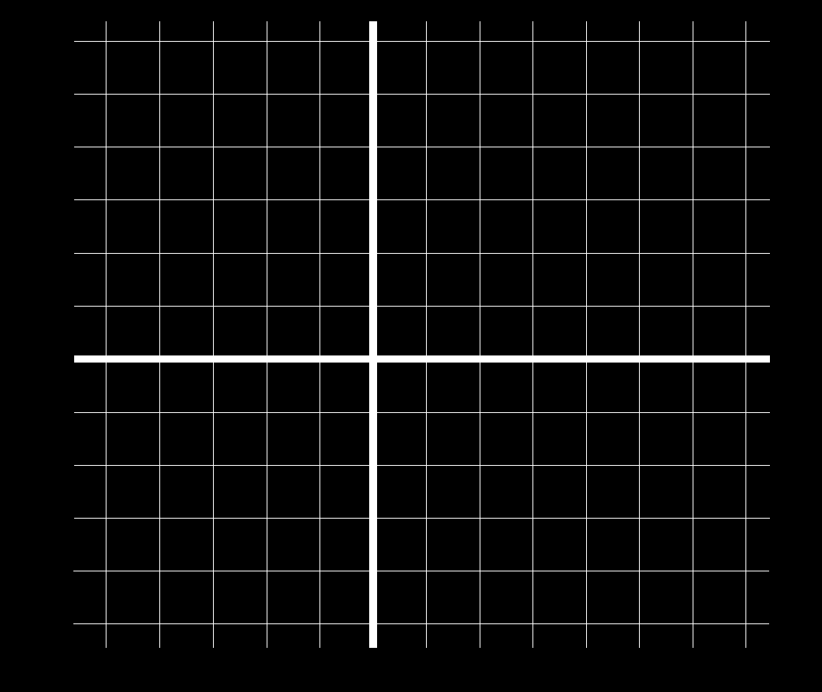

Slide 8
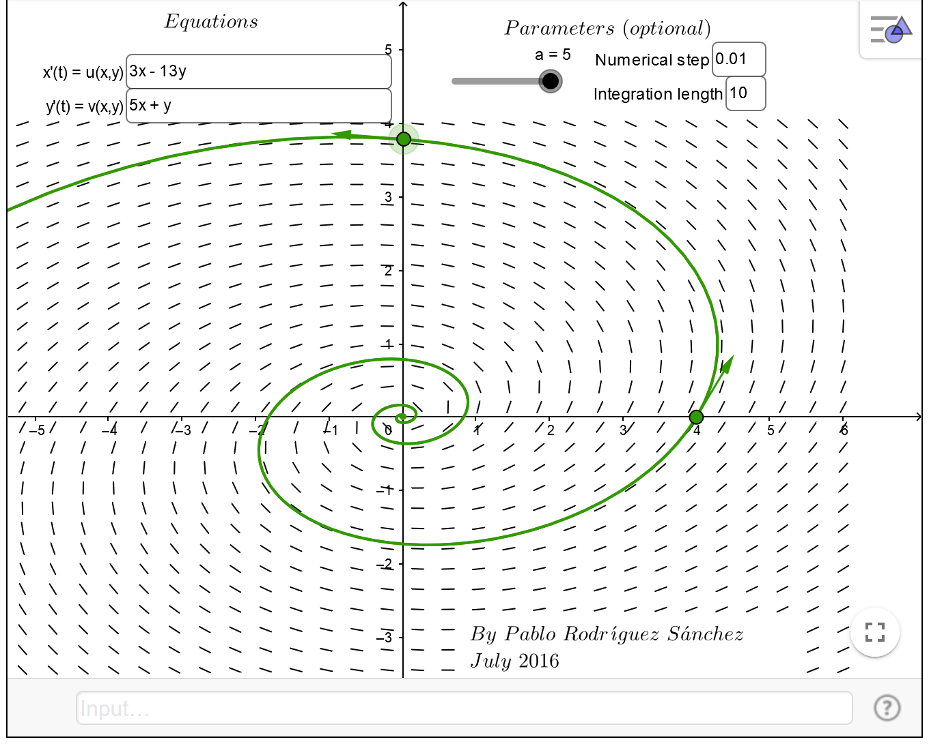
https://www.geogebra.org/m/abg8NJzF

Slide 9
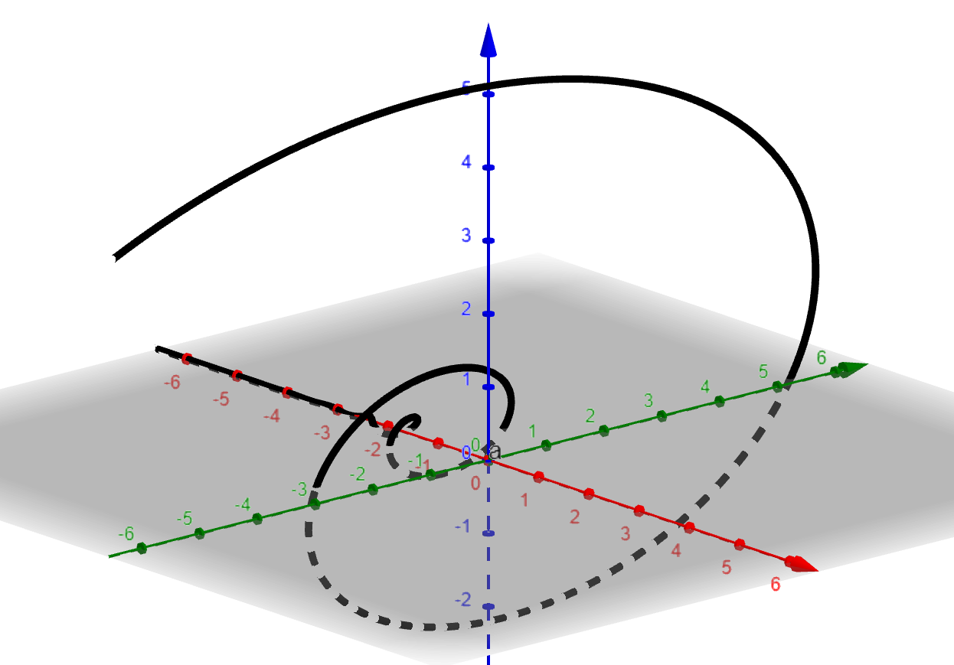
https://www.geogebra.org/3d

Slide 10
https://www.geogebra.org/m/abg8NJzF
https://www.geogebra.org/3d
(t,ℯ^(2 t) (cos(8 t)-8 sin(8 t)),ℯ^(2 t)*5 cos(8 t))

Slide 11
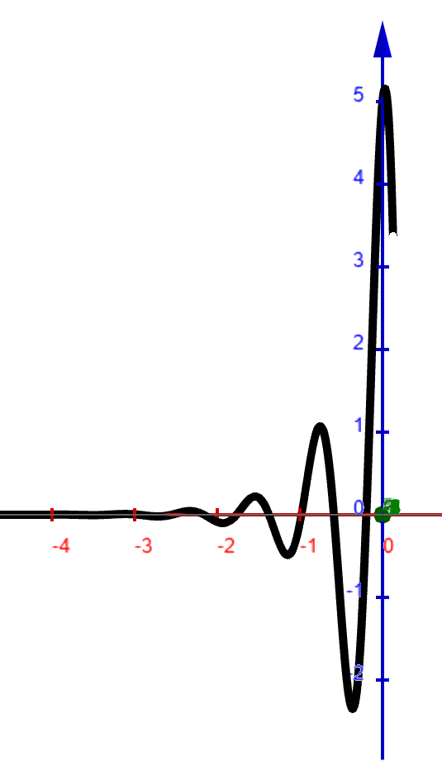
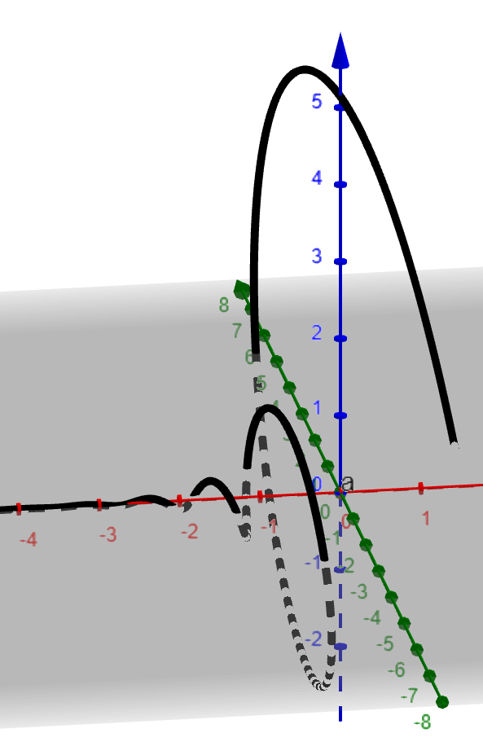

Slide 12
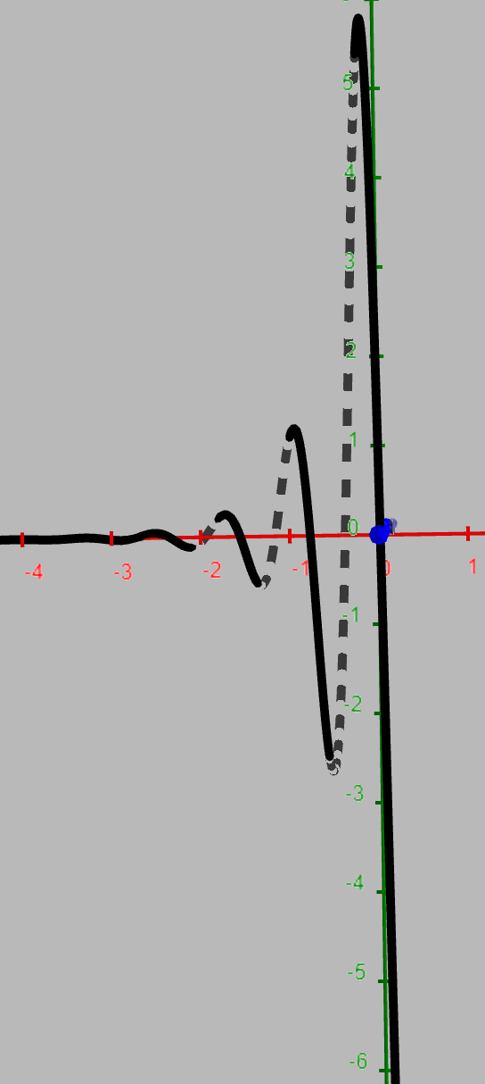
(t,ℯ^(2 t) (cos(8 t)-8 sin(8 t)),ℯ^(2 t)*5 cos(8 t))

Slide 13
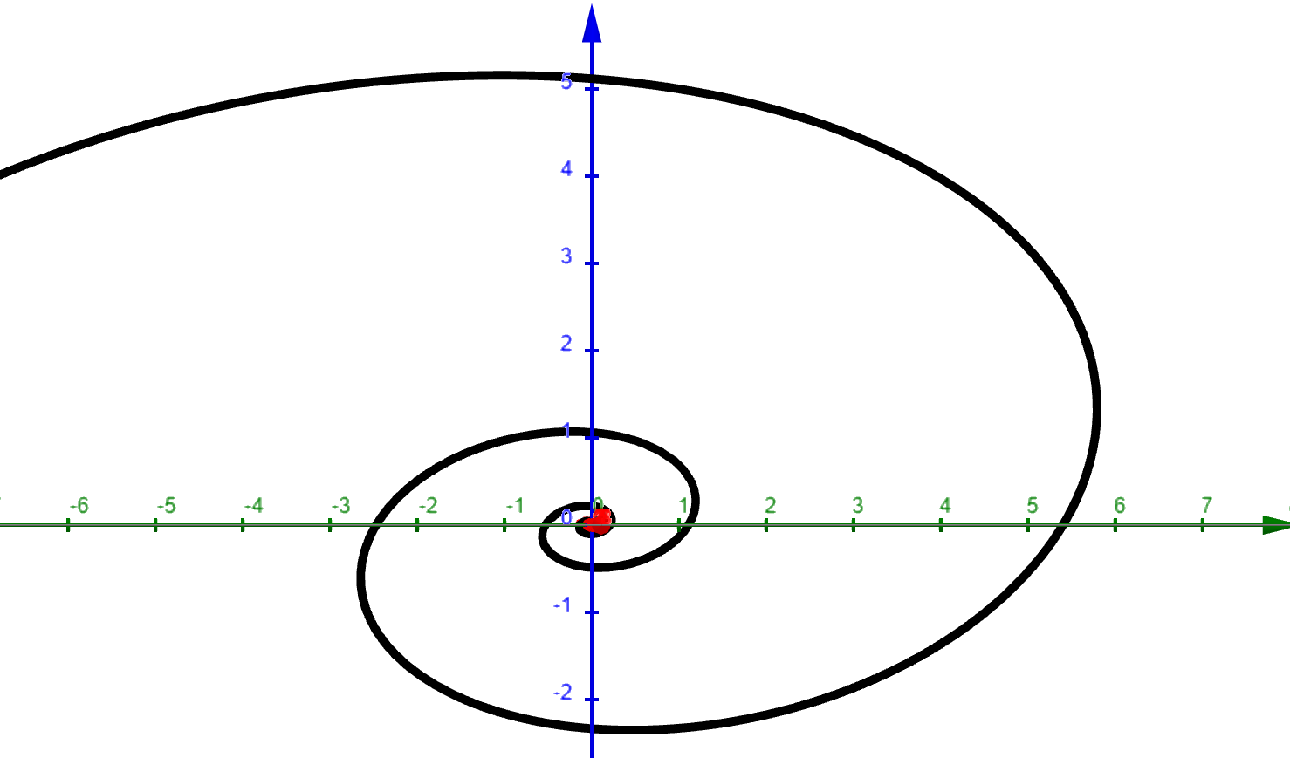
Positive t axis comes out of plane toward you.

Slide 14
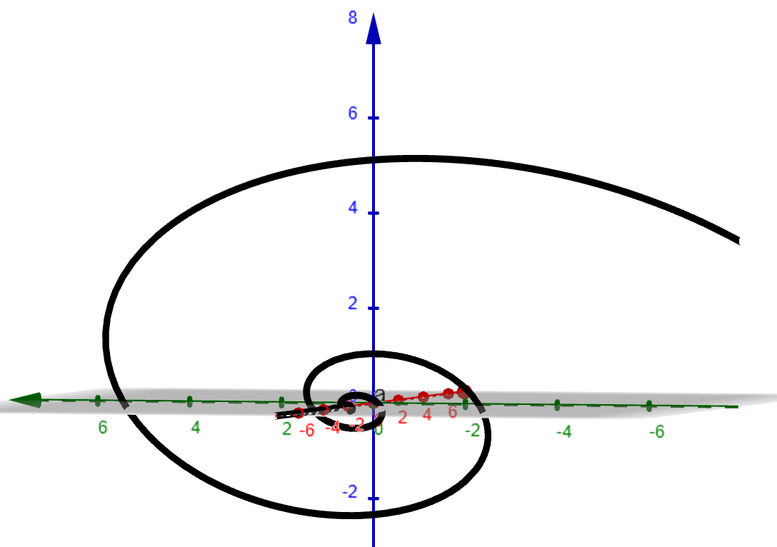
Negative t axis comes out of plane toward you.

Slide 15
https://www.geogebra.org/m/abg8NJzF

Slide 20
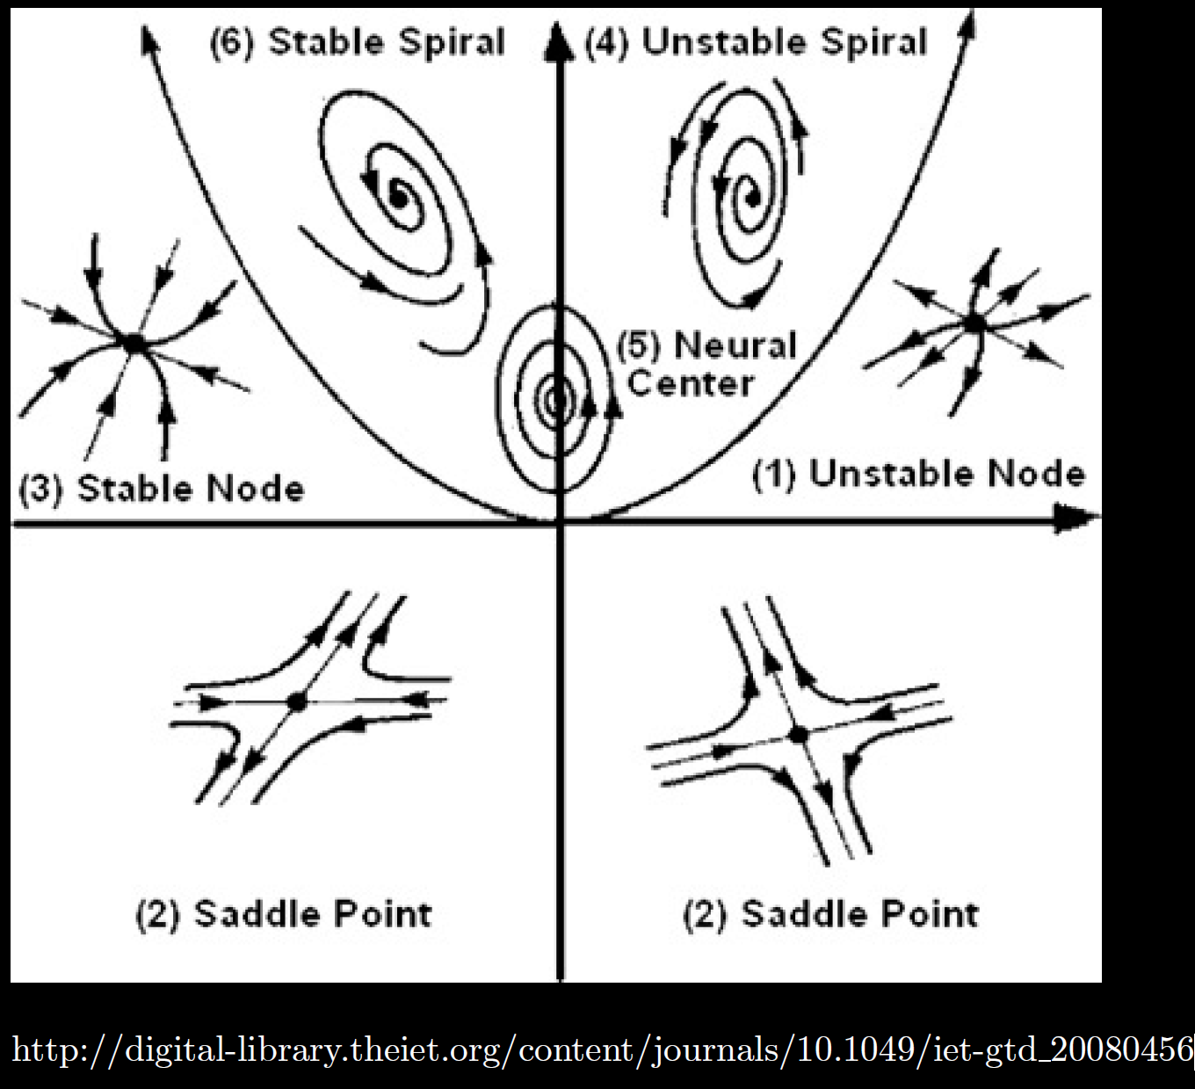

Slide 21
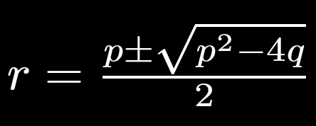

Slide 23
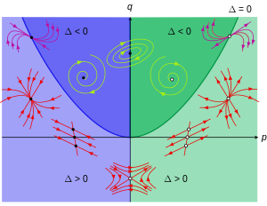
https://en.wikipedia.org/wiki/Phase_plane

Slide 26
