Slide 1
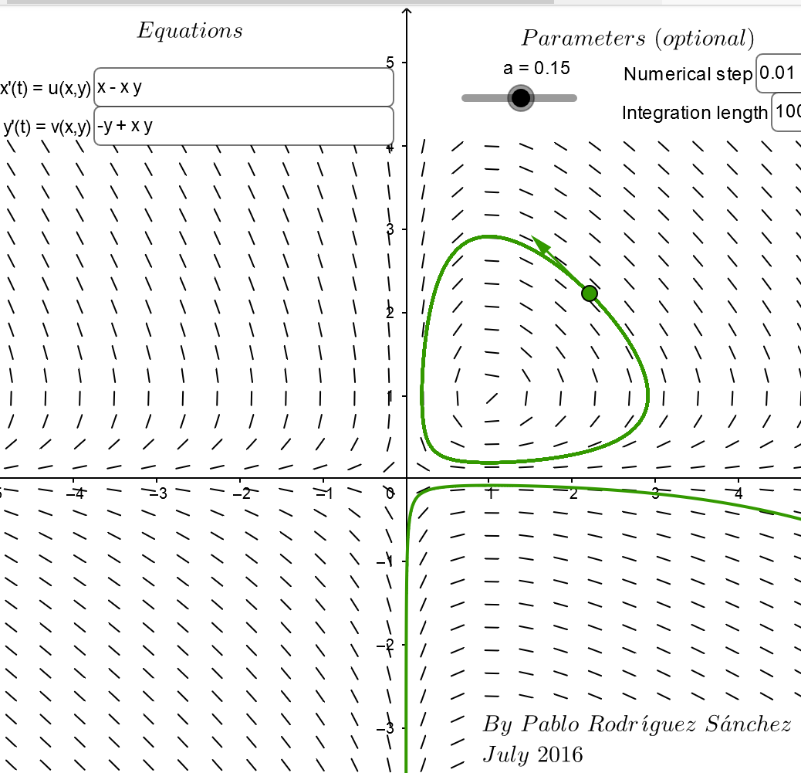
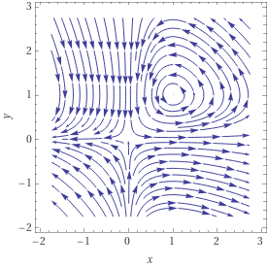
https://www.geogebra.org/m/abg8NJzF
https://www.wolframalpha.com/input/?i=streamplot+%7B+x+-+xy%2C++-y+%2B+xy%7D

Slide 2
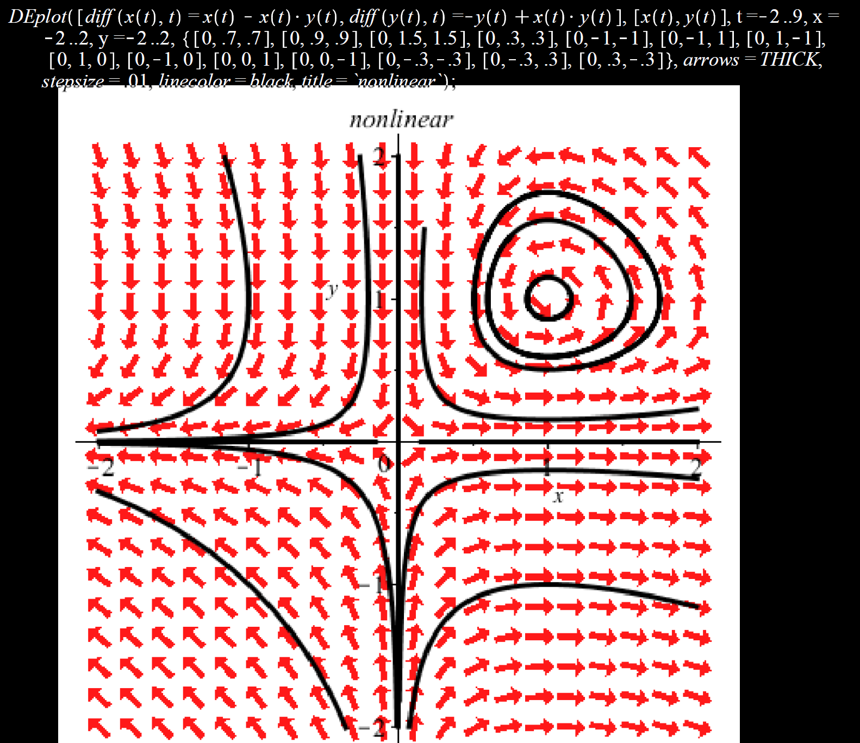
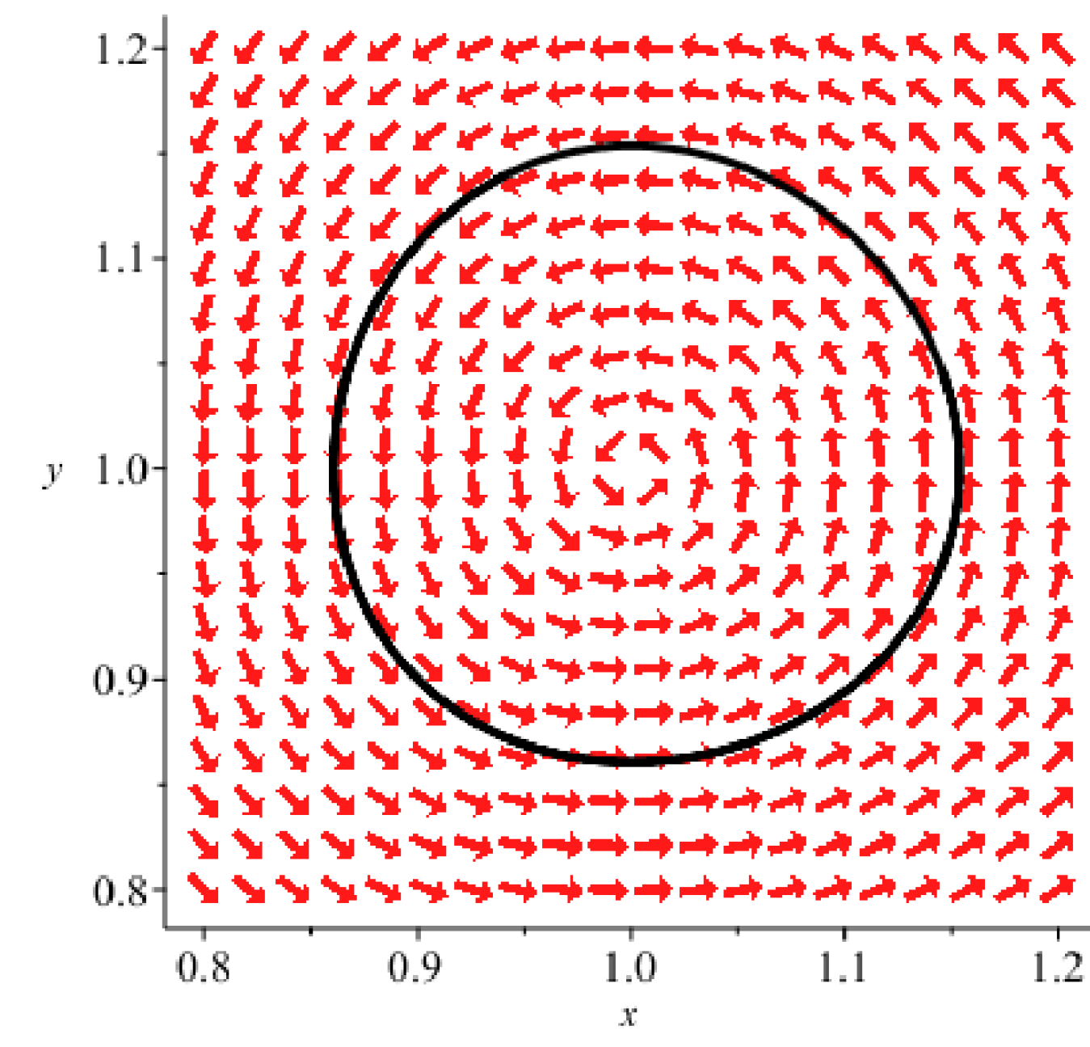
Locally can be approximated by a stable center
Locally can be approximated by an unstable saddle

Slide 7
We will determine stability of these critical points in 9.3
via linear approximations.
Can also determine graphically
(but be careful):

Slide 11
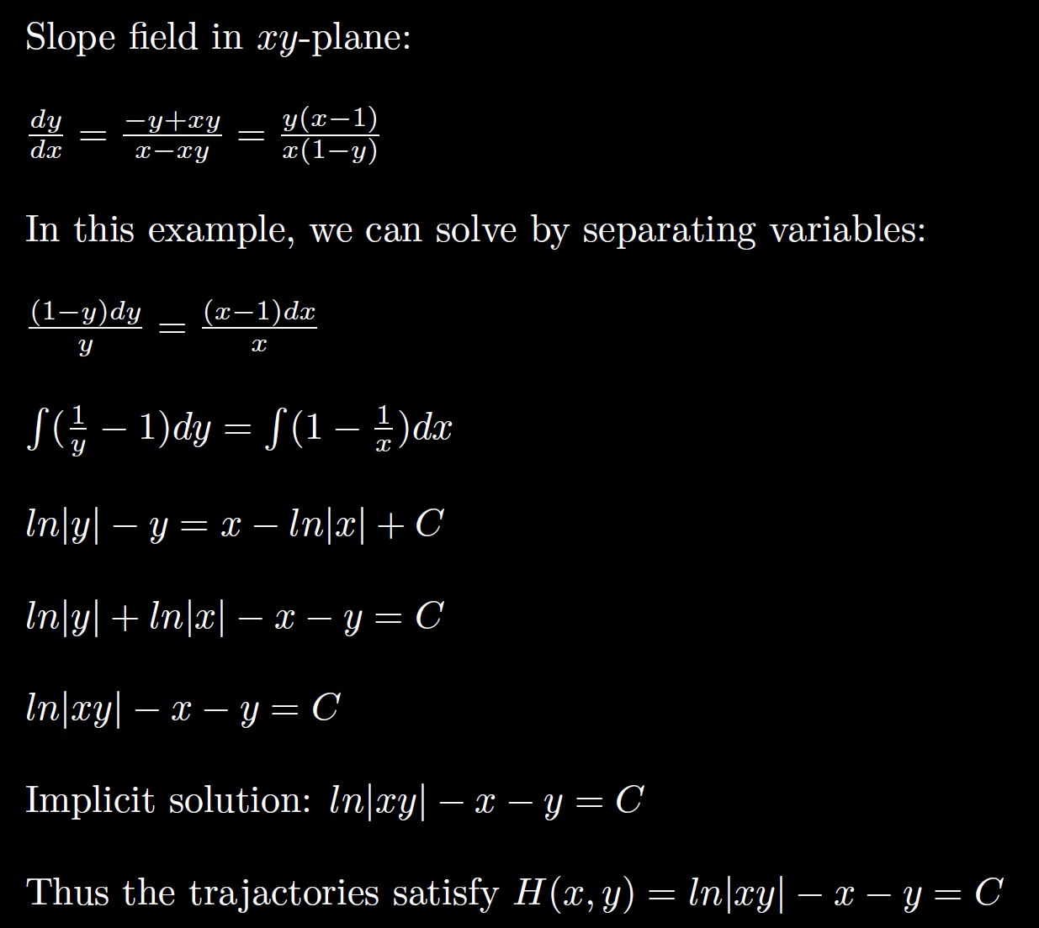
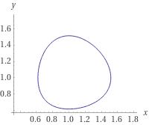
ln|xy| - x - y = -2.1

Slide 12
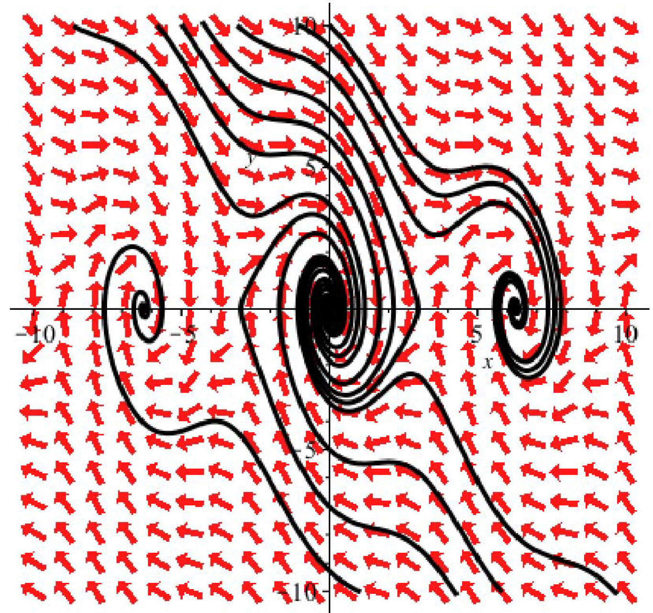

Slide 13
Basin of attraction – region of asymptotic stability of a critical point
Separatrix = trajectory that bounds basin of attaction

Slide 15
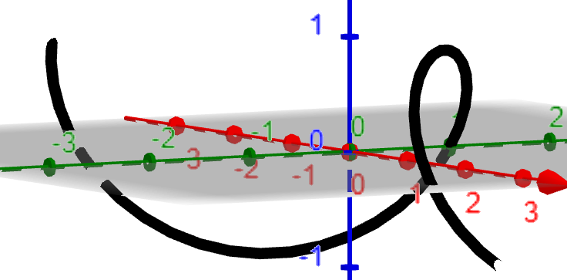
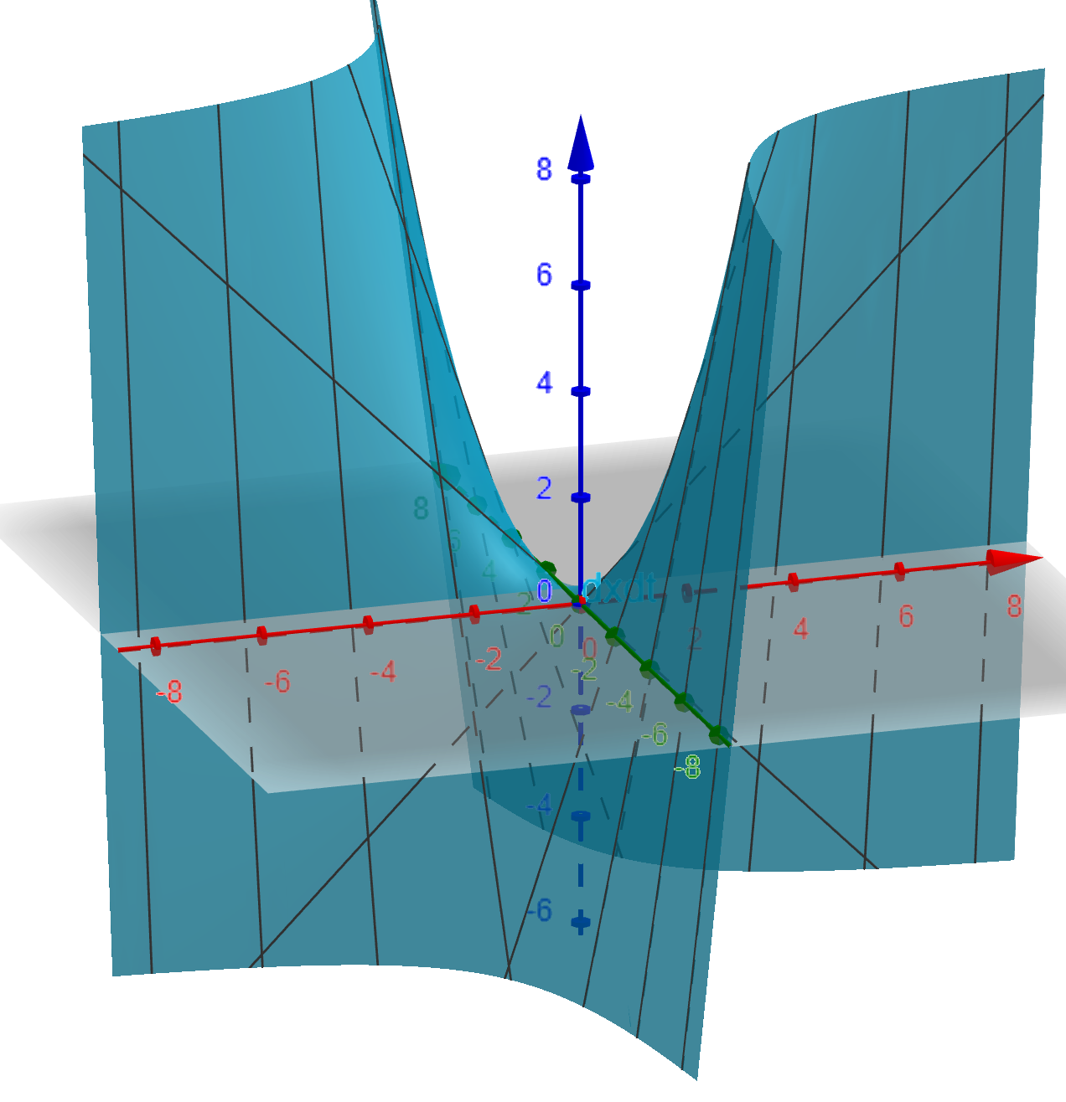
x
y
t
t

Slide 24
After translating critical point to origin:
Thus at the critical point , the system of DEs
is approximated by the translated linear system:

Slide 25
After translating critical point to origin:

Slide 31
