Slide 2
Problem session Thursday at 7pm (will send zoom link Thursday evening).
Exam 3 Friday over ch 7, 9, and 5.2.
Currently written part is about 50% with remaining part
True/False
Multiple Choice (choose the 1 best answer)
Multiple answer (choose the n best answers)
+5 points for every correct answer,
-5 points for every wrong answer.

Slide 3
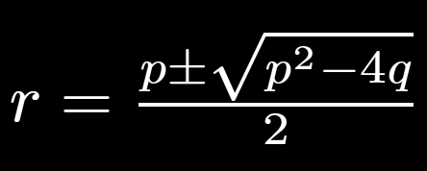
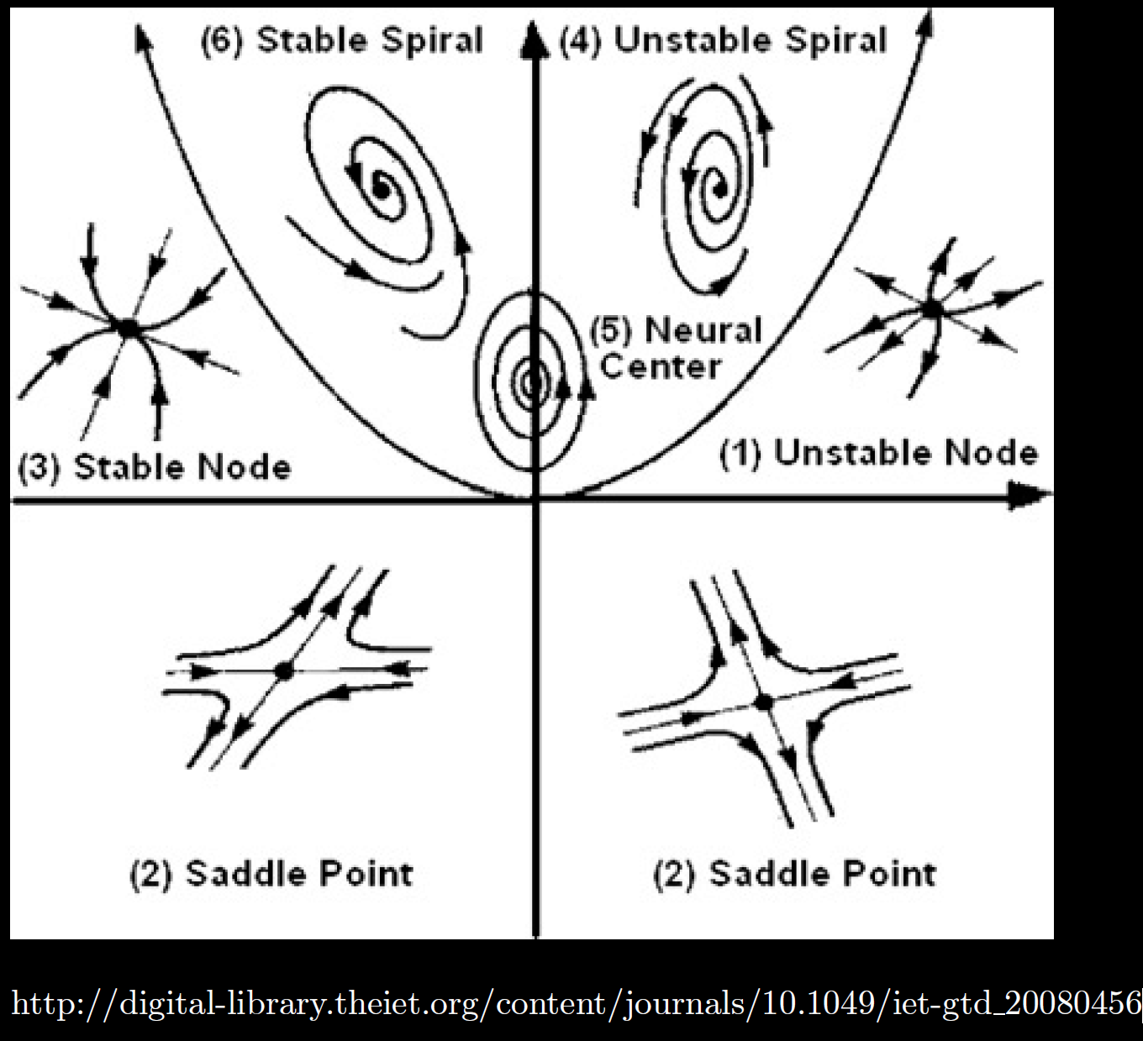

Slide 4
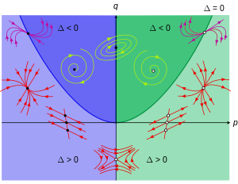
https://en.wikipedia.org/wiki/Phase_plane

Slide 5
After translating critical point to origin:

Slide 6
Algebraic questions
Can be similar to graphical, but given equations instead. May need to show work.
Ex: $x’ = 10x − 5xy, y’ = 3y + xy − 3y^{2}$
(Or linear).
http://howellkb.uah.edu/DEtext/Additional_Chapters/Part6/NonLinSys1.pdf

Slide 7
Ex: $x’ = 10x − 5xy, y’ = 3y + xy − 3y^{2}$

Slide 8
Ex: $x’ = 10x − 5xy, y’ = 3y + xy − 3y^{2}$

Slide 9
Ex: $x’ = 10x − 5xy, y’ = 3y + xy − 3y^{2}$

Slide 10
Ex: $x’ = 10x − 5xy, y’ = 3y + xy − 3y^{2}$

Slide 11
Ex: $x’ = 10x − 5xy, y’ = 3y + xy − 3y^{2}$

Slide 12
Ex: $x’ = 10x − 5xy, y’ = 3y + xy − 3y^{2}$

Slide 13
Ex: $x’ = 10x − 5xy, y’ = 3y + xy − 3y^{2}$

Slide 16
Graph
Slope field:

Slide 17
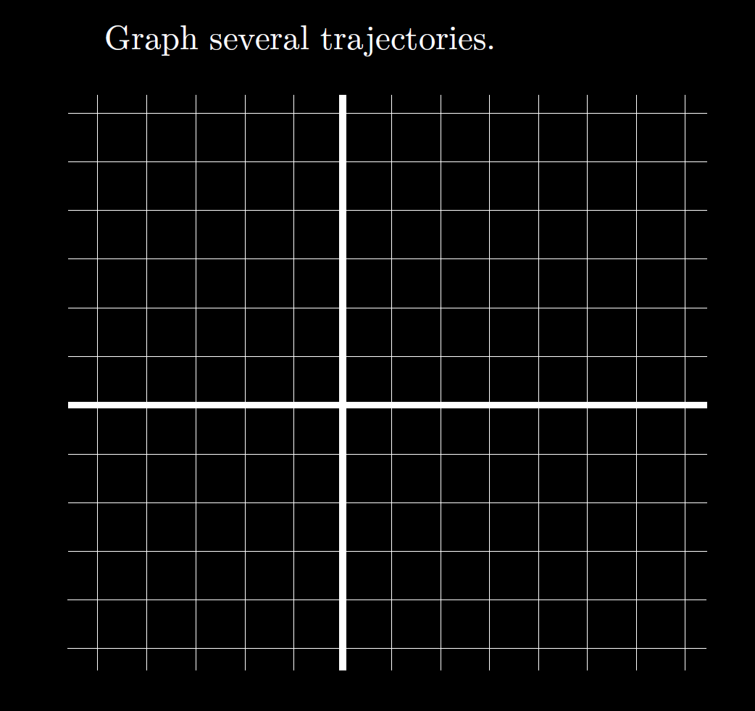

Slide 19
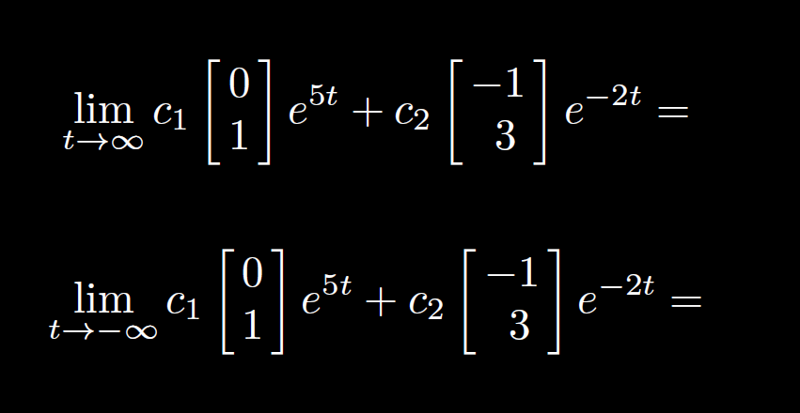
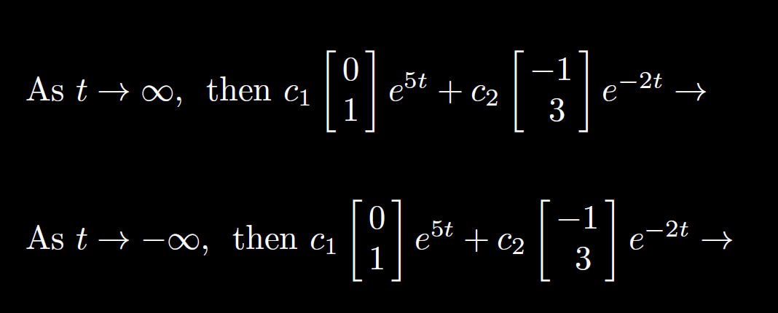

Slide 20
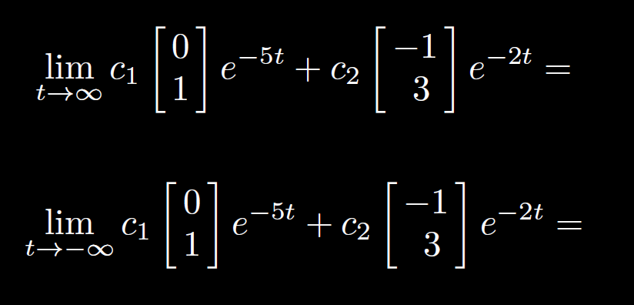
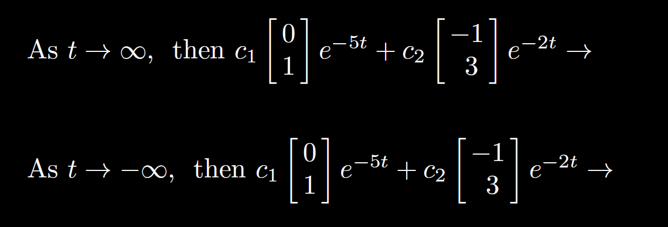

Slide 21
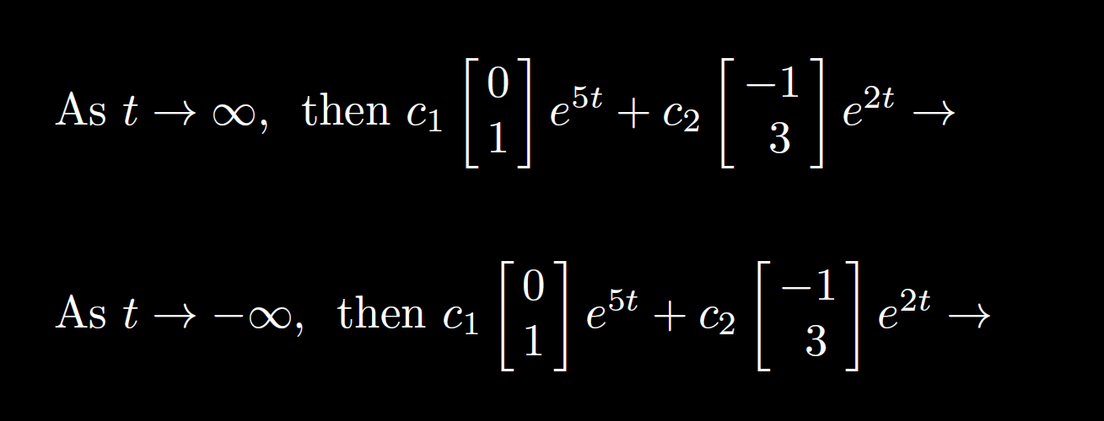

Slide 22
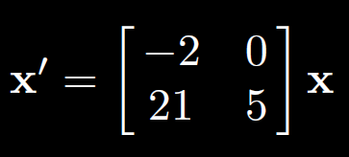
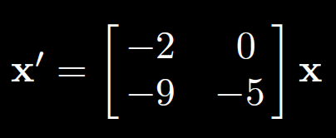
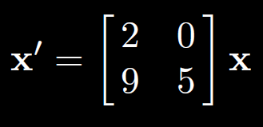

Slide 23
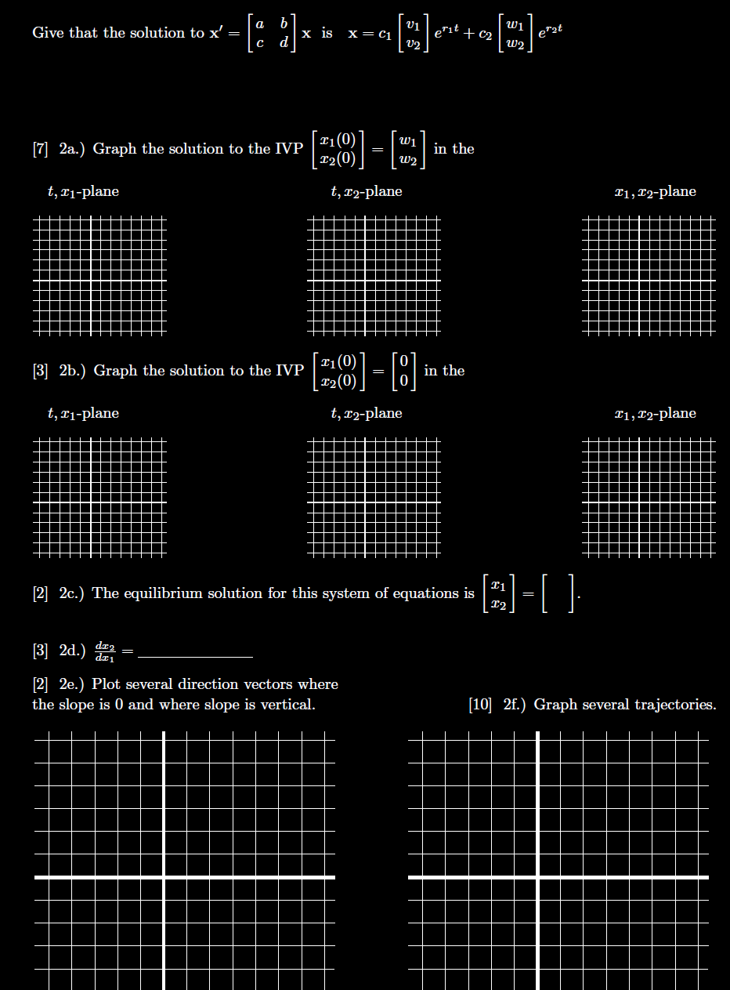

Slide 26
7.8: Repeated root case
2x2 system of equations: Need 2 linearly independent solutions

Slide 27
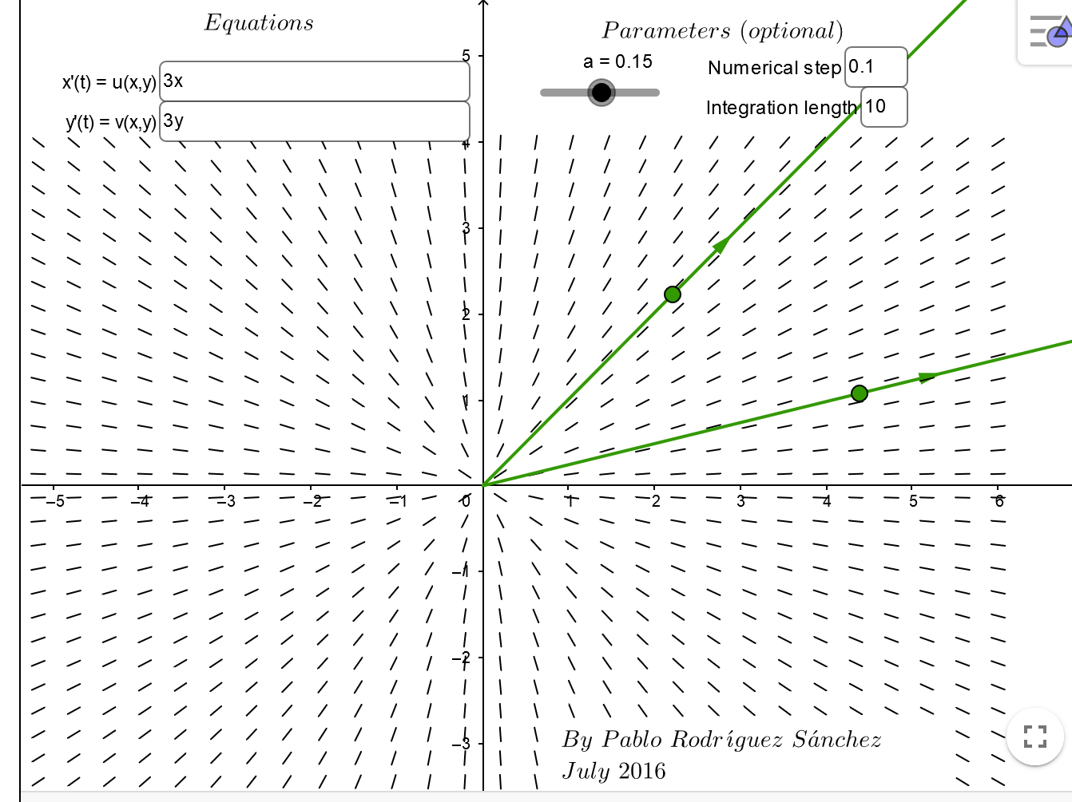
https://www.geogebra.org/m/abg8NJzF

Slide 28
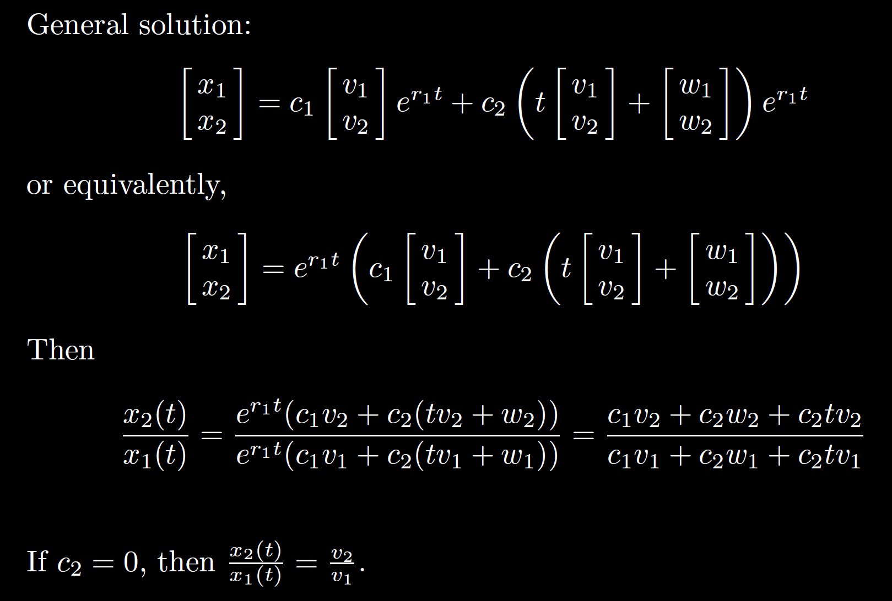

Slide 30
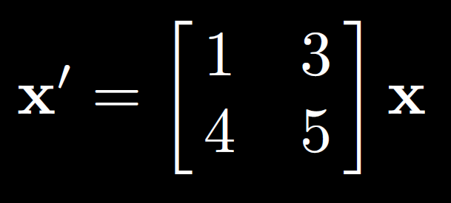
7.7:

Slide 32
