Slide 1
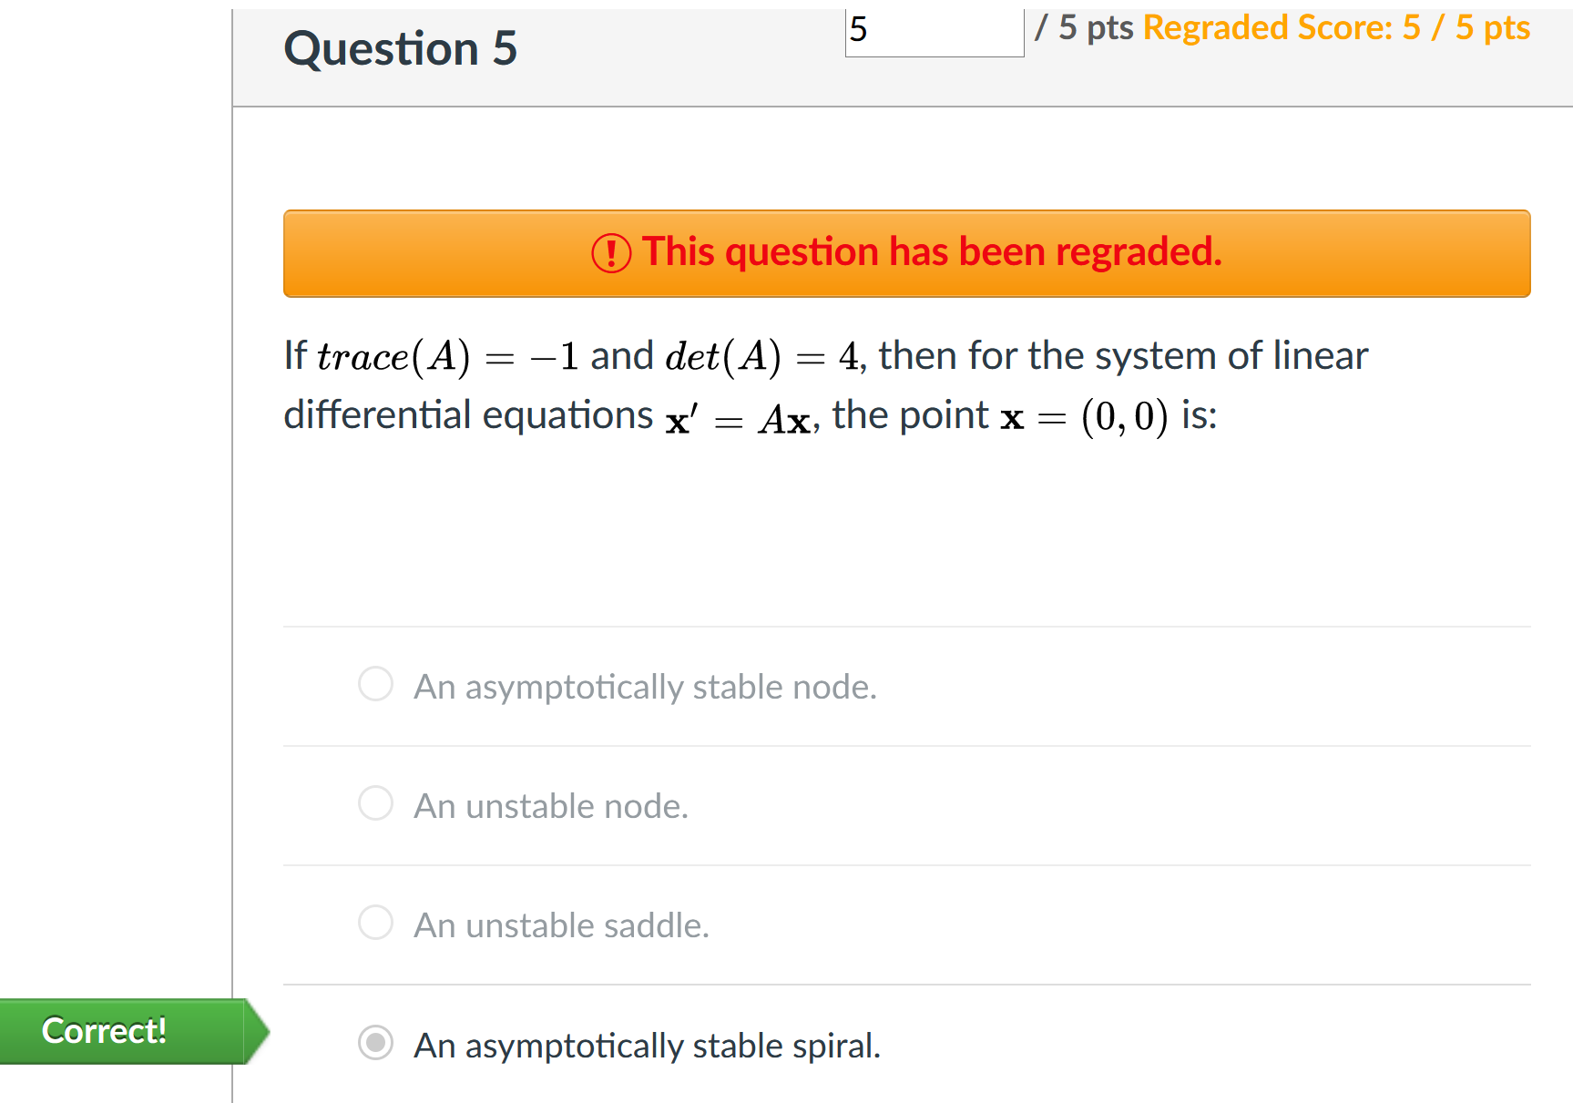
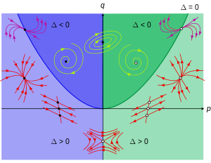
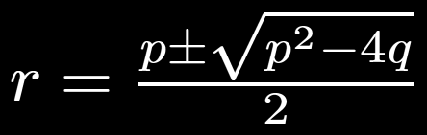

Slide 2
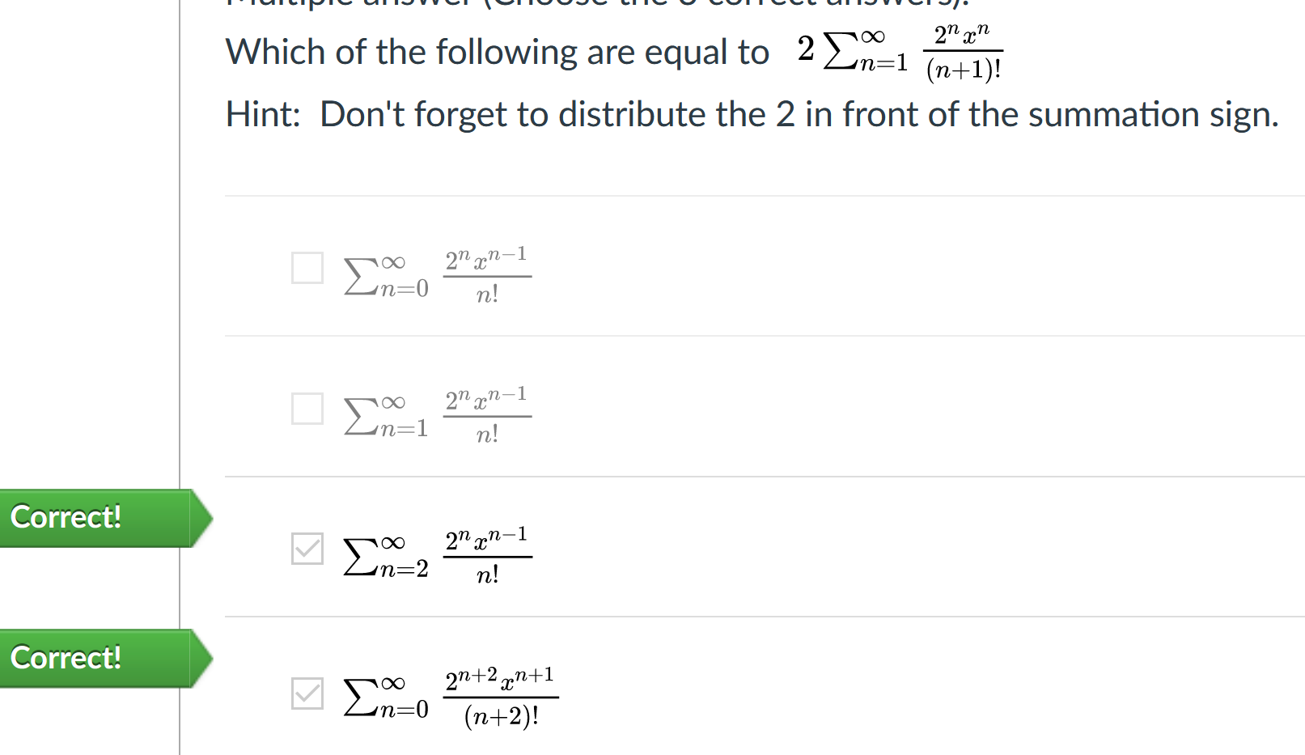

Slide 5
FYI: If wish to approximate solution near x₀ = p, then translate equation (let u = x-p), solve, then translate back to avoid needing to multiply out
p

