Slide 1
What is one of the most important concepts that we have covered? Enter your answer(s)
in the chat box.
Poll to be taken near end of class: What time(s) do you prefer for a Tuesday problem session?
Exam 2 will be similar to quiz 2, but timed (90 minutes).
Exam will include multiple choice as well as a written part that you should upload to ICON
You should also upload your citations (either with the problem or separately).
You can start anytime between 1:30pm and 2:30pm.
You have 90 minutes.
You can use the chat to text me questions anytime during the exam.
I will post messages to slide if there are multiple similar questions.
Do NOT log off until I have checked your upload.
11am, 12:30pm, 4:30pm, 6pm

Slide 2
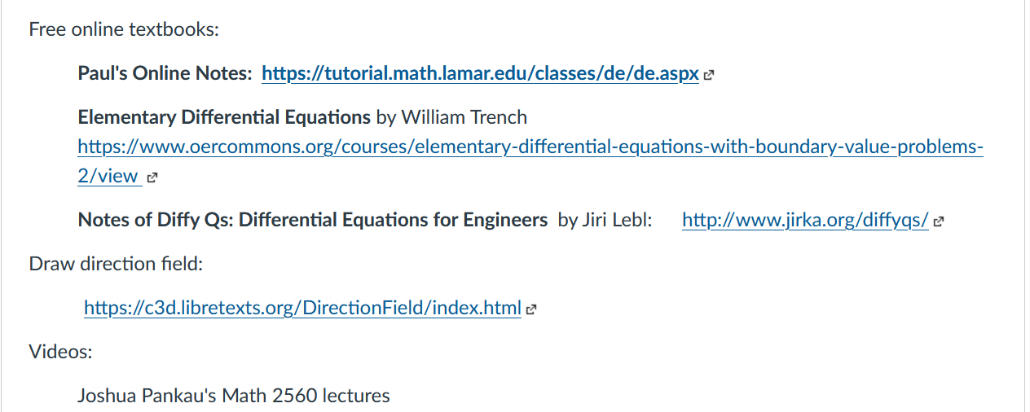
https://c3d.libretexts.org/DirectionField/index.html

Slide 3
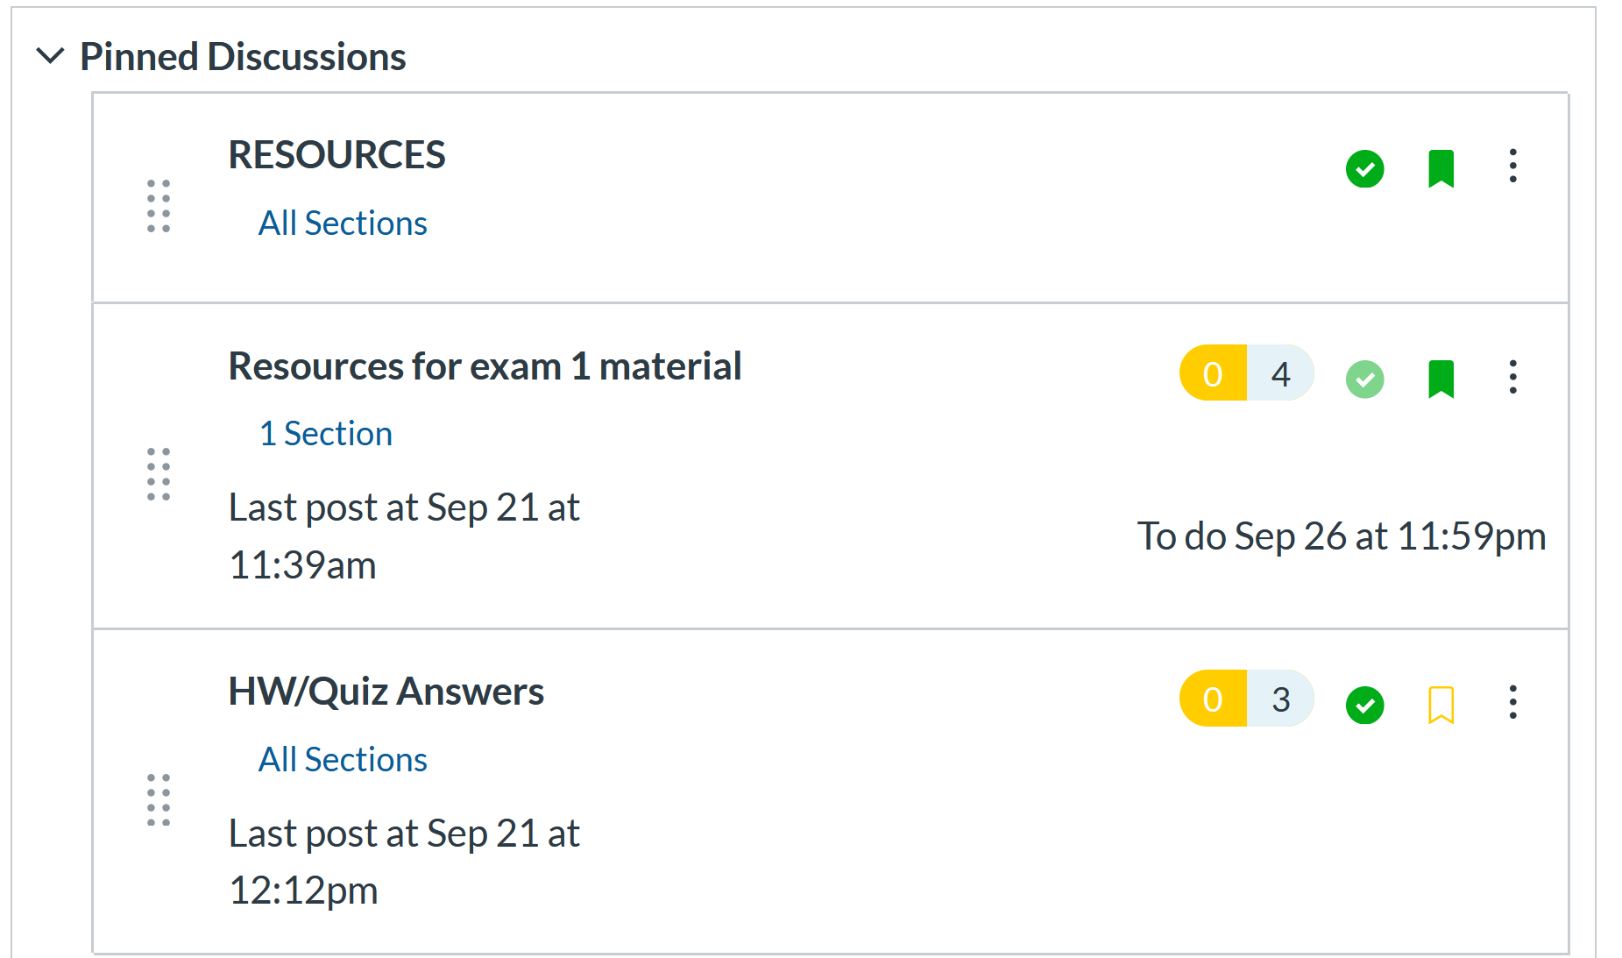

Slide 4
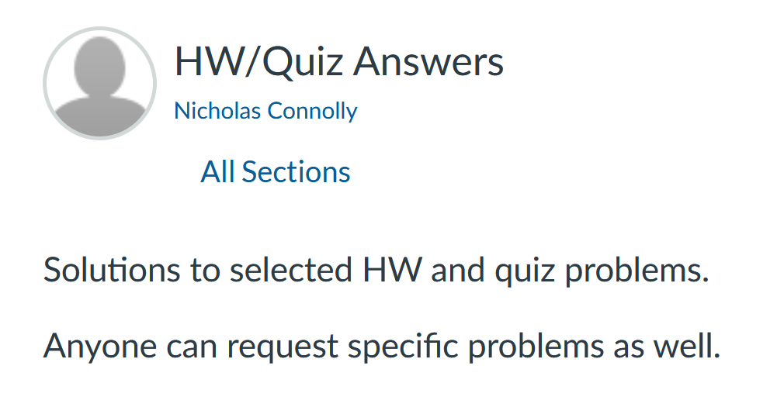

Slide 5
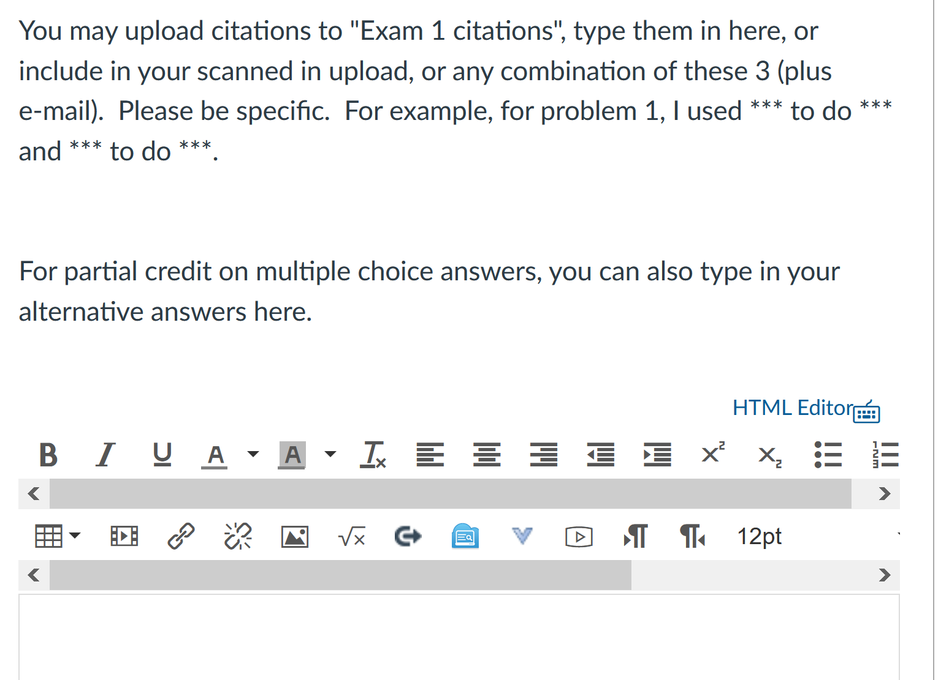

Slide 7
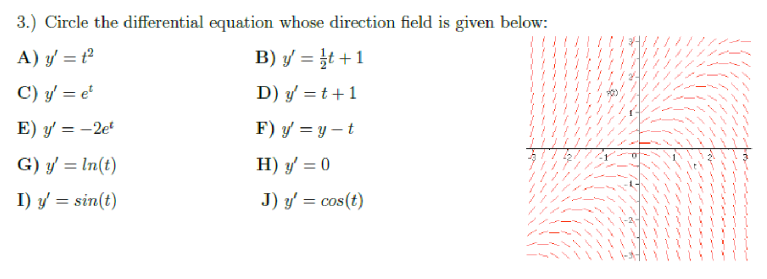

Slide 8
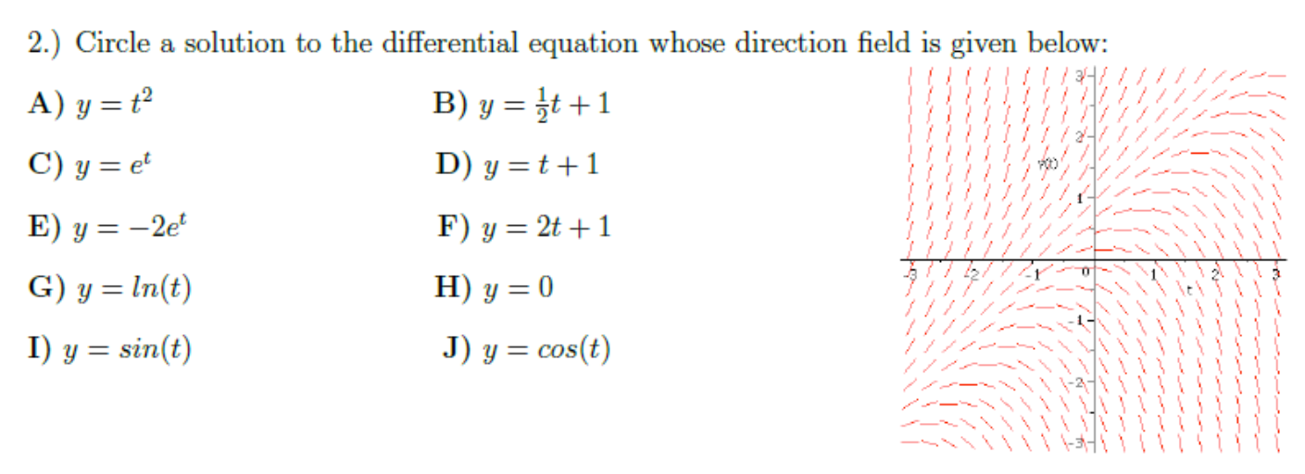

Slide 9
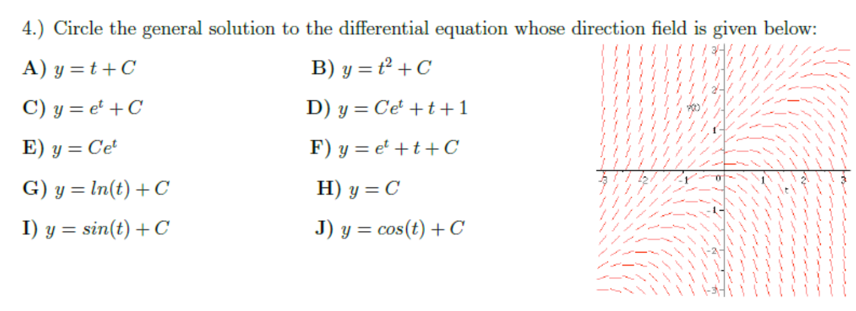

Slide 12
Make-up exam time: Wednesday 5pm – 6:30pm.

