Slide 1
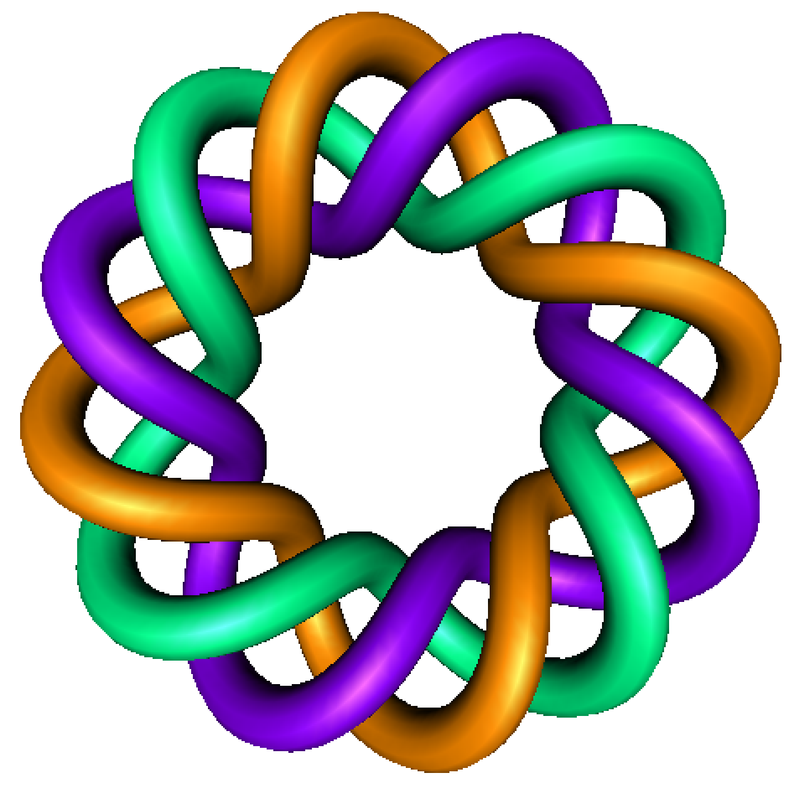
A Quick Review
of
Integration by Parts
By Dr. Isabel Darcy,
Dept of Mathematics and AMCS,
University of Iowa

Slide 3
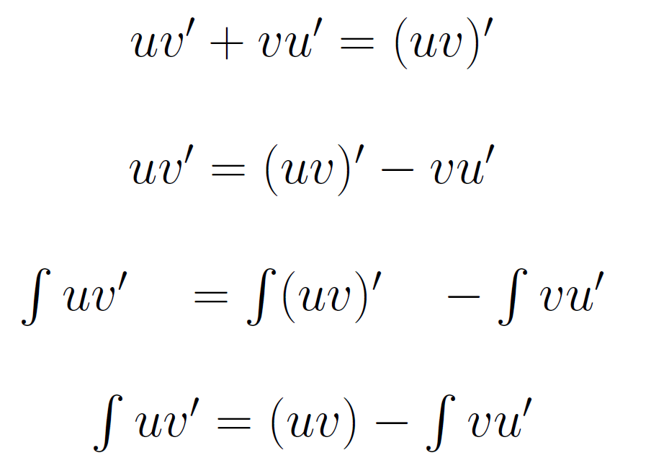
height
width
https://commons.wikimedia.org/wiki/File:Riemann_sum_convergence.png

Slide 10
