Slide 1
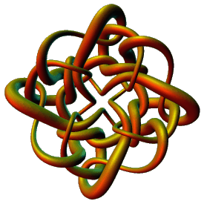
Rational 2-string tangles
Isabel K. Darcy
Mathematics Department
University of Iowa
http://www.math.uiowa.edu/~idarcy
Some slides from
Mariel Vazquez
Mathematics Department
San Francisco State University
http://math.sfsu.edu/mariel

Slide 2
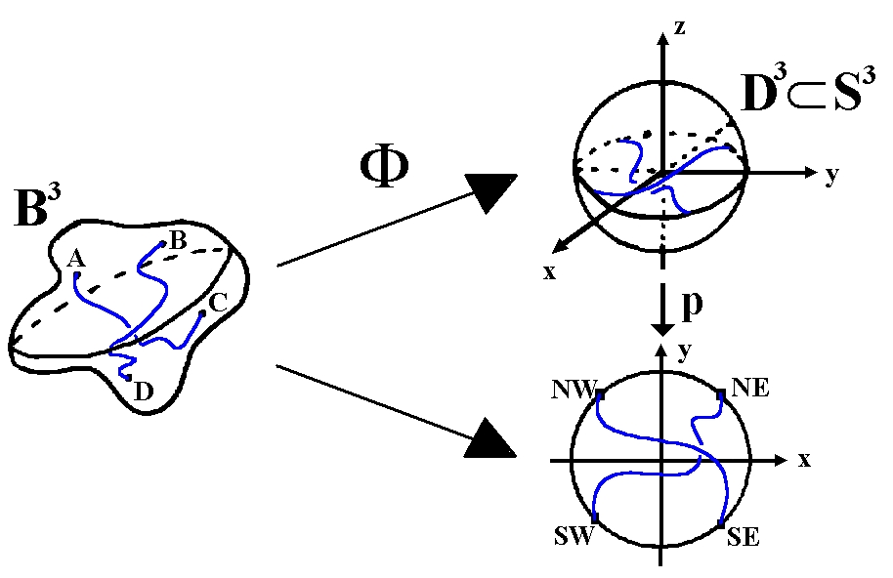
2-string tangles

Slide 3
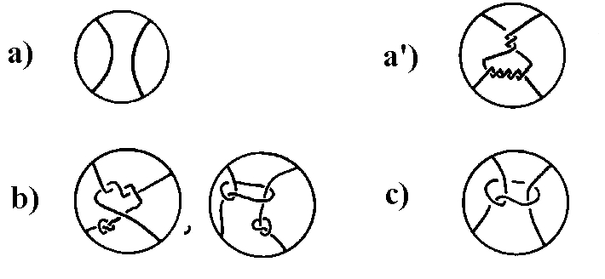
3 types of tangles
Rational Locally knotted Prime

Slide 4
Rational tangles
Rational
Rational tangles are homeomorphic to a trivial tangle (left)
ALLOWING the boundary of the 3-ball to move.

Slide 5
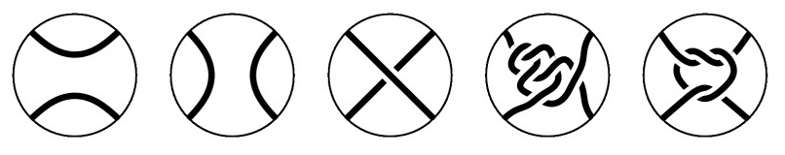
Which tangles are rational?

Slide 6
Which tangles are rational?
(0) (0, 0) (1) (-2, -1, -1, -1, -1)
These two are not rational.
The others are all rational

Slide 7
Rational Tangles
Rational tangles alternate between vertical crossings & horizontal crossings.
k horizontal crossings are right-handed if k > 0
k horizontal crossings are left-handed if k < 0
k vertical crossings are left-handed if k > 0
k vertical crossings are right-handed if k < 0
Note that if k > 0, then the slope of the overcrossing strand is negative,
while if k < 0, then the slope of the overcrossing strand is positive.
By convention, the rational tangle notation always ends with the number of horizontal crossings.

Slide 8
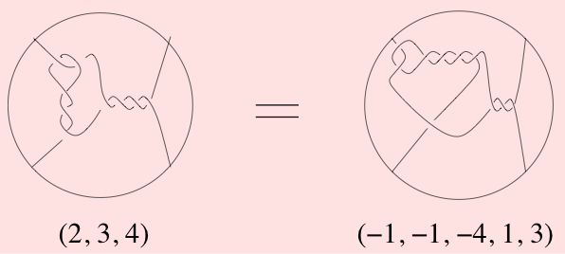
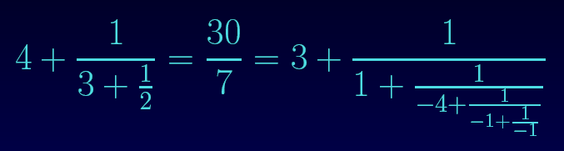
Classification Theorem (Conway 1970):
There is a 1-1 correspondence between rational tangles and Q ∪ {∞}

Slide 9
http://www.wolframalpha.com/
Some sample commands:
4 + 1/(3 + 1/2)
3 + 1/(1 + 1/(-4 + 1/(-1 + 1/-1)))
continued fraction 30/7

Slide 10
Why are we interested in rational tangles?

Slide 11
Why are we interested in rational tangles?
1.) Rational tangles are simple
simplest
non-rational
tangles:

Slide 12
Why are we interested in rational tangles?
1.) Rational tangles are simple
simplest
non-rational
tangles:
2.) Rational tangles are
formed by adding twists.
Think supercoils:
EM courtesy of Andrzej Stasiak

Slide 13
Why are we interested in rational tangles?
1.) Rational tangles are simple
simplest
non-rational
tangles:
2.) Rational tangles are
formed by adding twists.
Think supercoils:
EM courtesy of Andrzej Stasiak
3.) A tangle is rational if and only if one can push the strings to lie on the boundary of the 3-ball so that the strings do not cross themselves on 3-ball

Slide 14
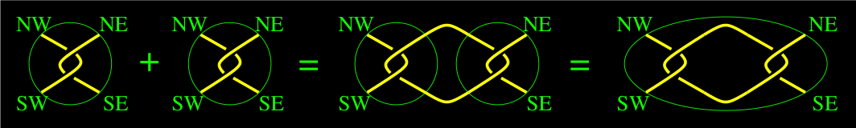
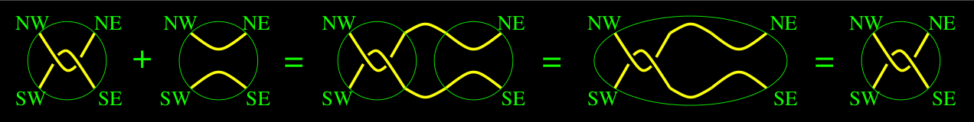
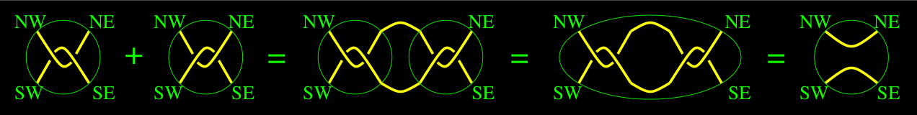
A + B = C
2 + 0 = 2
2 + -2 = 0
Most tangles don’t have inverses

Slide 18
A knot/link is rational if it can be formed from a rational tangle via numerator closure.
N(2/7) = N(2/1)
Note 7 – 1 = 6 = 2(3)

Slide 19
a = c
and
b – d is a multiple of a or
bd – 1 is a multiple of a.

Slide 20
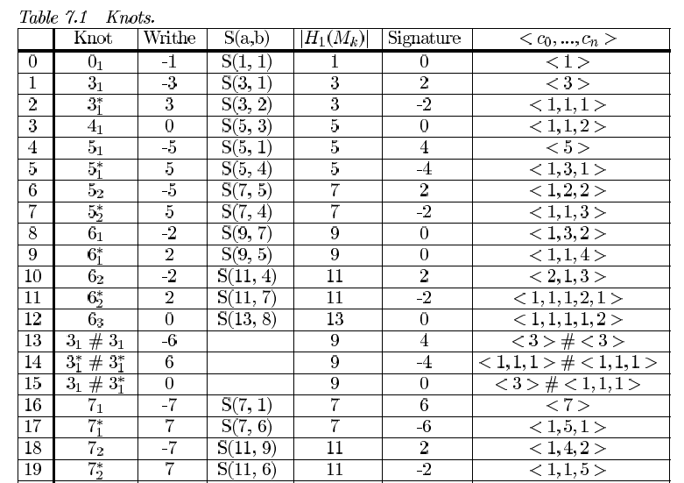
http://www.wolframalpha.com/
http://math.uiowa.edu/~idarcy/ART/knottable.pdf

Slide 21
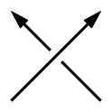
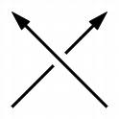
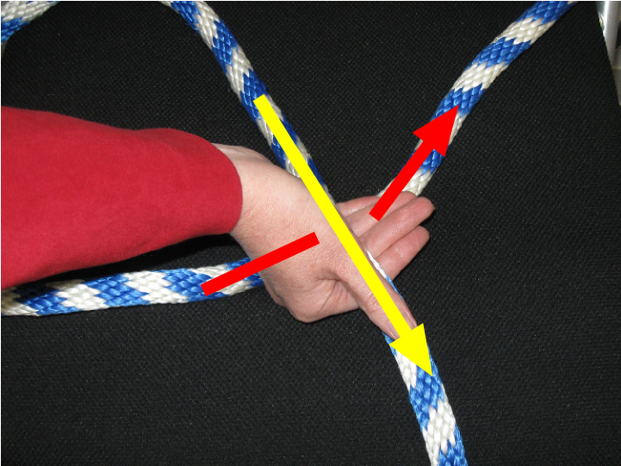
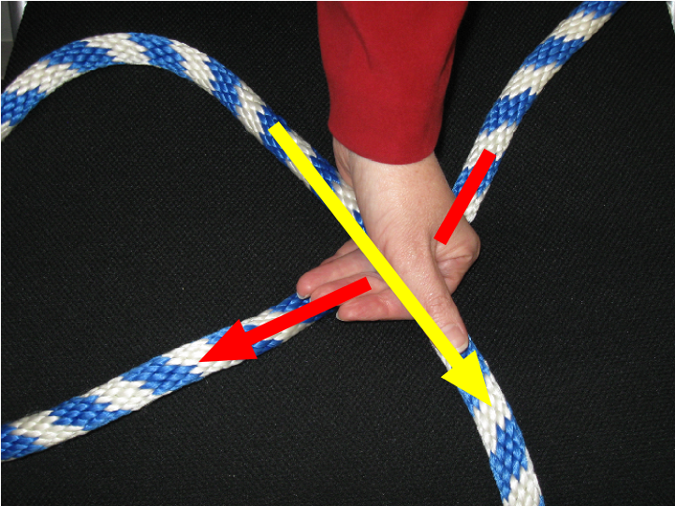
Crossing Sign Determination
Right-hand Rule
Right-handed Crossing
+1
Left-handed Crossing
-1

Slide 22
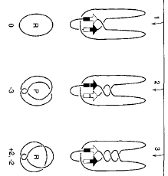
Processive recombination by wild-type gin and an enhancer-independent mutant. Insight into the mechanisms of recombination selectivity and strand exchange.
Crisona NJ, Kanaar R, Gonzalez TN, Zechiedrich EL, Klippel A, Cozzarelli NR.
J Mol Biol. 1994 Oct 28;243(3):437-57.

